Slide 1


Year 4
Multiplication Tables Check
Information for Parents
5th March 2026

Slide 2

Supporting your child with their times tables.
The aims of today’s session:
To explain how we teach and practise the multiplication tables in Key Stage 2.
To explain how you can help your child to learn the multiplication tables at home.

Slide 3
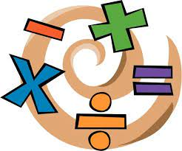
What is the MTC?
The Multiplication Tables Check (MTC) is a statutory assessment created by the government for all children in Year 4.
The purpose of the MTC is to determine whether pupils can recall their times tables up to 12x12 fluently, which is essential for future success in mathematics.
It will help schools to identify pupils who have not yet mastered their times tables, so that additional support can be provided.

Slide 4
National Curriculum Expectations:
Year Group | End of Year Expectations
Year 1 | Count in multiples of 2, 5 and 10. Recall and use doubles of all numbers to 10 and corresponding halves.
Year 2 | Recall and use multiplication and division facts for the 2, 5 and 10 multiplication tables, including recognising odd and even numbers.
Year 3 | Recall and use the multiplication and division facts for the 3, 4 and 8 multiplication tables.
Year 4 | Recall and use multiplication and division facts for multiplication tables up to 12 x 12.
Year 5 | Revision of all multiplication and division facts up to 12 x 12.
Year 6 | Revision of all multiplication and division facts up to 12 x 12.

Slide 5
National Curriculum Expectations:
Year 1 | Year 2 | Year 3 | Year 4
Counting in 2s, 5s and 10s | 2x, 5x,10x | 3x, 4x, 8x | 6x, 7x, 9x, 11x, 12x
Year 4: children are expected to recall and use multiplication and division facts for the multiplication tables up to 12x12

Slide 6
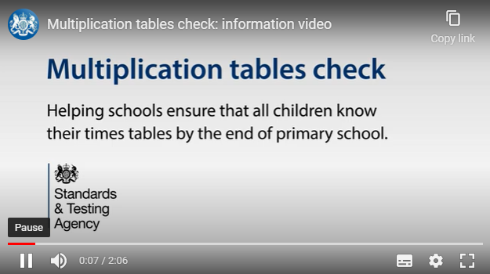
What will the MTC be like for my child?

Slide 7
What will the MTC be like for my child?
It is an on-screen check consisting of 25 times table questions.
Your child will be able to answer 3 practice questions before taking the actual check.
They will then have 6 seconds to answer each question.
On average, the check should take no longer than 5 minutes to complete.

Slide 8
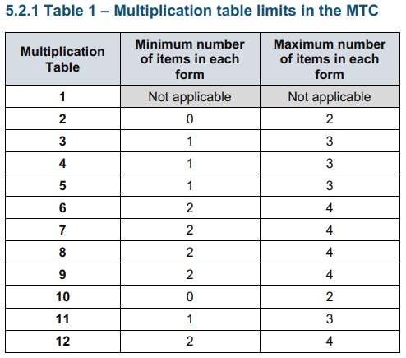
The majority of the MTC questions will focus on the tables learnt in KS2.

Slide 9
When will the MTC take place?
Schools will have a 2-week check window in June to administer the MTC: Monday 1 June - Friday 12 June 2026
Teachers will have the flexibility to administer the check to individual pupils, small groups or a whole class at the same time.

Slide 10
What will the outcomes be?
There is no pass mark for the MTC. Last year, the national average score was 20.6
The school will get access to all of the pupils’ results, allowing us to identify children who need additional support as they move into Upper Key Stage 2.
We will share your child’s score with you and inform you if any additional support is required.

Slide 11

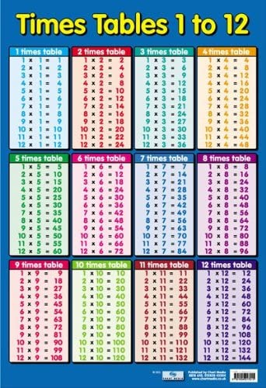
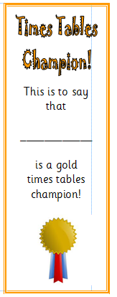
Multiplication Tables at School
Focused lessons on building and learning times table and division facts
MOT (Maths On Track) for additional practise
Times Tables Rock Stars
Times Table Tracker
Interventions
Early morning tasks (Quiz Booklet)
Games, chanting and posters/facts on display
Regular assessments to monitor progress

Slide 12
Preparing for the MTC:
We always encourage the children to practise their times tables regularly and completing homework set on Times Table Rock Stars is key, especially as this is also online and will help the children get used to typing numbers quickly.
We will have access to a ‘try it out’ area from April within school time. We can use this to make sure pupils have the necessary support required to access the check. This includes opportunities for pupils to familiarise themselves with the check format.

Slide 13
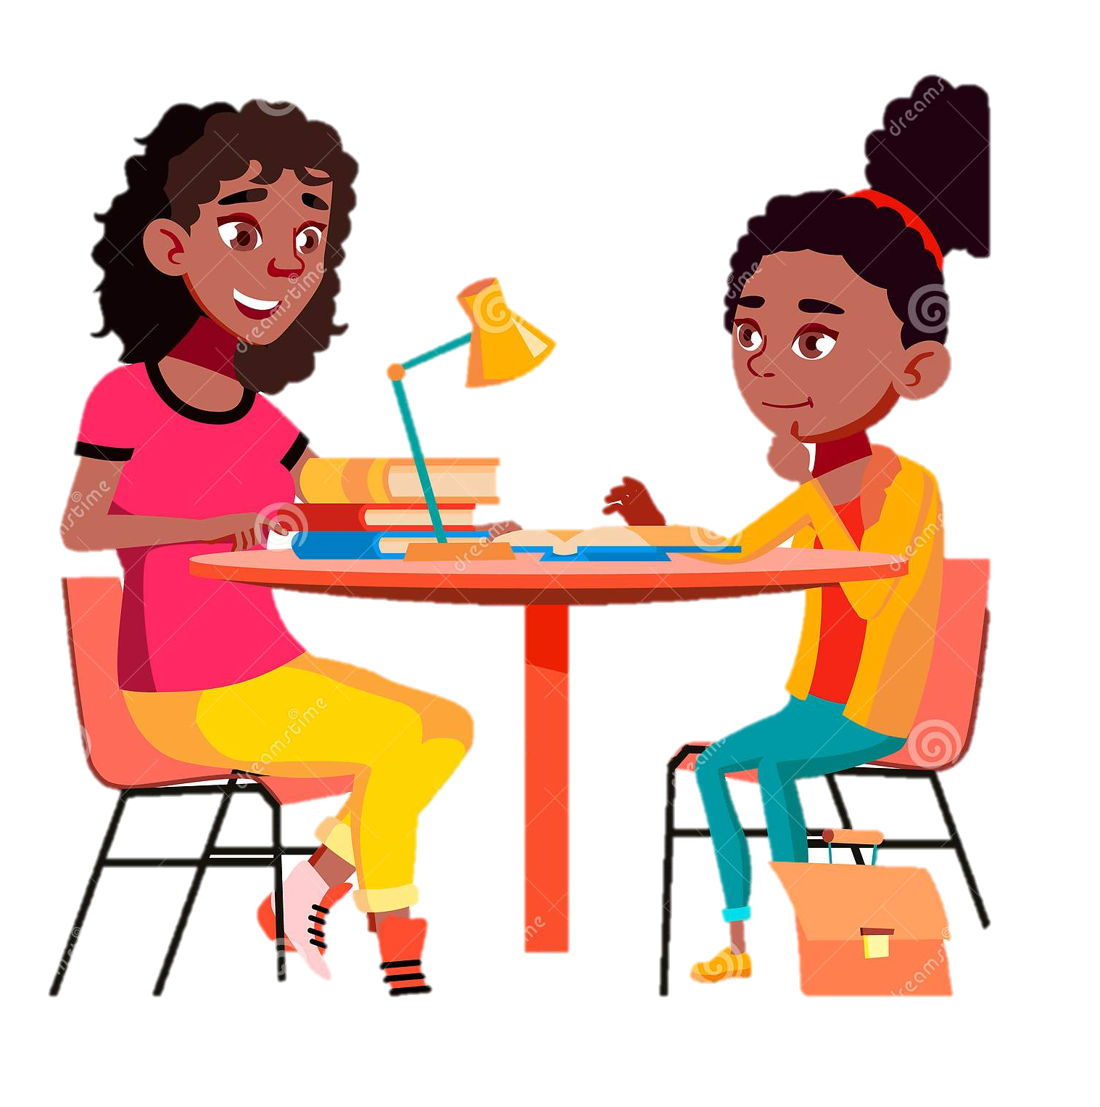
How can you help at home?
Practicing times tables at home with your child every day.
Try to build this into your daily routine.
You can practice in lots of different ways…

Slide 14
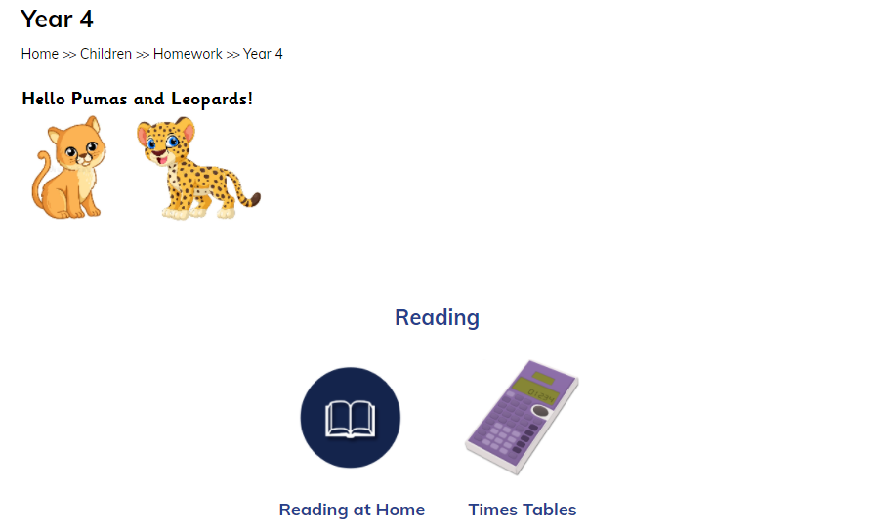
How can you help at home?
All practise is positive!
Online resources can be found on the school website on the Year 4 Homework page:

Slide 15
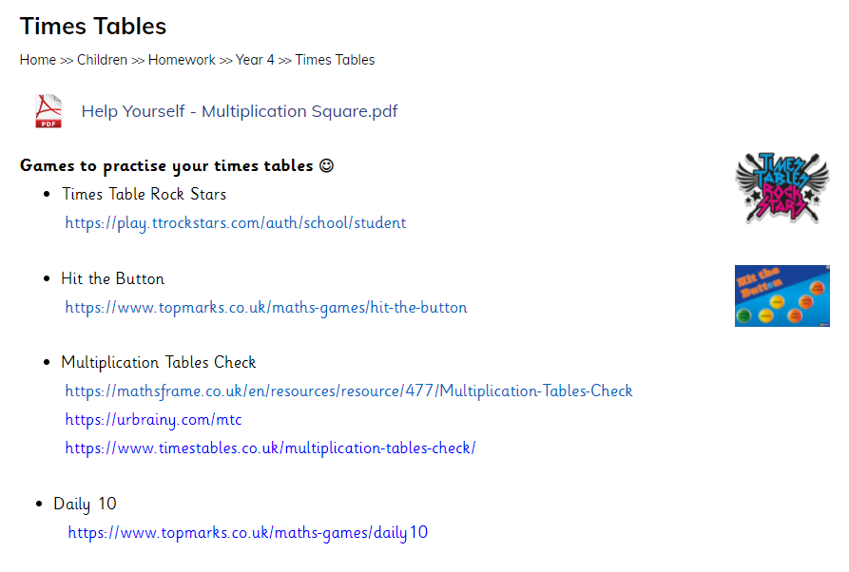
On browser, all of these sites are free to access.
These websites are similar to the MTC.

Slide 16
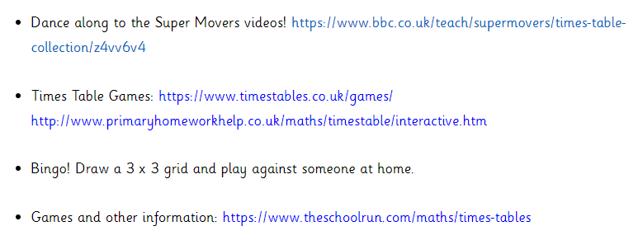
Encourage your child to practice regularly at home.
They can practice in lots of different ways!

Slide 17
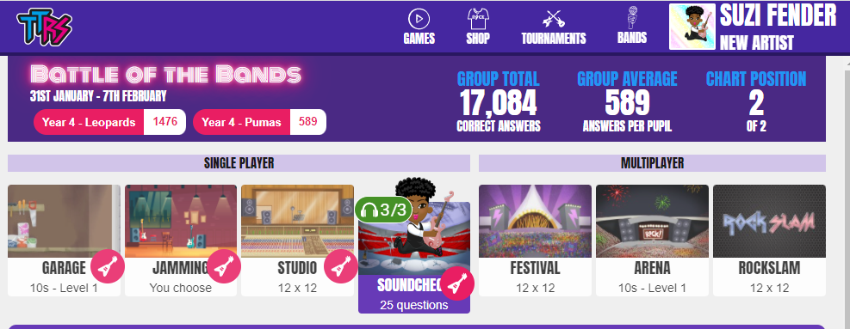
This game is similar to the official MTC.
Please encourage your children to practise on ‘Sound Check’.

Slide 18
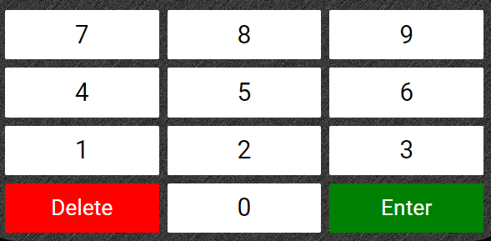
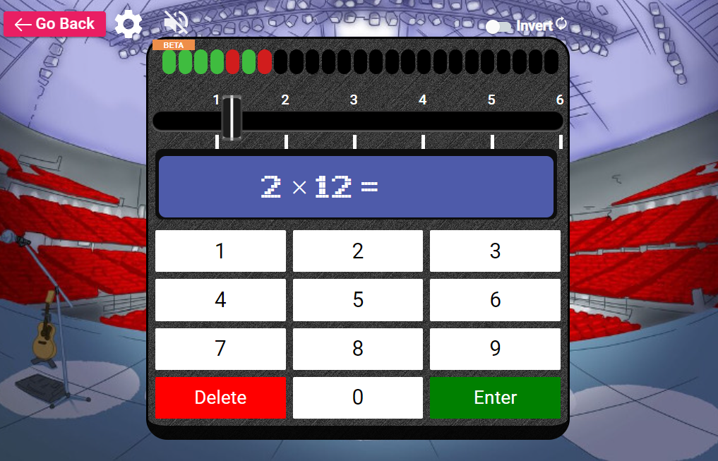
Flips the number pad.
There are 25 questions. The bar along the top shows the score.
Green = correct.
Red = incorrect
The timer counts 6 seconds.
Top Tip: Teach your child to allow the timer to count down (rather than press enter). This gives them more time to think and check their answer without rushing.

Slide 19
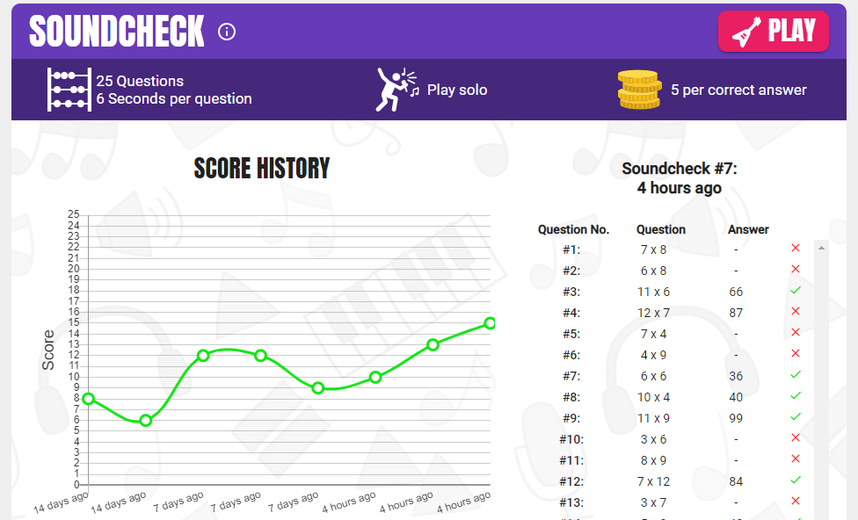
Underneath, you can see their score history:

Slide 20
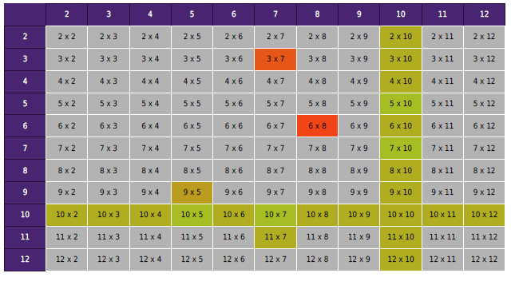
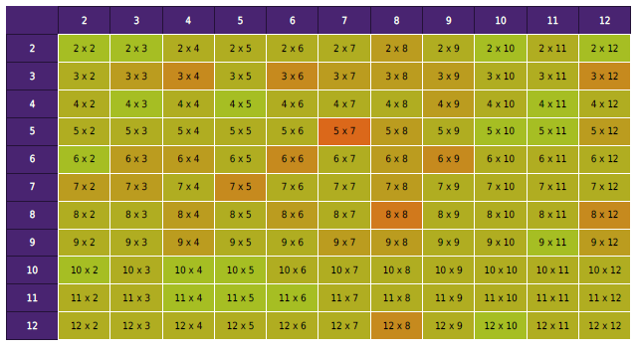
Your child’s heat map shows the areas they need to practise.
We will share these with you at parents’ evening.
Grey = not able to answer
Red = incorrect
Amber = sometimes correct
Green = correct

Slide 21
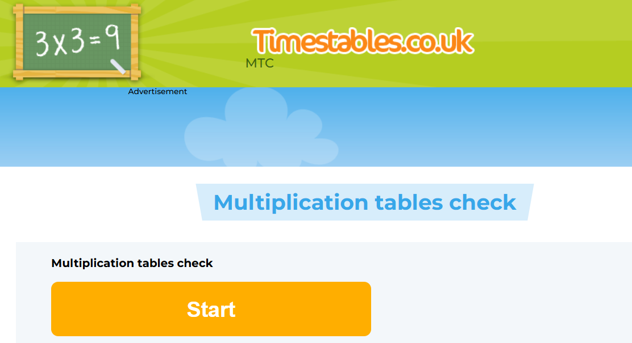

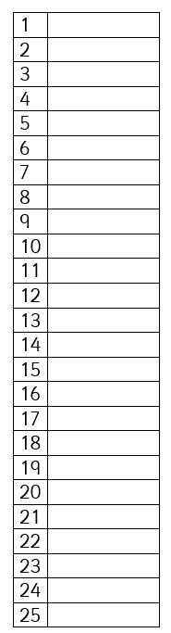
Please have ready:
pen or pencil
piece of paper (1-25)
Have a go with your child!
Multiplication Tables Check - 2025 - Timestables.co.uk

Slide 22
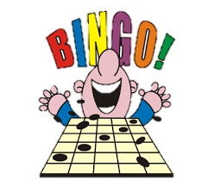
Bingo!
With your child, draw a 3 by 3 grid on a piece of paper and pick 9 numbers to fill the grid from a select times table e.g. 6x below -
You can call the questions out and children cross off the correct answers to try to get three in a row or a ‘full house’!
36 | 12 | 48
42 | 6 | 24
66 | 18 | 72
6, 12, 18, 24, 30, 36, 42, 48, 54, 60, 66, 72

Slide 23

Hot Potato!
Grab a bean-bag or ball. Pass the bean-bag around the table and call out the times tables you are practising.
Let’s try it with our 8 times table…

Slide 24
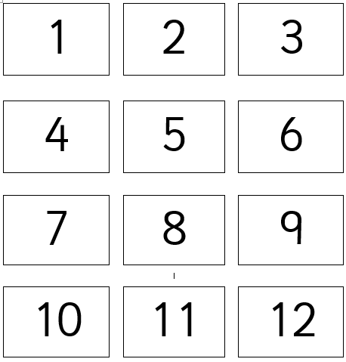
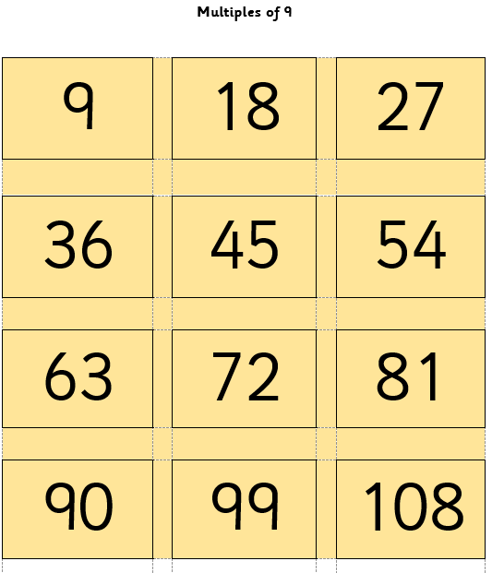
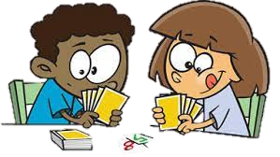
Multiples Cards
Cut out the digit cards and the multiples cards
You can use these to play games like snap, match or pairs
Place the cards face down. Have a go with your child at finding matching pairs for your 9 times table!

Slide 25
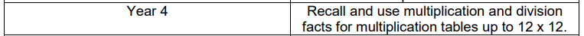
Preparing for the MTC:
We will inform you at parents’ evening of your child’s current practice scores and if we have identified your child as needing targeted support in the coming months before the MTC, in order to get them as ready as possible.

Slide 26


Any questions – please ask!
We will put this presentation on the school website.
Practise times tables at home with your child every day. Use the resources provided in your packs and the on the school website.
You can always speak to your child’s class teacher about their progress. Please contact us through the school office by phone or email.

