Slide 1
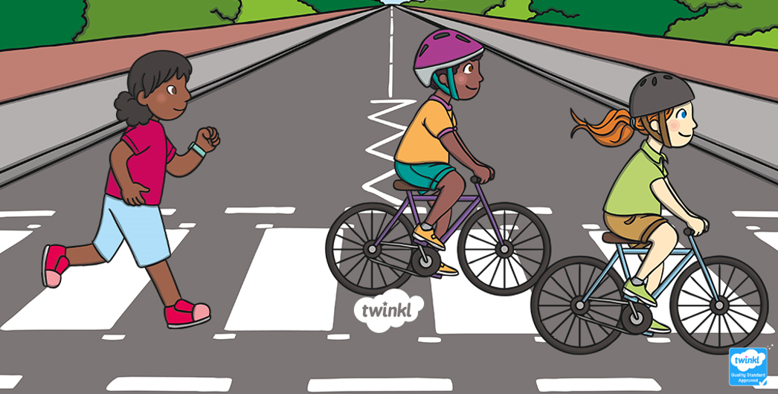
Road Safety

Slide 2
Aims
To understand why it is important to be safe near the road
To learn the Green Cross Code.
To know how to use roads safely, as a pedestrian or cyclist.

Slide 3
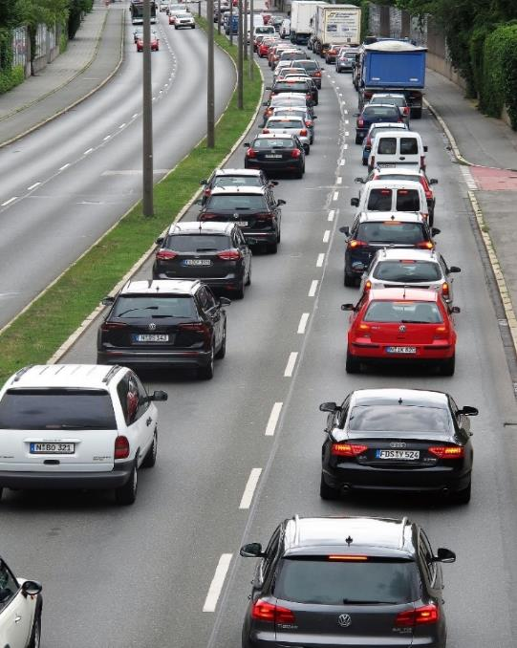
Did You Know…?
Every four minutes, someone is seriously hurt on roads in the UK.

Slide 4
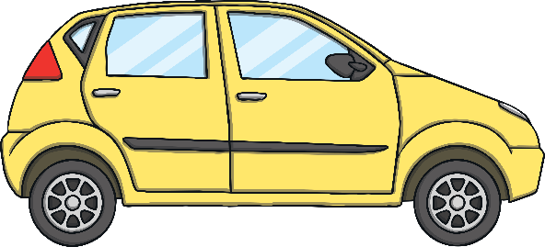
How Can You Stay Safe on the Roads?
Would you know how
to cross a busy road?

Slide 5

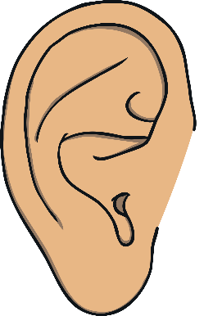

How Do You Cross a Road Safely?
Stop!
Look!
Listen!

Slide 6
The Green Cross Code
The Green Cross Code is a way to remember how to cross a road safely.

Slide 7
The Green Cross Code
FIND a safe place to cross.
STOP on the pavement, just before the kerb.
LOOK and LISTEN for traffic.
LET traffic pass.
WALK across when it’s clear. Do not run.

Slide 8
Where Is a Safe Place to Cross?
These are all safe places to cross:
zebra crossing
footbridge
underpass
pelican crossing
with a Crossing Patrol Officer

Slide 9
Is It Safe?
Is it safe to cross here?
Why not?

Slide 10
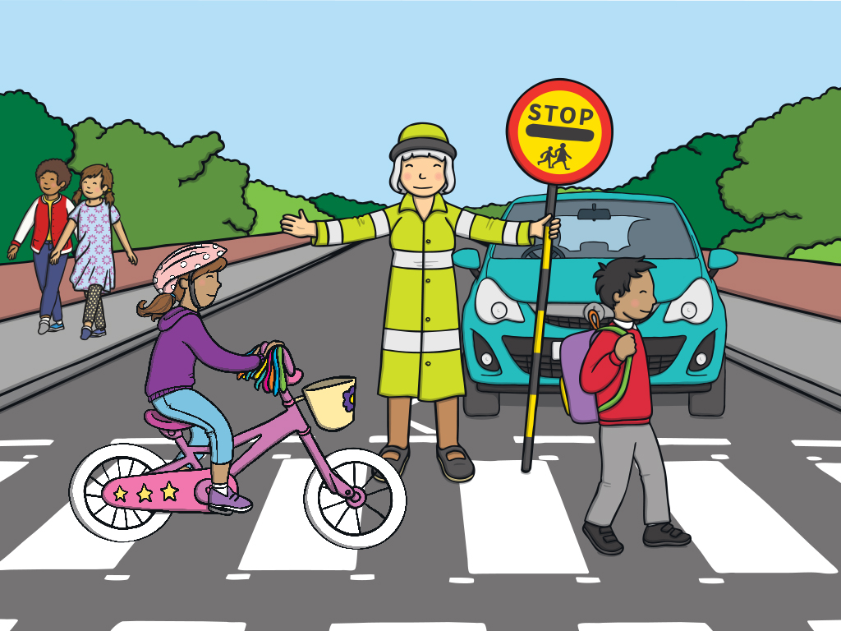
Pedestrians
A pedestrian is a person who is walking. Wear bright colours or reflective clothes to make sure you are visible to drivers in vehicles.
Lollipop Person
Helps people to cross the road safely. They are often near schools and hold a large STOP sign to stop the traffic for pedestrians to cross.
1
x
x
3
4
x
x
2
Helmets
If you are a cyclist, always wear a helmet. Wear bright clothes that will help you to be seen. Keep a lookout for vehicles and pedestrians.
Seatbelts
If you are a passenger in a car, always fasten your seatbelt. Don’t distract the driver. Always get out of the car on the pavement.
Zebra Crossing
A zebra crossing has no traffic lights but is a safe place to cross. Black and white road stripes and a flashing beacon warn cars to look out for pedestrians.
5
x

Slide 11
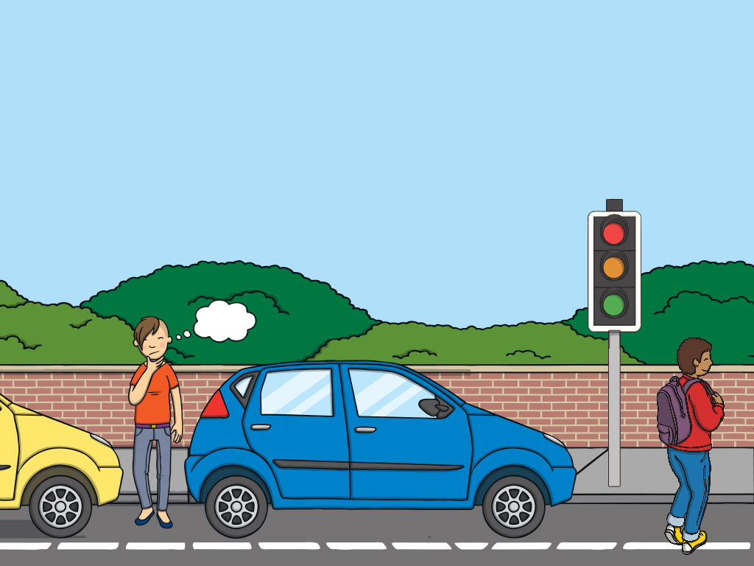
Traffic Lights
Traffic lights are easy to spot. They shine green for traffic to GO. Amber warns the traffic to slow and red tells the traffic to STOP. There are also lights for pedestrians. A green man tells you to WALK and a red man tells you to WAIT.
Green Cross Code
THINK! Is it safe to cross?
STOP! Stop before the kerb, don’t get too close to traffic.
LOOK! In all directions and listen.
WAIT! Let traffic pass.
WALK! Walk straight across, don’t run.
x
3
x
1
Parked Cars
Always look for a safe place to cross. You must be able to see clearly in all directions and be visible to cars and cyclists.
2
x
4
x
Pelican Crossing
A safe crossing place with traffic lights to slow and stop traffic.

Slide 12

Think! Hedgehog Road Safety - King of the Road 1998 UK TV Advert - YouTube

Slide 13
Poster Competition!
The school council would like you to design a poster to be displayed outside the school. Your poster should tell your class mates and your parents or grown ups how to keep safe near the road. You could include things like:
Parking their cars in safe places (not on the zigzag or yellow lines)
Crossing at the zebra crossing or traffic lights
Not looking at phones while near the road
Following the Green Cross Code
The school council will choose their favourite from every class and these will be laminated and displayed on both sites along the fences.

