Slide 1
Dental Health Choices
Presented by Sue Dunne

Slide 2



Everyone no matter how young or old has the right to a healthy happy mouth

Slide 3
unfortunately
Lots of people do not have healthy happy mouths
This is a great shame because its easy to look after your mouth and have a fabulous smile and a healthy mouth
Do you want to find out how to keep your teeth and mouth healthy?
There are simple steps we can all do to look after our mouth
Notes:
Tooth decay and gum disease are the two commonest diseases both are nearly always preventable.
Having an un healthy mouth is implicated in Heart disease and strokes. Looking after the mouth is vital for good general health.

Slide 4
Step 1
Brush your teeth
and
your gums

Slide 5
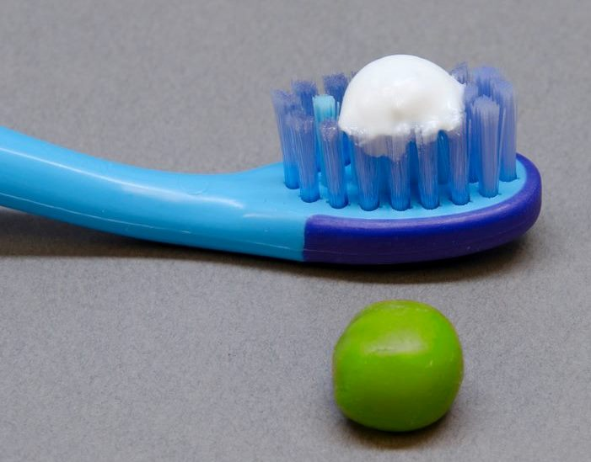
Brush your teeth twice a day for two minutes at bed time and one other time in the day (most people brush in the morning)
Use a pea sized amount of toothpaste that has fluoride in.
children over the age of 3 can use a basic adult paste
Spit the toothpaste out but do not rinse your mouth with water or mouthwash
Notes:
Bed time tooth brushing is very important. During sleep the flow of saliva is diminished and therefore the protective mechanism of saliva is reduced. The fluoride in the toothpaste adds a protective layer to the enamel and as a result the enamel becomes harder and is able to resist the effects of bacterial acids produced by plaque and sugar.
Brushing teeth has two effects application of fluoride and removal of plaque bacteria.

Slide 6

why do I have to brush my teeth and gums ?
Your mouth has lots of germs that stick to teeth called plaque.
They love living there, they grow and grow all day and night.
They grow bigger and bigger all the time
If you don’t brush them away twice a day they can make your mouth unhealthy
That’s why you must brush your teeth and gums to brush the germs away

Slide 7
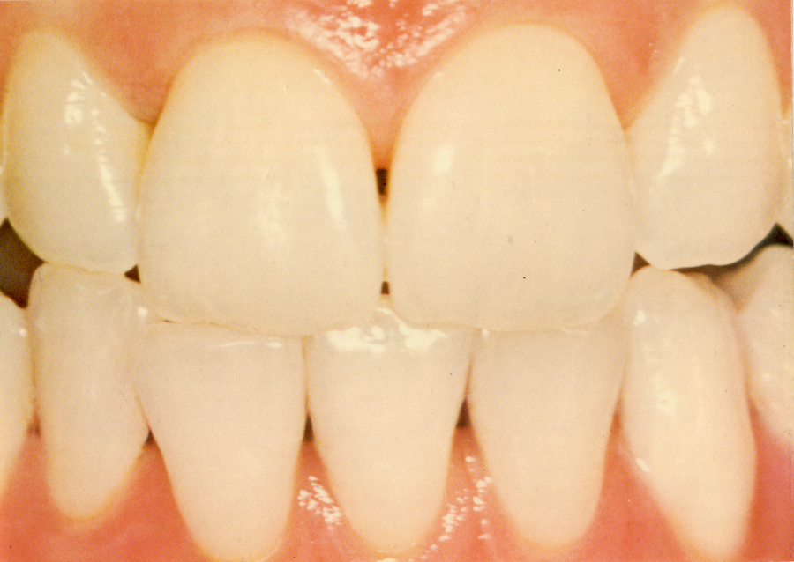
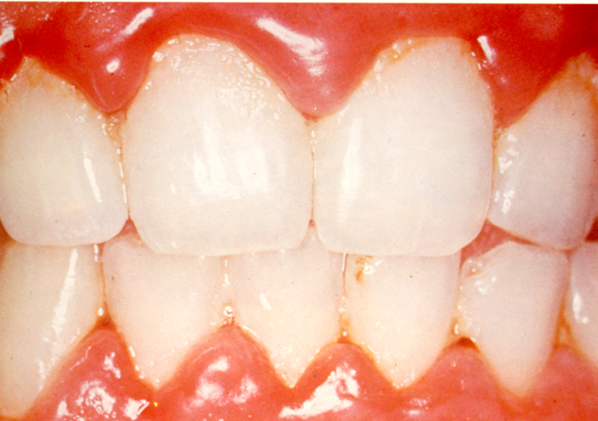
Spot the Difference !
healthy
unhealthy
Notes:
Look at the difference in the two pictures
Healthy gums are pale and firm
Unhealthy gums are red, shiny and puffy and will bleed when brushed
Health gums do not bleed it is not normal.

Slide 8
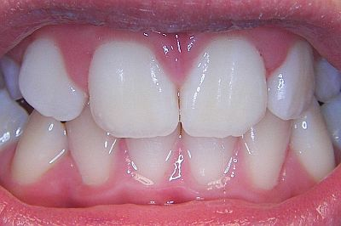
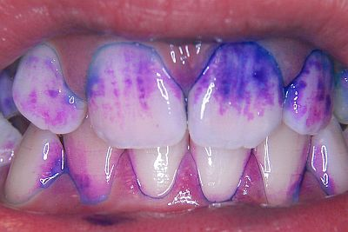
How to tell if you have cleaned properly ?
Undisclosed teeth
Disclosed teeth
Notes:
Disclosing tablets are available from pharmacies and can show how effective tooth brushing is or isn't.
One good point to make is if you are a right handed person it is often difficult to clean the right hand side of the mouth and visa versa look at the disclosed teeth there is more plaque on one side.

Slide 9
Step 2
Stop tooth decay

Slide 10
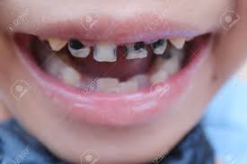
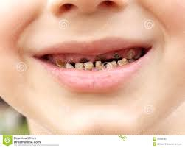
Do you think these pictures show healthy mouths ?
Notes:
Showing pictures of gross tooth decay of baby teeth.
Tooth decay is the most common reason for children under the age of 9 to be admitted into hospital to have removed under general anaesthetic.

Slide 11
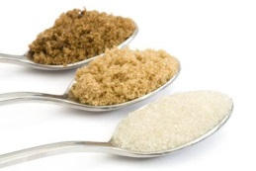
How does sugar cause tooth decay !
The plaque germs in our mouths love sugar
Every time we have food or drink with sugar in the germs turn the sugar into an acid.
Acid starts to dissolve the hard covering on your teeth.
Saliva has minerals in that helps gets rid of the acid in an hour
If we have too many acid attacks, our saliva hasn’t enough minerals to stop the acid making a holes in our teeth
Acid

Slide 12
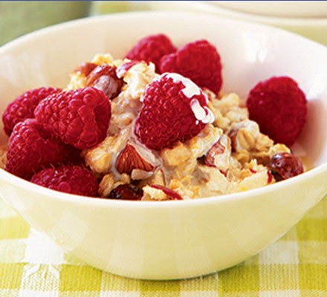

Can we stop tooth decay from happening ?
Yes we can !
Keep sugary food and drink to mealtimes
Breakfast
Lunch Time
Dinner Time
Notes:
It is the frequency of sugar consumption that caused tooth decay not the amount of sugar consumed
By keeping any form of sugars to mealtimes and choosing sugar free snacks in between meals if needed. The saliva has time to neutralise any bacterial acids and to remineralise the enamel that is weakened during an acid attack

Slide 13
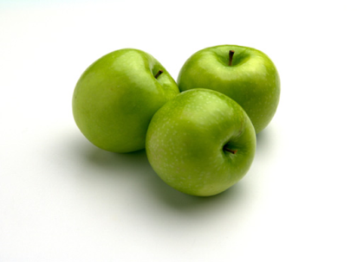
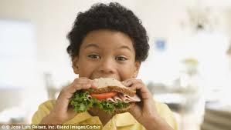
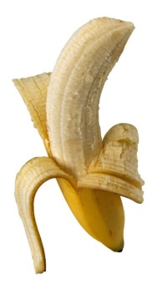
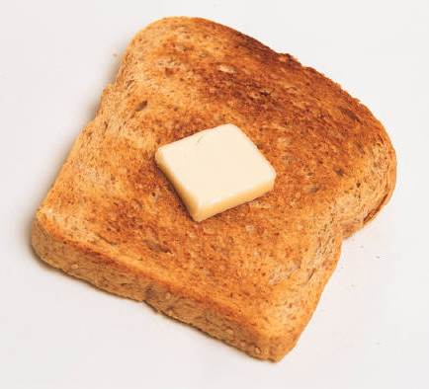
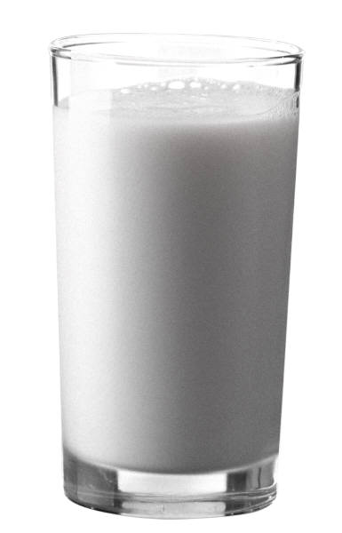




Snacking in between meals
Pick sugar free or savoury foods

Slide 14
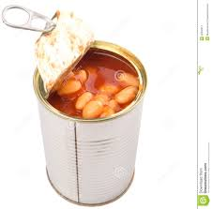
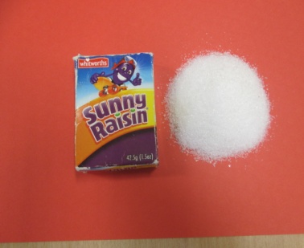



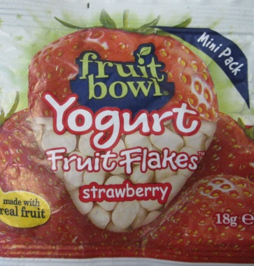


Be careful some foods and drinks can have lots of sugar in even if you think they haven't
Notes:
All the above has sugar in a small pot of flavoured yogurt can contain 5 teaspoons of sugar
The bottle of volvic flavoured water contains 7 teaspoons of sugar.

Slide 15
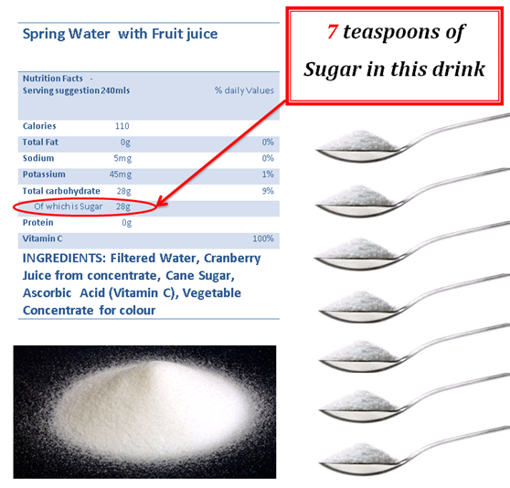

Slide 16
Another reason to brush your teeth
Toothpaste has fluoride in
Fluoride helps to make your teeth strong
Do not rinse your mouth after you brush its better to leave the toothpaste on. The fluoride carries on working to strengthen teeth
If you wash it off, it cannot do that job because you have washed it away
Remember to spit but not rinse to help stop tooth decay
Notes:
Fluoride helps in preventing tooth decay.
The most effective way is fluoride in tap water. We do not have fluoride in the tap water in Wiltshire or Swindon so the only way we can benefit from fluoride is in our toothpaste. Everyone over the age of 3 years of age needs a toothpaste with a fluoride content of between 1350ppm and 1500ppm (parts per million) most ordinary toothpastes such as colgate or aquafresh contains 14500ppm and is ok to use for anyone over the age of 3

Slide 17
That’s it 2 guidelines for looking after teeth can you do it ?
Yes you can !

