Slide 1


Slide 2
National Curriculum
RSHE covers everything that primary schools should teach about relationships and health, including puberty. The national curriculum for science also includes subject content in related areas, such as the main external body parts, the human body as it grows from birth to old age (including puberty) and reproduction in some plants and animals. It will be for primary schools to determine whether they need to cover any additional content on sex education to meet the needs of their pupils

Slide 3
By the end of primary children will learn about:
Relationship education
Families and people who care for me
Caring friendships
Respectful relations
Online Relationships
Being safe
Health and wellbeing
Mental wellbeing
Internet safety
Physical health
Healthy eating
Health and prevention
Drugs and alcohol (age appropriate)
Basic first aid
Changing adolescent body

Slide 4
By the end of primary children will learn about:
Sex Education
It is important that the transition phase before moving to secondary school supports pupils’ ongoing emotional and physical development effectively. Primary schools are required to have a sex education programme tailored to the age and the physical and emotional maturity of the pupils. It should ensure that both boys and girls are prepared for the changes that adolescence brings and – drawing on knowledge of the human life cycle set out in the national curriculum for science - how a baby is conceived and born.

Slide 5
Why is RSE in Catholic Schools important?
RSE is part of the mission of Catholic schools to educate the whole person. It should be carried out as part of the holistic education which seeks to form as well as inform young people in preparation for adult life.
In order for Catholic RSE to be fully effective it needs to:
Be faithful to the Church's vision of human wholeness whilst recognising the contemporary context in which we live today;
Involve parents as they are primary educators of their child;
Provide a positive view of human sexuality and dignity of the human person;
Equip young people with the ability to make practical judgments about the right thing to do in particular circumstances;
Explore and promote virtues which are essential to promoting respect and dignity;
Be delivered in an age appropriate way which reflects the development of the child;
Be part of the cross-curricular work in both primary and secondary schools;
Be sensitive to the needs of the individual pupil and recognise the mix of pupils with different sexual orientations, genders and family backgrounds in each class;
Be taken seriously by governors and teachers as an integrated part of the broad and balanced curriculum that Catholic schools offer;

Slide 6
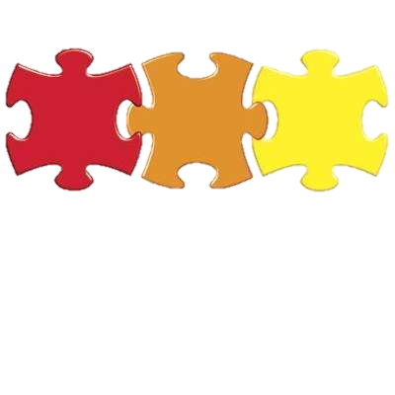

Where it fits…
1: Being Me in My World
3: Dream and Goals
2: Celebrating Differences
6: Life to the Full RSE
4: Healthy Me
5: Relationships

Slide 7
Life to the Full
The majority of the RSHE objectives will be met through our PSHE curriculum, however as a Catholic school we must be mindful of our Catholic values.
Therefore, during Term 6 we will be using Life to the Full in place of our Jigsaw programme. This is an approved Catholic programme that will allow us to fully deliver the RSHE objectives in accordance with our role as a Catholic school.
The sections covered specifically by ‘Life to the Full’ will be:
Personal Relationships
My body and my health
Life Cycles
Life to the Full will include the Sex Education part of RSHE and will take into account our Catholic values. There is one part of this curriculum which parents can choose to withdraw their child from and we look at this in a moment.

Slide 8
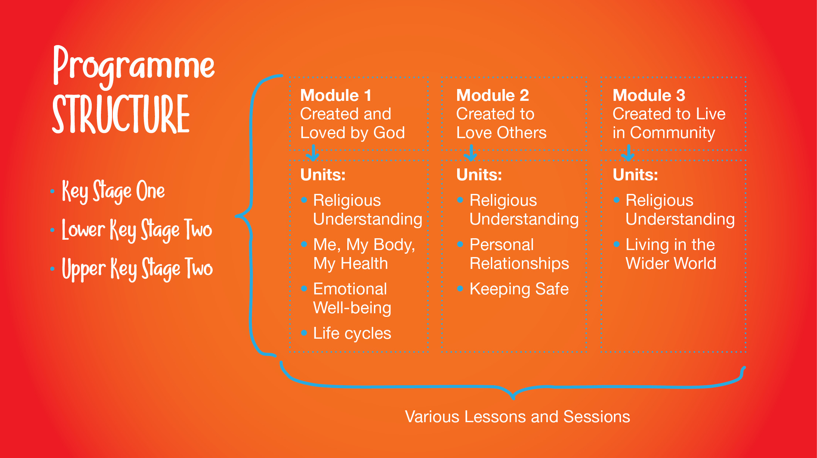
All of the other units are covered by our wider PSHE programme Jigsaw.

Slide 9
EYFS
Objectives covered:
Me, my body and health
We are unique with individual skills, gifts, and talents
We are each unique, with individual gifts, talents and skills.
Whilst we all have similarities because we are made in God’s image, difference is part of God’s plan.
Personal Relationships
To identify special people (e.g. parents, carers, friends) and what makes them special
The importance of the nuclear family and of the wider family
The importance of being close to and trusting of ‘special people’ and telling them is something is troubling them
How their behaviour affects other people and that there is appropriate and inappropriate behaviour
The characteristics of positive and negative relationships
About different types of teasing and that all bullying is wrong and unacceptable
Life Cycles
There are natural stages from birth to death and what they are.

Slide 10
Year 1
Objectives covered:
Me, my body and health
We are unique with individual skills, gifts, and talents
Personal Relationships
To identify ‘special people’ (their parents, carers, friends, parish priest) and what makes them special;
The importance of nuclear and wider family;
The importance of being close to and trusting special people and telling them if something is troubling them.

Slide 11
Year 2
Objectives
Me, my body and health
Our bodies are good and we need to look after them.
The names of the parts of our bodies
Girls and boys have been created by God to be similar and different, these differences are physical, emotional and spiritual and together make up the richness of the human family.
How to maintain personal hygiene
What constitutes a healthy lifestyle including healthy eating, dental and physical activity
The importance of sleep, rest and recuperation
Lifecycles
Appreciate that there are natural life stages from birth to death, and what these are
Personal Relationships
How their behaviour affects other people, and that there is appropriate and inappropriate behaviour;
The characteristics of positive and negative relationships;
Different types of teasing and that all bullying is wrong and unacceptable.
To recognise when they have been unkind and say sorry;
To recognise when people are being unkind to them and others and how to respond;
To know that when we are unkind to others, we hurt God also and should say sorry to him as well;
To know that we should forgive like Jesus forgives.

Slide 12
Year 3
Objectives covered:
Me, my body and health
Similarities and differences arise as they grow and make choices, and that by living and working together we create a community.
Self-confidence arises from being loved by God
We need to respect and look after our bodies as they are a gift from God, through what they wear, eat and what they physically do.
Personal Relationships
Ways to maintain and develop good, positive trusting relationships; strategies to use when relationships go wrong.
That there are different types of relationships, including those between acquaintances, friends, relatives and family.
That good friends is when both persons enjoy each other’s company and also want what is truly best for the other.
The difference between a group of friends and a ‘clique’
Develop a greater awareness of bullying (including cyber-bullying), that all bullying is wrong, and how to respond to bullying;
Learn about harassment and exploitation in relationships, including physical and emotional abuse and how to respond.

Slide 13
Year 4
Objectives:
Me, my body and health
What puberty means?
When puberty takes place?
Puberty is part of God’s plan for our bodies.
Correct naming of genitalia
Changes that happen to girls during puberty
Changes that happen to boys during puberty
Lifecycles
They were handmade by God with the help of their parents.
How a baby grows and develops in its mother’s womb including scientifically the uniqueness of the moment of conception.
How conception and life in the womb fits into the cycle of life.
That throughout their lives human beings act at three integrated levels, physical, psychological and spiritual.

Slide 14
Year 5
Objectives covered:
Me, my body and health
Similarities and differences arise as they grow and mature, and that by living and working together we create a community.
Self-confidence arises from being loved by God
Personal Relationships
Pressure comes in different forms, and what those different forms are;
There are strategies that they can adopt to resist pressure.
Understand what consent and bodily autonomy means;
Discuss and reflect on different scenarios in which it is right to say ‘no’.
Learn about how thoughts and feelings impact on actions, and develop strategies that will positively impact their actions;
Apply this approach to personal friendships and relationships.

Slide 15
Year 6
Objectives
Me, my body and health
Human beings are different to other animals
There is a unique growth to our bodies and what changes happen during puberty.
We need to respect and look after our bodies as they are a gift from God, through what they wear, eat and what they physically do.
There is a need for modesty and appropriate boundaries.
They need to make good choices that have an impact on their health; rest and sleep, exercise, personal hygiene and avoiding the overuse of electronic entertainment etc.
Lifecycles
Children will know:
How a baby grows and develops in its mother’s womb.
Basic scientific facts about sexual intercourse between a man and woman - taught at school’s discretion
The physical, emotional, moral and spiritual implications of sexual intercourse taught at school’s discretion
The Christian viewpoint that sexual intercourse should be saved for marriage - taught at school’s discretion
The nature and role of menstruation in the fertility cycle and that fertility is involved in the early start of life.
Some practical help to manage the onset of menstruation.

Slide 16
Key Decisions
Within the RSHE curriculum there are key decisions that schools have to make regarding appropriate age related content. As a school, we feel that ‘Life to the Full’ pitches these correctly therefore we are proposing to introduce:
Names of genitalia in Year 2
Changes to the body during puberty in Year 4
Discussing where babies come from in Year 6
These decisions are not made lightly, and have taken into consideration the ages of the children, the content of the wider curriculum and the needs of our children.

Slide 17
Parental right to withdraw
As RSHE is a statutory curriculum subject from this year the parental right to withdraw has changed.
As shown on the slides before there are some objectives which are delivered at the school’s discretion, as these go beyond the compulsory curriculum. It is only during the teaching and delivery of these objectives that you may withdraw your child from their lesson.
If you wish to request to withdraw your child you must inform Miss Fry in writing before May half term so that she can discuss this further with you.

Slide 18
What next?
Please read the RSHE policy attached to the email
Please complete the parent survey, the link can also be found in the email.
Hopefully this has been helpful in explaining Holy’s Rood RSHE curriculum and how we have carefully planned this to ensure that we meet the needs of the national curriculum, our intrinsic catholic values and most importantly our children.

