Slide 1
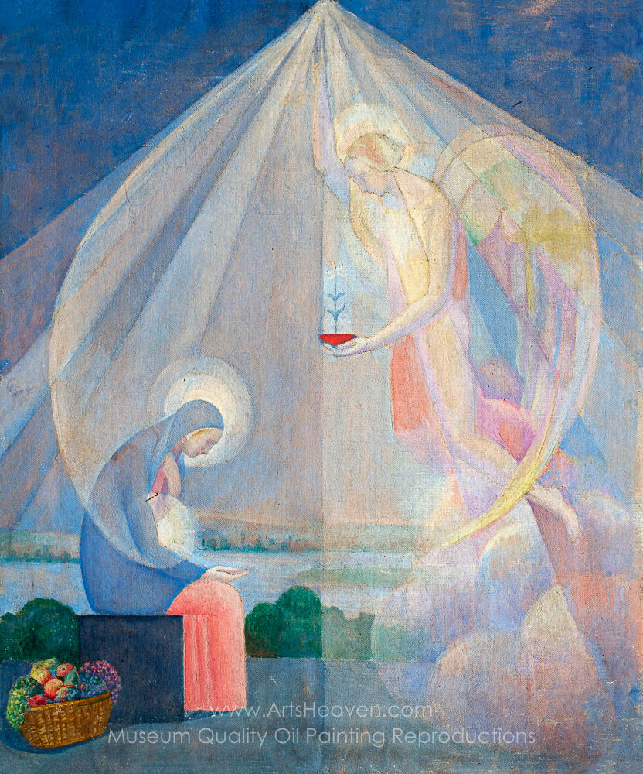
Hook:
Take a couple of minutes to look
at this picture and try and answer
the questions.
What can you see?
What do you notice?
What do you think this is a painting of?

Slide 2
What story did you think this painting was from?
It is a story of the Annunication, when Angel Gabriel came to visit Mary and tell her that she was going to have a baby.
Why was the baby special?
What story is this the first part of?

Slide 3
Today we are going to be revisiting the Christmas story, by the end of our lesson we will:
know the meaning of the annunciation and can retell the story.
identify the key events and retell the story of the First Christmas.

Slide 4

Challenge
Have a look at the paintings on the next couple of slides
What part of the story do they represent?
Where in the story do they fit?
Do you like the artist’s interpretation or not? Why
Why do you think the artist has chosen those colours or shapes?

Slide 5
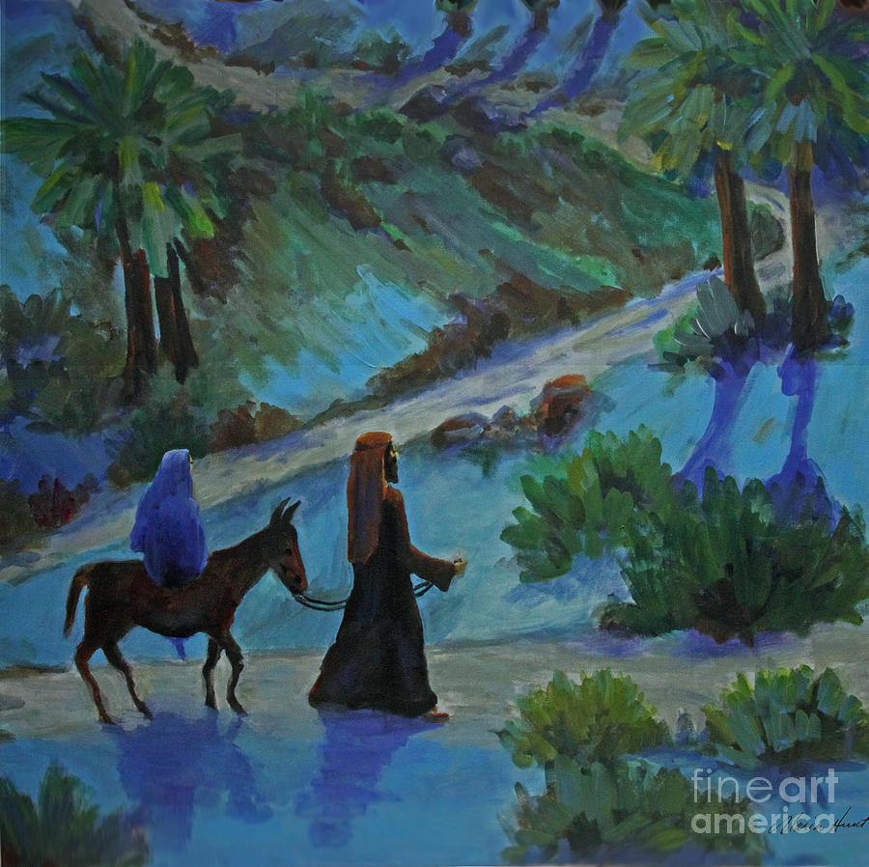
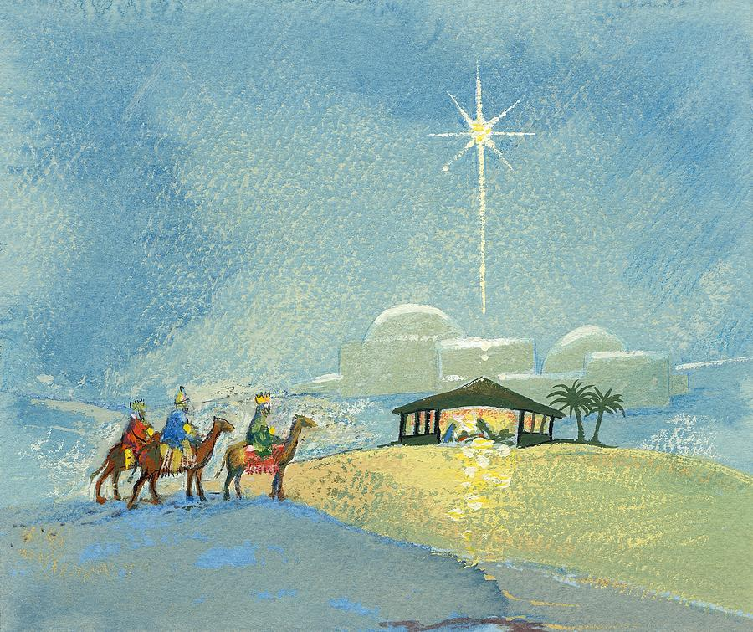

Slide 6
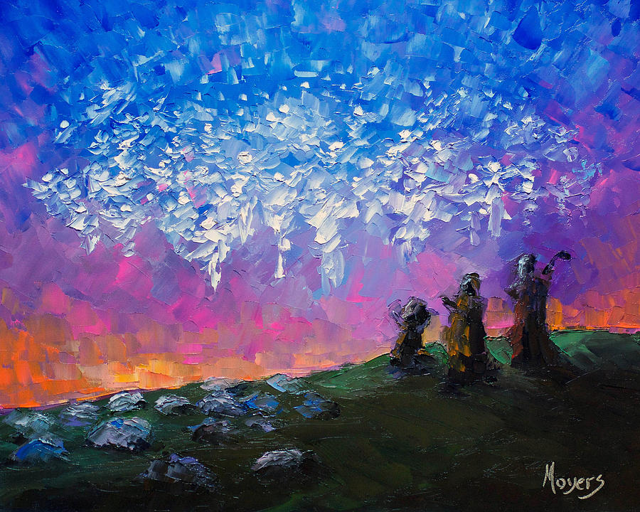
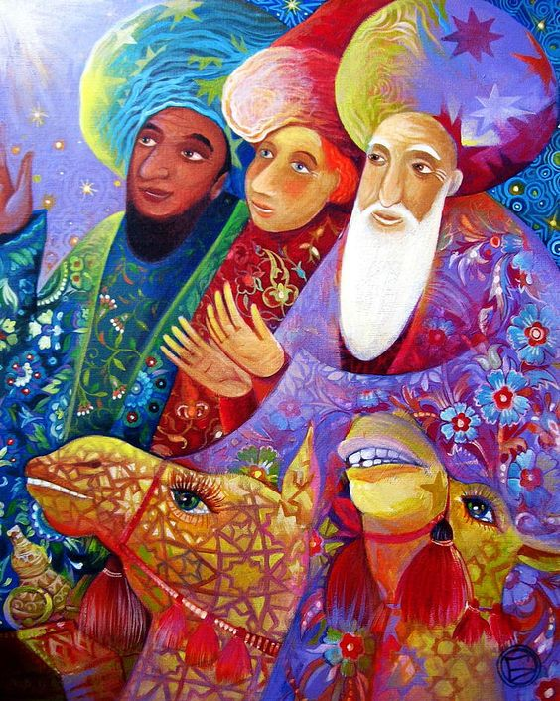

Slide 7
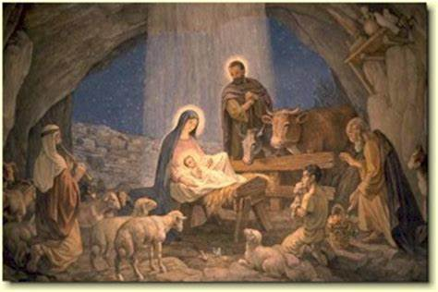
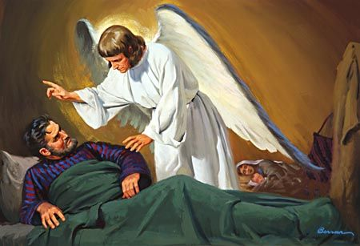

Slide 8
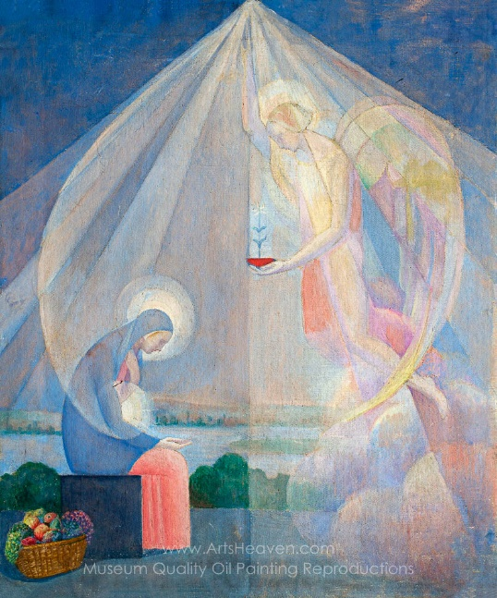

Together we can see how they form the sequence of the story.

Slide 9
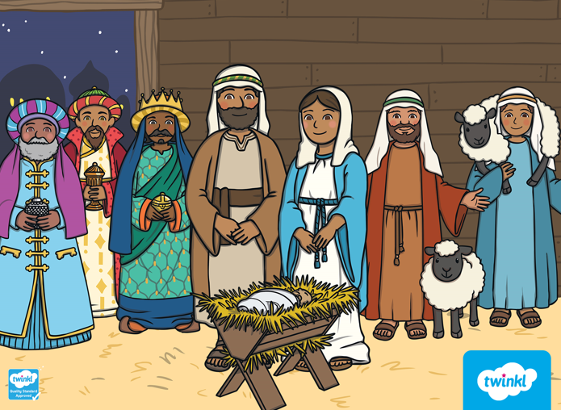
Let’s remind ourselves of the Christmas Story
Religious Studies KS1: The Christian Story of the First Christmas - BBC Teach

Slide 10
This image here is often not included in the Christmas Story but it is a really important part. After the Wise Men have visited Jesus and choose to go home another way. Joseph has a dream in which an angel visits him and warns him of the dangers. For his reason Joseph chooses to take his family and flee to Egypt.

Slide 11
Let’s think about the story….
What are the important parts of the story?
What difficulties might they have faced?
Why was the journey so important?
What happened on their arrival in Bethlehem?
What made the Wise Men make the journey to Bethlehem?
Who did they think Jesus was?
How did they get there?
What was the difficult part of their journey? How did they overcome these difficulties?

Slide 12
Today’s Task
Today we will be writing our own recount of the Christmas story. We need to be thinking about what happened in each part and how they must have been feeling.

Slide 13
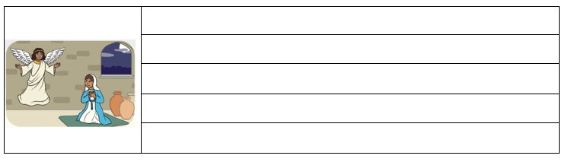
Let’s have a look at one part together…..
What is happening in this part,? What is the important information that we need to include?

Slide 14
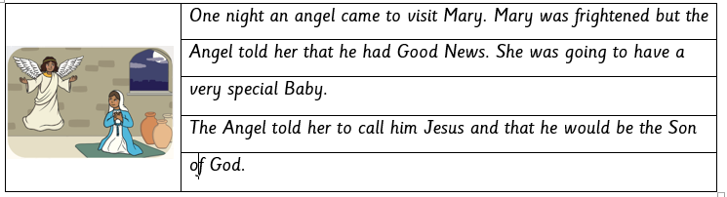
For example
Why do Christians celebrate Christmas?

Slide 15
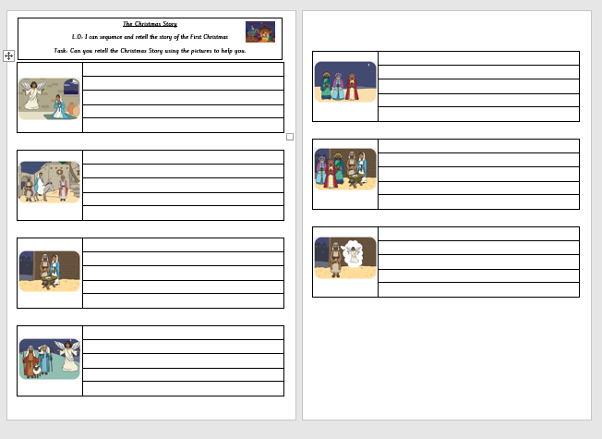
Your Task
Write a short recount of each part of the story?
Remember to think about how the characters would have been feeling.
Read your recount to a member
of your family.

