Slide 1
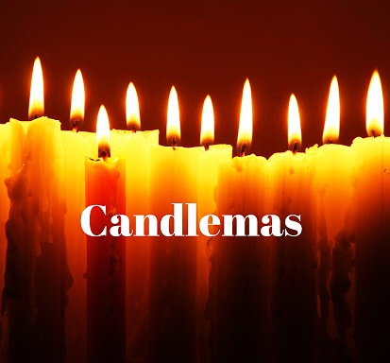
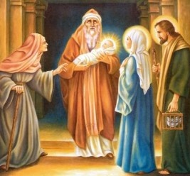
The Presentation of the Lord
Tuesday 2nd February

Slide 2
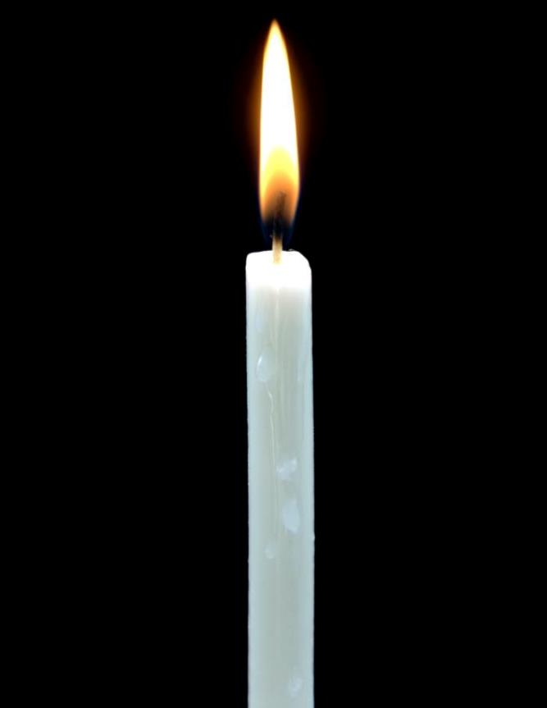
Today is the second of February which is the feast of The Presentation of the Lord. It is also called Candlemas. In pre-Christian times, it was the festival of light. This ancient festival marks the point in the winter half-way between the winter solstice, the shortest day, and the spring equinox. The strength of the life-giving sun increases as winter gives way to spring.

Slide 3

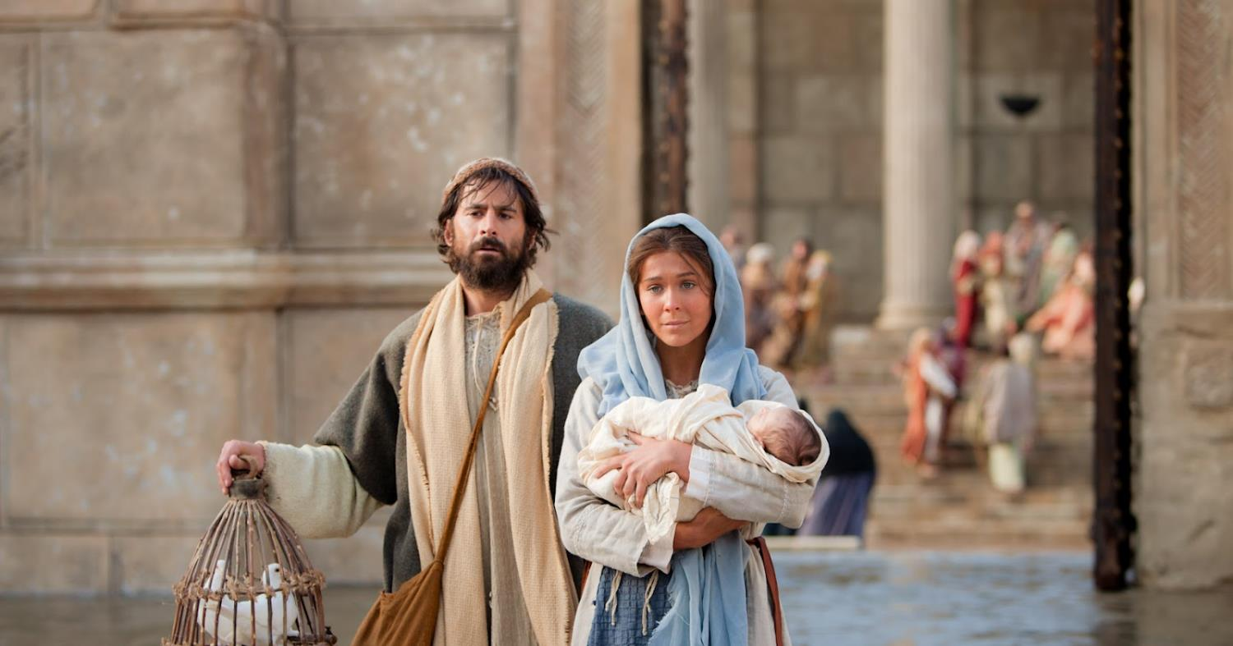
The Feast of the Presentation of the Lord
This takes place 40 days after Christmas. It marks the end of the Christmas season.
What else lasts for 40 days?

Slide 4
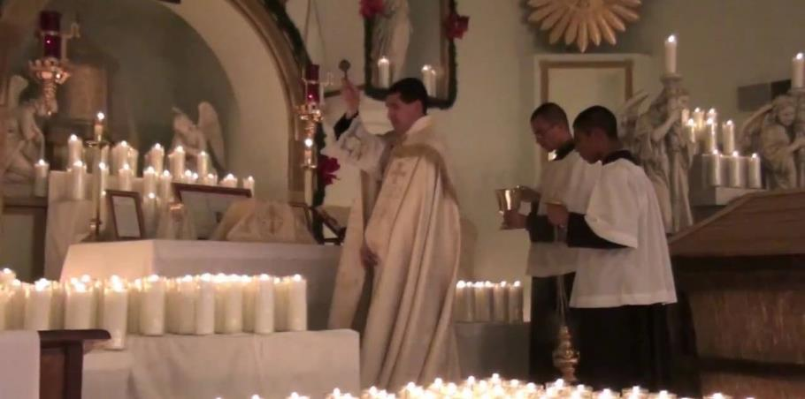
Before the Liturgy there is a procession, the priest blesses the candles that will be used in the church during the next year.

Slide 5
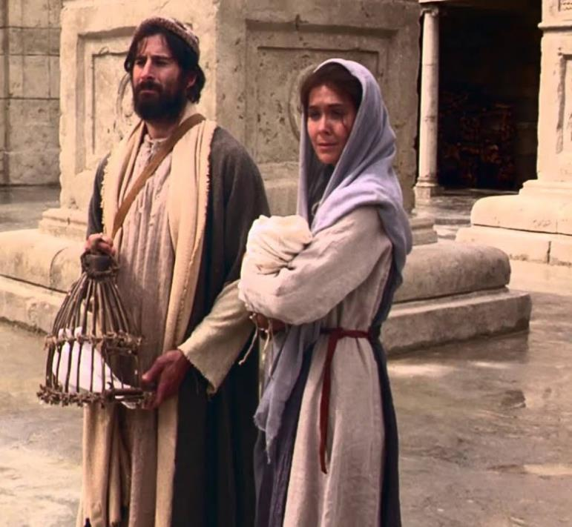
When Jesus was 40 days old Mary and Joseph traveled to the temple in Jerusalem. Many years before Jesus came to earth as a baby, God had given Moses laws for His people to obey. One of those laws was that any family who had a firstborn son had to take that son and have him dedicated at the temple. To dedicate someone means to offer him to God. The parents of the firstborn son had to take an offering with them. The offering was a lamb or if a family didn’t have enough money, God allowed them to bring two birds.

Slide 6
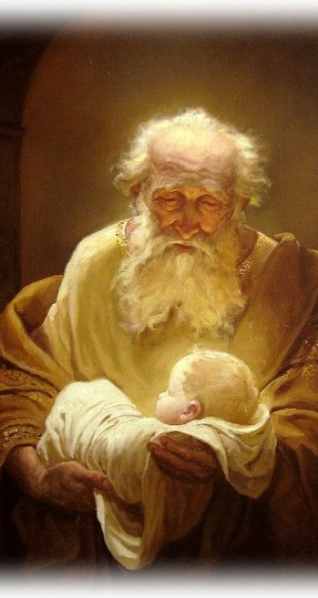
Simeon was a man who loved God. He lived a life that pleased God. Simeon listened and obeyed God’s voice. Earlier in Simeon’s life God told him that he would not die until he had seen with his own eyes the Promised Christ (the Messiah). Simeon believed the promise and was looking for the day to come for God’s promise to happen. This must have been an exciting promise to Simeon. Each year as he worshiped and served God, he must have kept his eyes open for God’s promised Saviour.

Slide 7
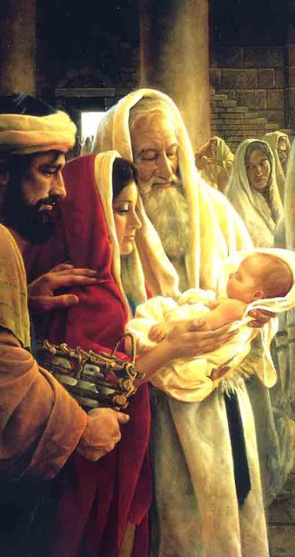
Simeon saw Mary holding baby Jesus in her arms with Joseph as they walked through the temple doors. God’s Spirit told Simeon that this baby was the Promised Saviour. Simeon went to Mary and reached out to hold her Baby Boy. He held him in his arms and began to praise God. Simeon said:
“Lord, now You are letting Your servant depart in peace, according to Your word; for my eyes have seen Your salvation”
Mary and Joseph were amazed at Simeon’s praises to God. He was thanking God for sending the Saviour and allowing him to see him before he died.

Slide 8
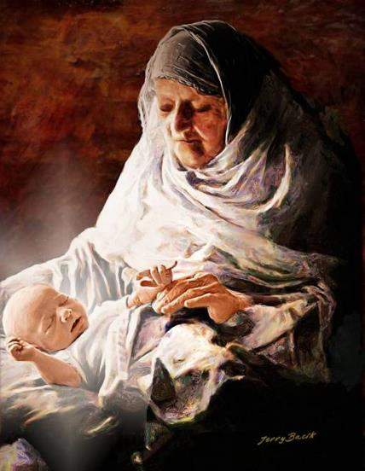
There was another person in the temple that day. Her name was Anna. As soon as she saw Jesus, she immediately thanked God for sending the Saviour who was going to take away the sins of the world.
Simeon and Anna saw and believed that Jesus was God’s promised Saviour. They recognised Jesus because they had a close relationship with God.

Slide 9
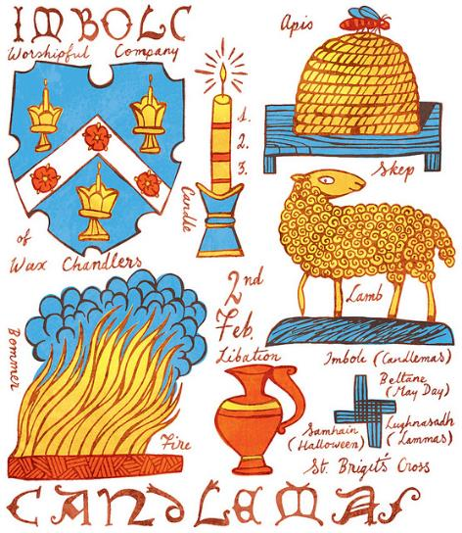
Prayer
Dear Lord,
give us the eyes of faith to see you in the world.
Where fear closes our eyes,
help us.
Where tears blind us,
heal us.
Set us free to see your love at work in the world.
Amen.

Slide 10
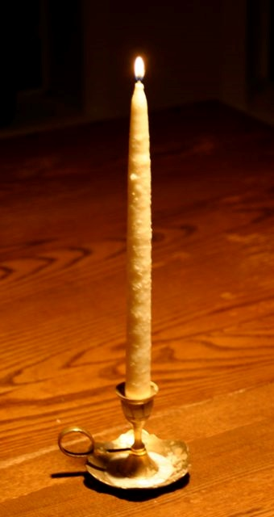
Candles have been made in Europe since 400 AD, from olive oil and beeswax as well as tallow which was made from animal fat. People who made candles were called chandlers. Families lit candles to scare away wicked spirits on the dark winter nights.

Slide 11
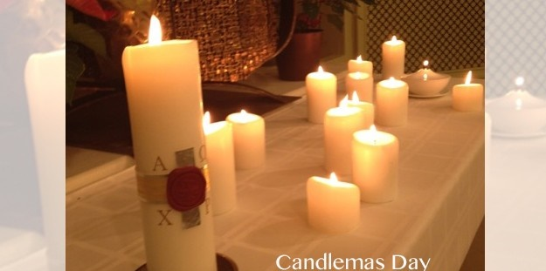
Because it is associated with increasing light, Candlemas is the day when all the candles to be used during the church’s year are blessed. These include the altar candles, the Paschal candle which is lit at Easter time, and the white and purple Advent candles.

Slide 12
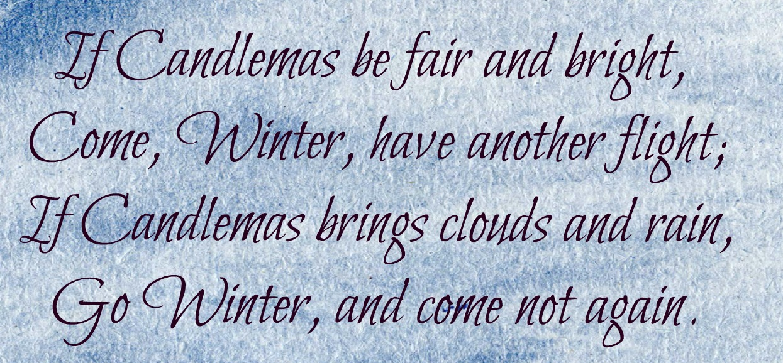
Other Candlemas celebrations

Slide 13
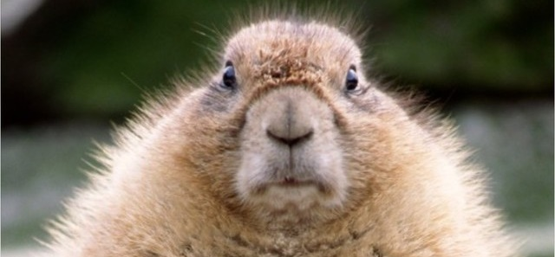
People believed that Candlemas predicted the weather for the rest of the winter.
Groundhog Day is a very old tradition started in Pennsylvania by the early German settlers that came to live in the United States. Groundhog Day is on 2nd February. If the groundhog comes out of his burrow and he does not see his shadow, then spring will arrive early. If the groundhog comes out and sees his shadow, then he will return to his burrow and the cold winter weather will last six more weeks.

Slide 14
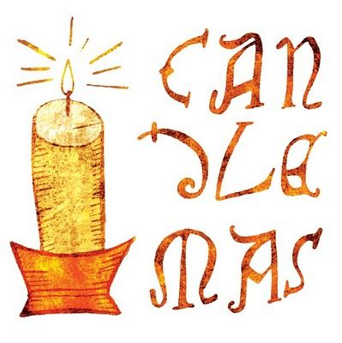
Jesus is the light of the World.
How can you bring Light to the world today?

