Slide 1


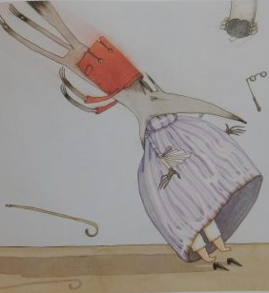
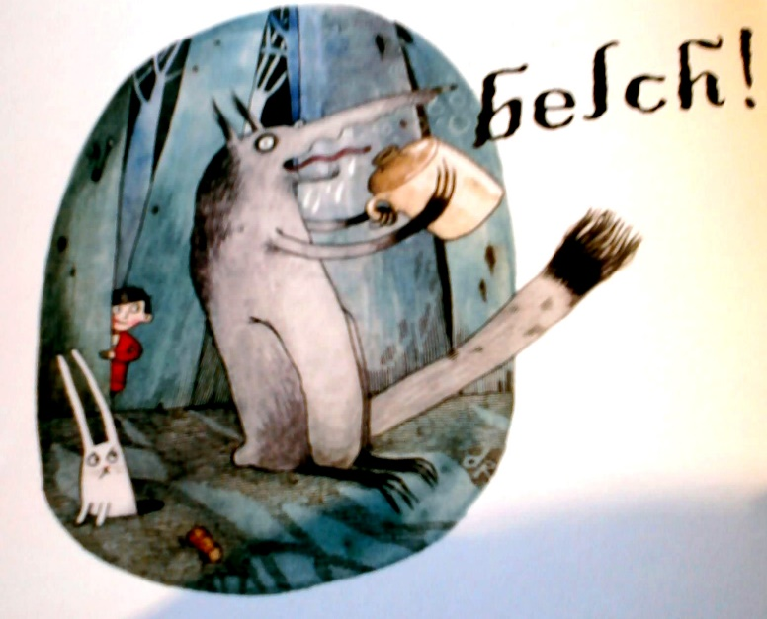
What was the real story?

Slide 2
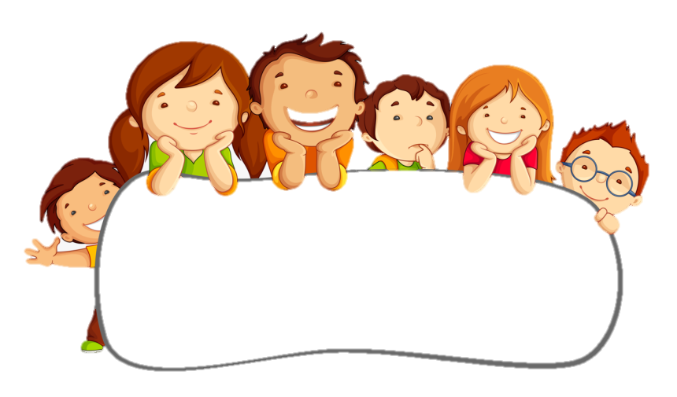
bad tummy
chewy!
Not healthy
stuck in his throat
She’s too big for
his stomach
We didn’t think it was a good idea that the Wolf decided to eat Grandma. We came up with many reason why. Let’s take a look.
too much meat
Hard to digest

Slide 3
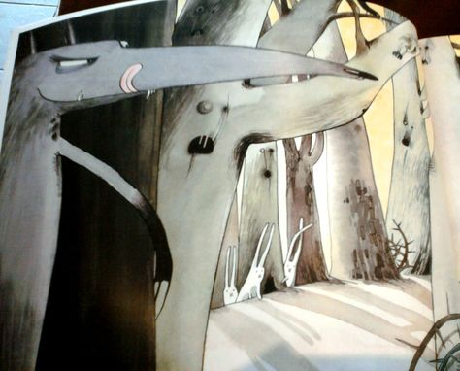
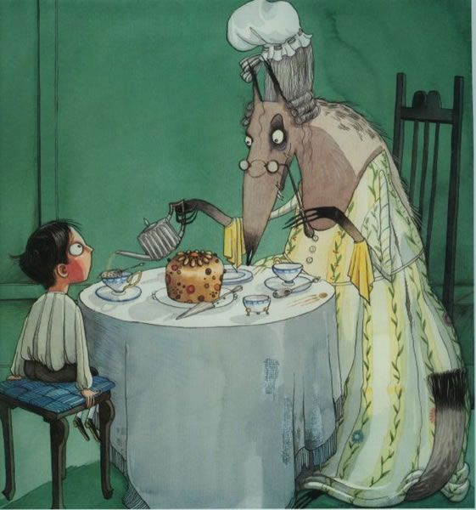
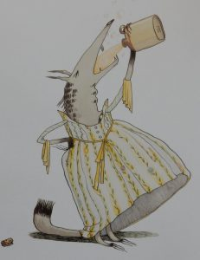
The Wolf thought Grandma was very tasty and he will be on the look out again for his next victim.
What could we do to help save more innocent people?

Slide 4
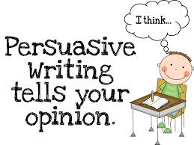
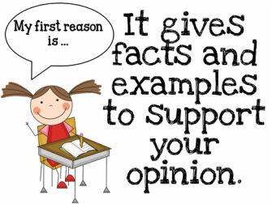

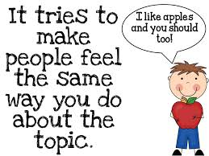
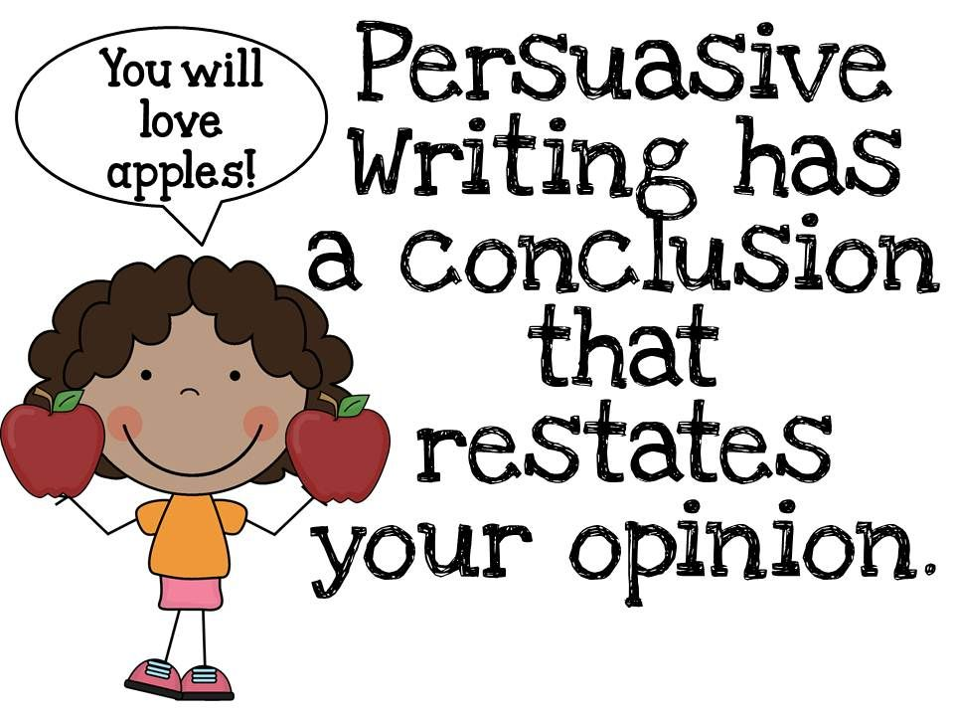
Persuasive
Writing

Slide 5
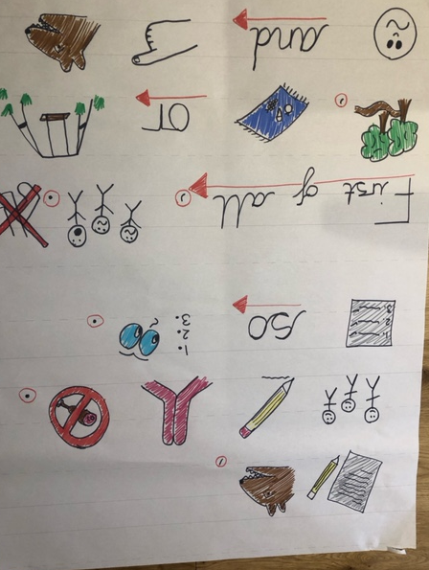
Imitation

Slide 6
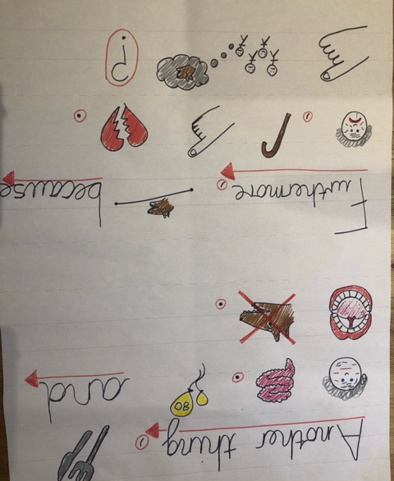
Imitation

Slide 7
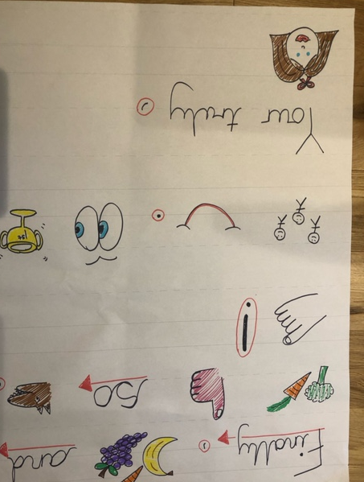
Imitation

