Slide 1


Slide 2

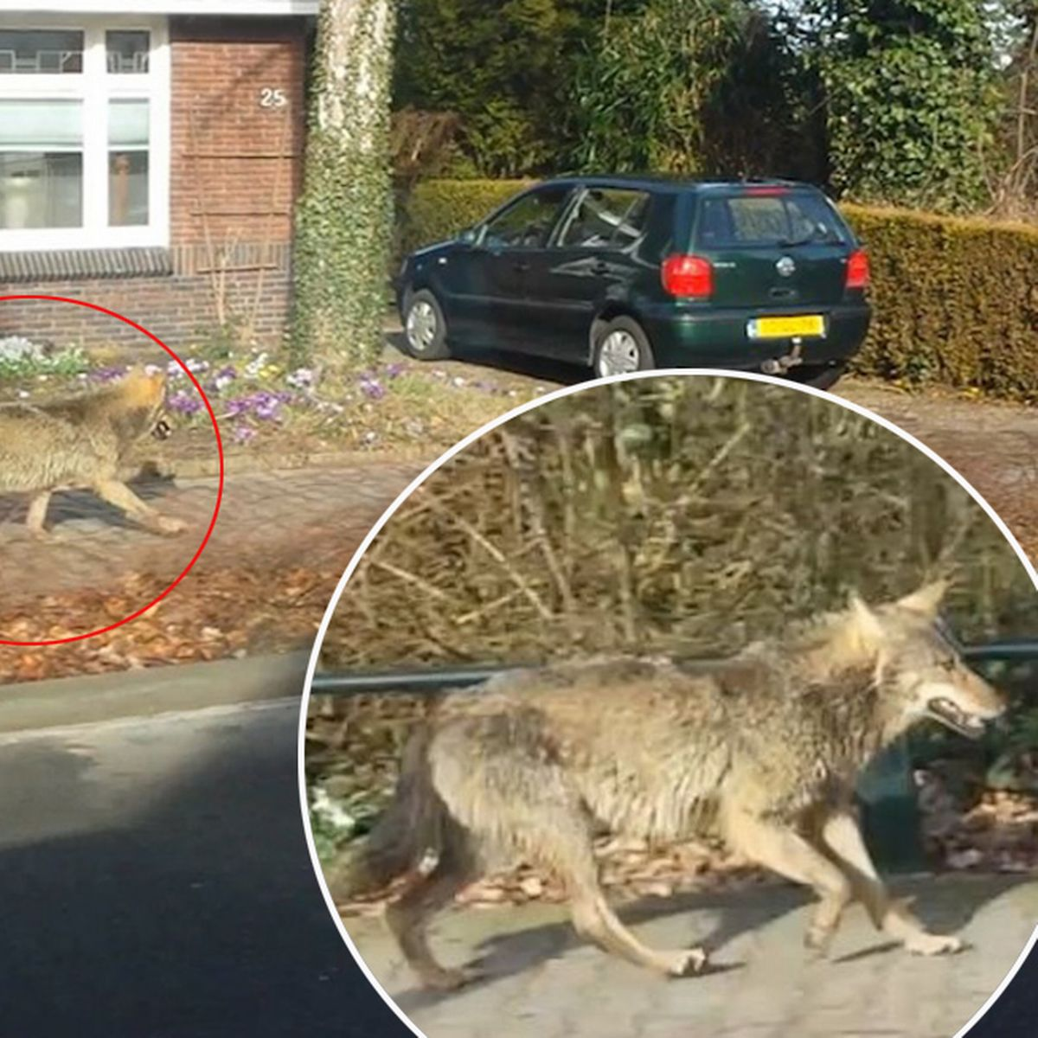
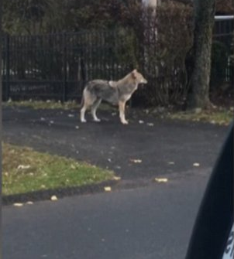

Slide 3
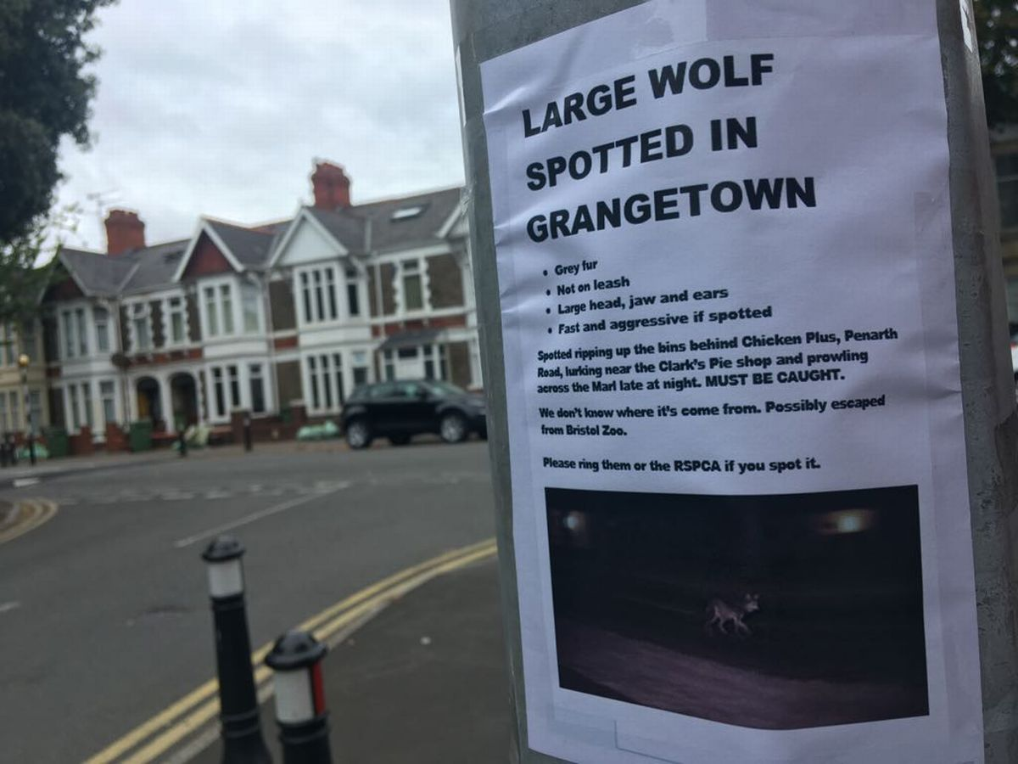
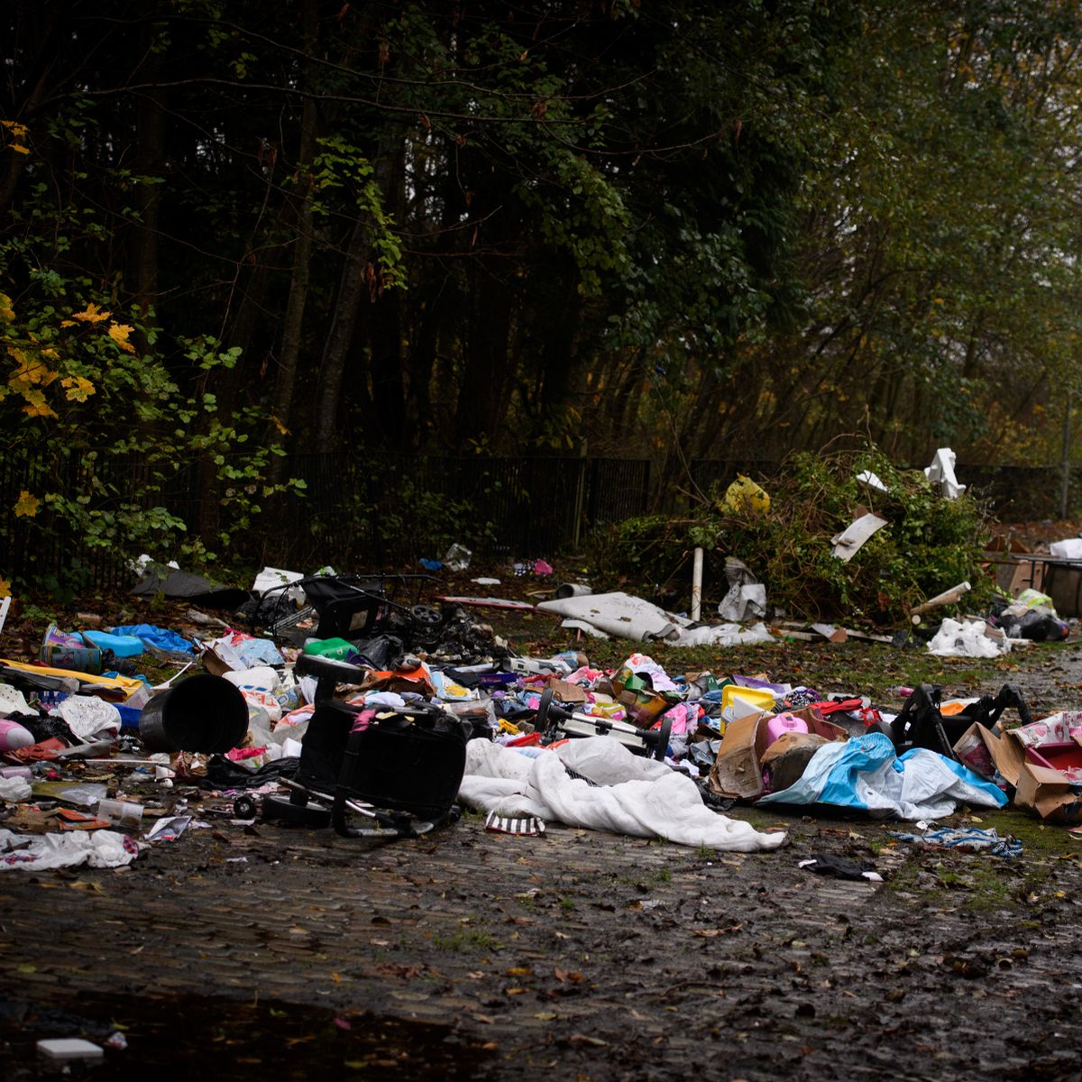




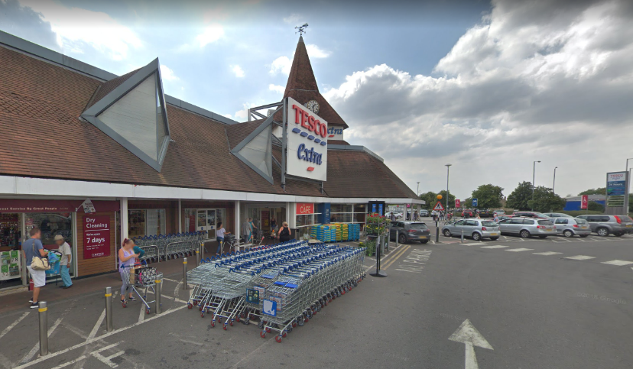
Emptying rubbish bins
Roaming around the streets
Terrifying people
Stealing / theft of

Slide 4




What could we do to
stop him?
What would get him
to see our point
of view?

Slide 5





Persuasive
Writing

Slide 6
Why should he stop this?
●Emptying rubbish bins

Slide 7
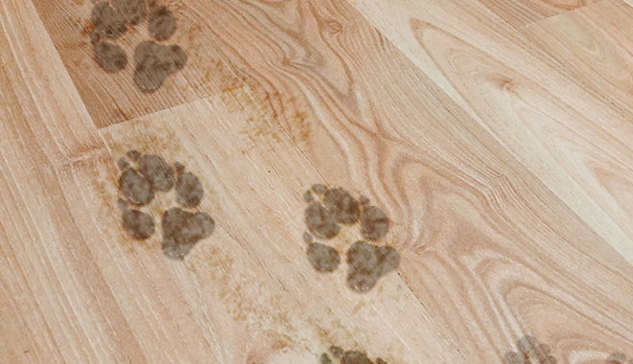
Why should he stop this?
●Roaming around the local area

Slide 8

Why should he stop this?
●Stealing food from shops

Slide 9
Why should he stop this?
●Terrifying people

