Slide 1

Descriptive Paragraph
Traditional Tale
What do we do once we have
written a piece of writing?
Why?

Slide 2
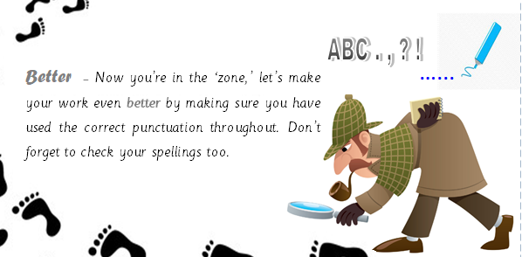
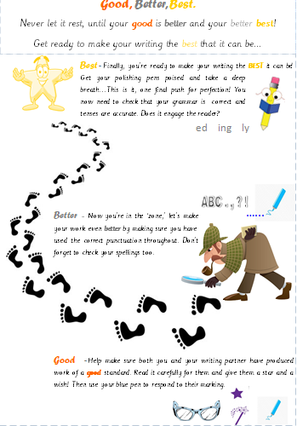
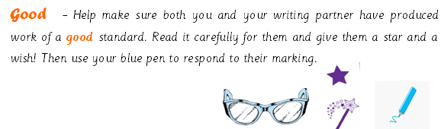

Slide 3
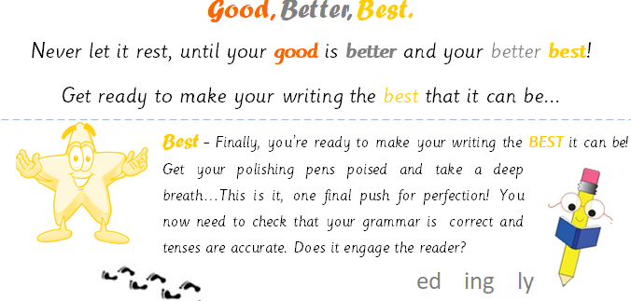


Slide 4
Our check points for editing
Capital letters at start of sentences and a full stop at the end
Capital letters for
proper nouns
Have I used features
from the toolkit?
Have a I applied my phonics using digraphs and trigraphs I know?
Have I explained why in my sentence and extended using a conjunction?
(Subordination and coordination)
Have I over used adjectives?
Do I need them all?
Could I just use the best one?
When I have asked a question
have I used correct punctuation?
Does my sentence make sense?

Slide 5
What do we like?
What could be improved?
Have they referred to our toolkit?

Slide 6
What do we like?
What could be improved?
Have they referred to our toolkit?

Slide 7
What do we like?
What could be improved?
Have they referred to our toolkit?

Slide 8
What do we like?
What could be improved?
Have they referred to our toolkit?

Slide 9

Share your work with a partner
Can your partner find anything you have missed?
What did they like?

