Slide 1
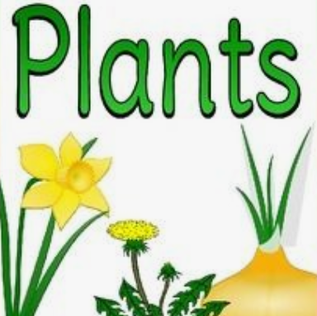
Monday 22nd February 2021
LO: I can identify a range of common plants
WS: To observe closely identifying and classifying plants.

Slide 2
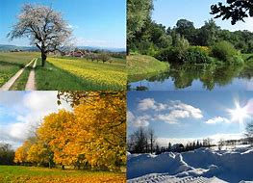
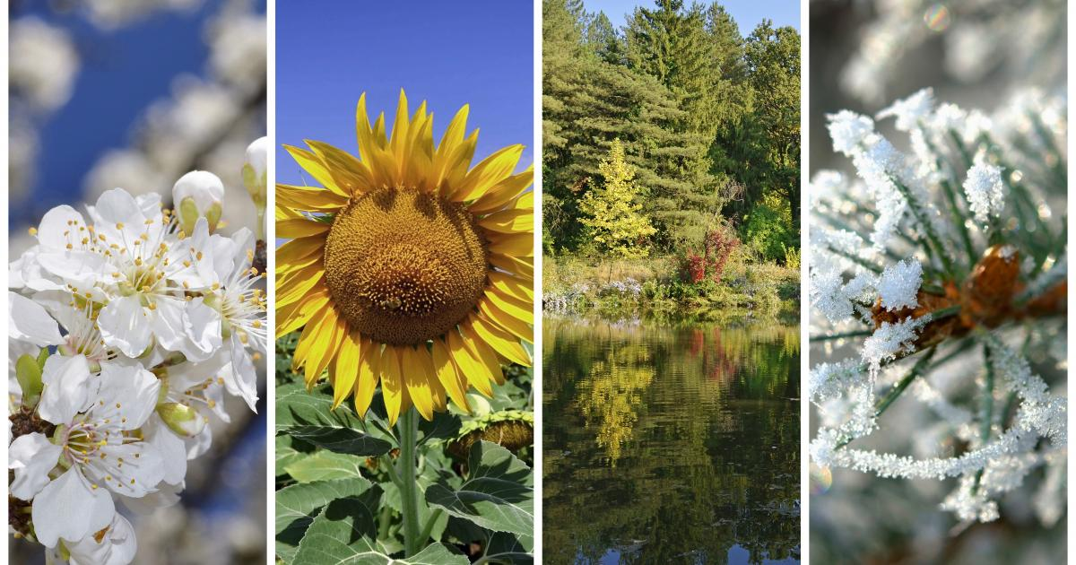
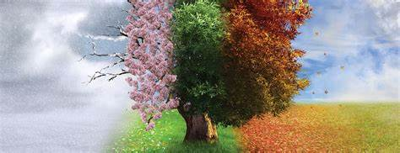
What are the four seasons?
What season are we in now?
What season will be next?

Slide 3
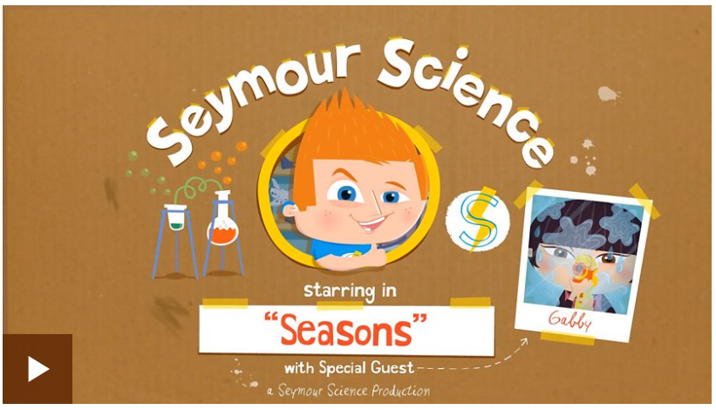
http://www.bbc.co.uk/guides/zcx3gk7
Watch the video and see what changes you notice between the seasons.

Slide 4
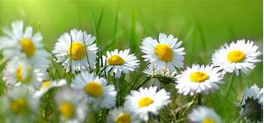
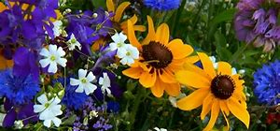
In March the season will be ………………………………. This season starts to show signs of new life growing outside.
We will start to see lots of different types of …………………. growing.
What happens when you plant a seed what will it grow into?

Slide 5

Our new science topic is Plants.
What do you know about plants?

Slide 6
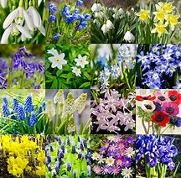
Do you know the name of any plants?
We can make a list of the plants we know.

Slide 7
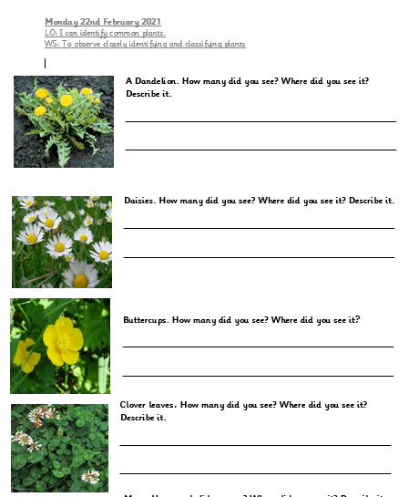

Today we are going on a plant hunt– we are going to find as many different types of plant as we can.

Slide 8
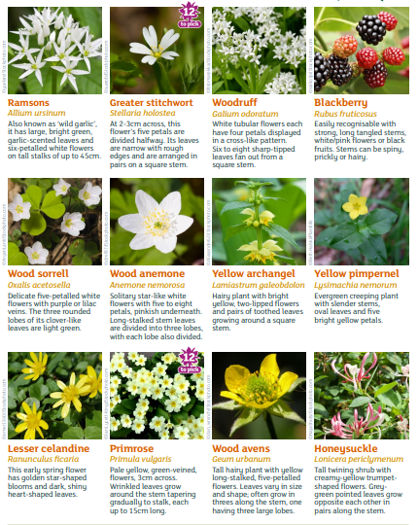
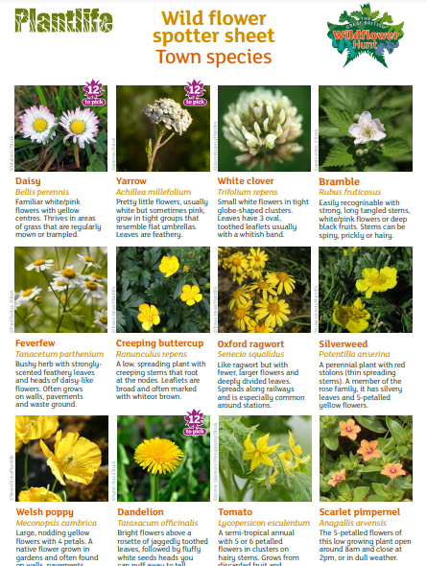
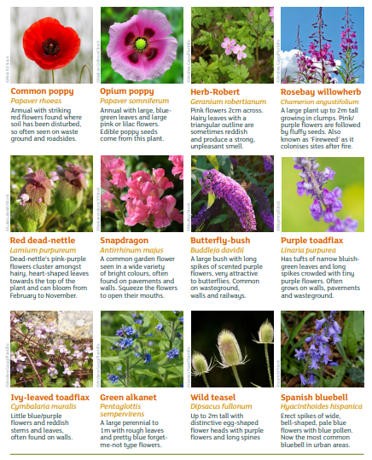
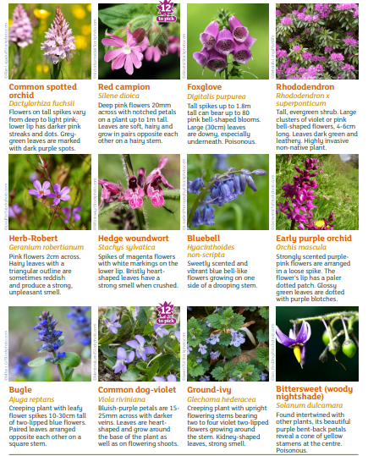
Can you find any of these plants?

Slide 9
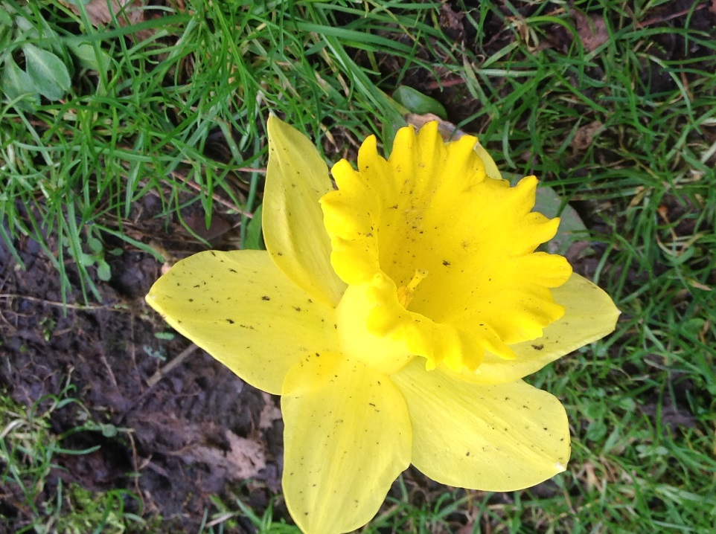
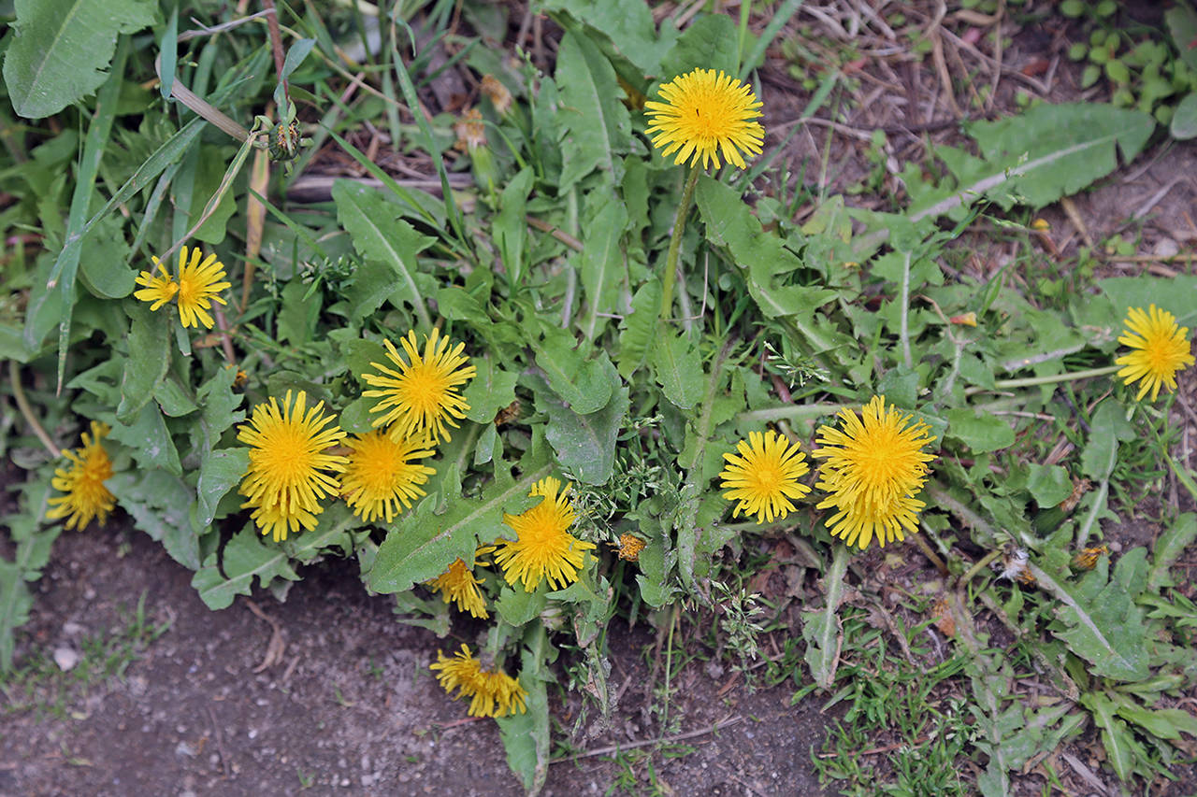
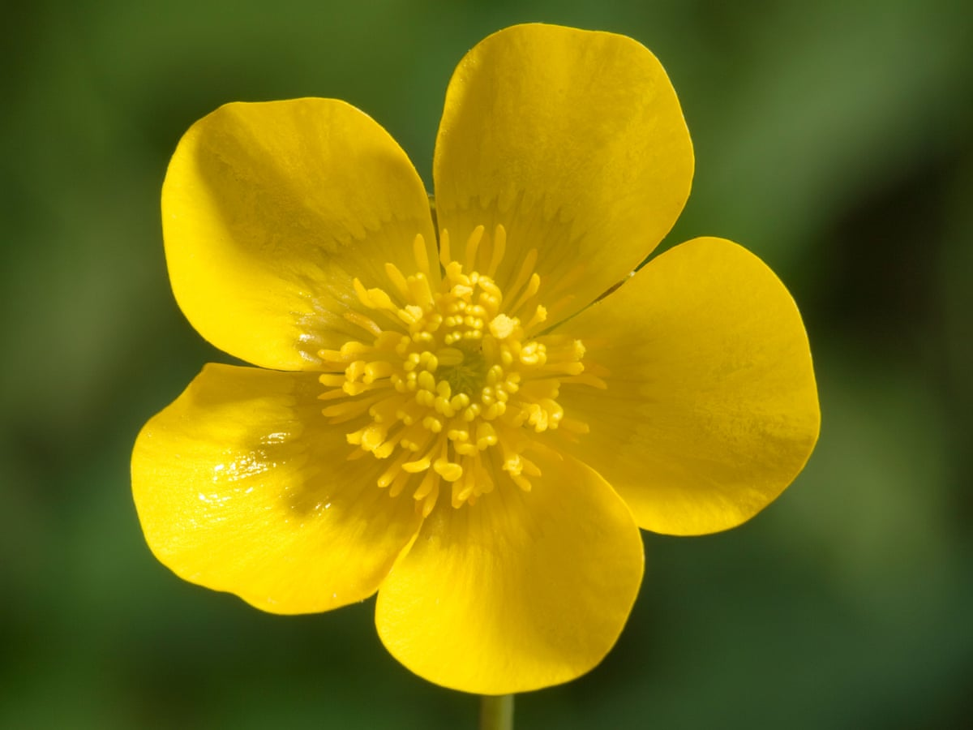
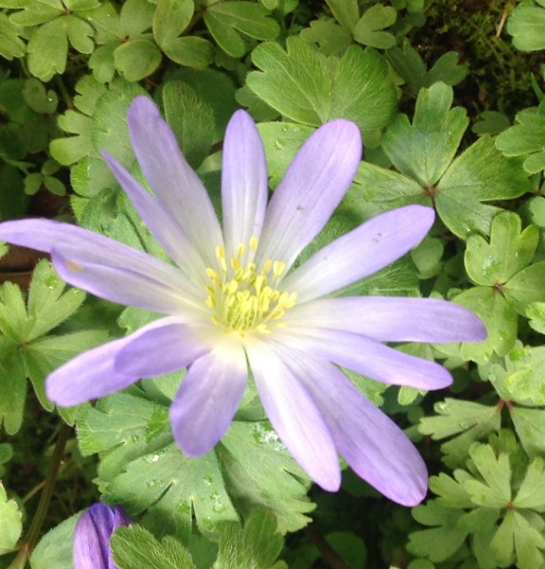
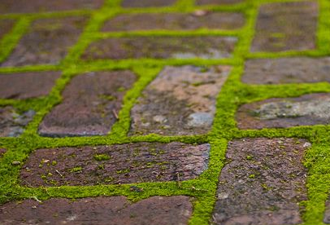
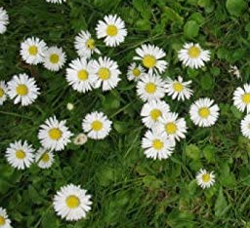
I have been on a plant hunt. Can you identify the plants I have found?

