Slide 1

CEW Revisit/Teach
Revisit CEW incorrect/ tricky or commonly used.
Teach new CEW when necessary.
Phonics
Common Exception Words
Don’t forget to challenge yourself writing the Year 2
CEW you find tricky.
Don’t go for the easy ones ☺

Slide 2
ou
oe
th
a_e
o_e
th
i_e
ea
igh
u_e
ie
au
ph
e_e
Revisit and review
Practise previously learned letters.
Practise oral blending and segmentation.
Notes:
https://www.phonicsplay.co.uk/resources/phase/5/flashcards-time-challenge

Slide 3

Revisit and review
Practise previously learned letters.
Practise oral blending and segmentation.
Today we will be learning a new alternative spelling for the ur sound.
Today this sound will be spelt using the following graphemes…
ear

Slide 4

Teach
Teach a new letter.
Teach blending & segmenting.
Today we are learning the alternative
spelling for the ur sound- ear
learn
What strategies could we use to help us
decide which graphemes we need?

Slide 5
Teach
Teach a new letter.
Teach blending & segmenting.
Today we are learning the alternative
spelling for the ur sound- ear
earn
Can you put this word into a sentence?

Slide 6
Teach
Teach a new letter.
Teach blending & segmenting.
Today we are learning the alternative
spelling for the ur sound- ear
pearl
Can you put this word into a sentence?

Slide 7
Teach
Teach a new letter.
Teach blending & segmenting.
Today we are learning the alternative
spelling for the ur sound- ear
earth
Can you put this word into a sentence?

Slide 8
Practise
Practise reading and/or spelling words with the new letter.
Today we are learning the alternative
spelling for the ur sound- ear
I woke up erly for school.
Which word is spelt incorrectly? Can you edit the sentence?

Slide 9
Practise
Practise reading and/or spelling words with the new letter.
Today we are learning the alternative
spelling for the ur sound- ear
We hird the fire alarm go off.
Which word is spelt incorrectly? Can you edit the sentence?

Slide 10
Practise
Practise reading and/or spelling words with the new letter.
Today we are learning the alternative
spelling for the ur sound- ear
Can we surch for the lost horse?
Which word is spelt incorrectly? Can you edit the sentence?

Slide 11

Apply
Read or write application
Include CEW in sentences.
We live on planet Earth.
I was late for my rehearsal.

Slide 12
Apply
Read or write application
Include CEW in sentences.
We live on planet Earth.
I was late for my rehearsal.

Slide 13
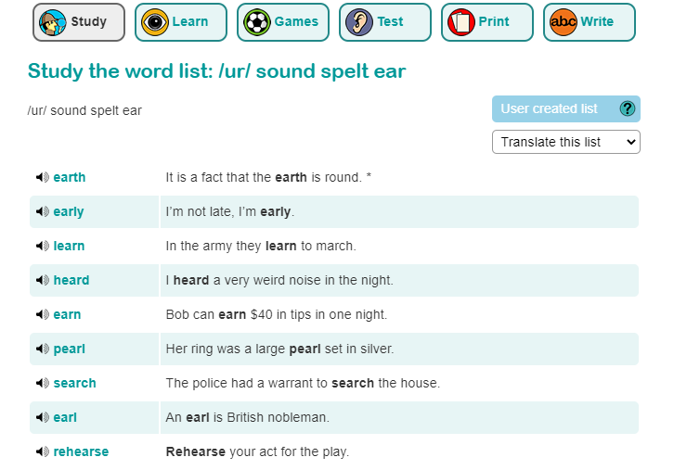
Apply
Read or write application
Include CEW in sentences.
Extra day- application
https://www.spellzone.com/word_lists/list-209198.htm

