Slide 1
Wednesday 24th February 2021

Slide 2



What was life like in the past?

Slide 3
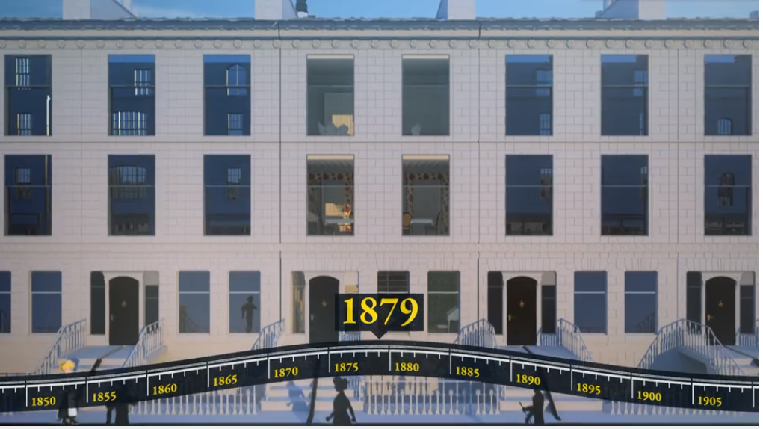
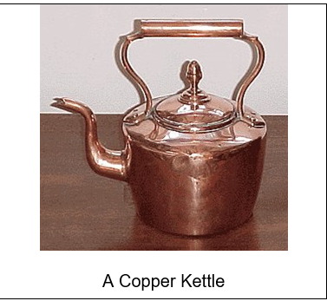
What did we look at before half term?

Slide 4
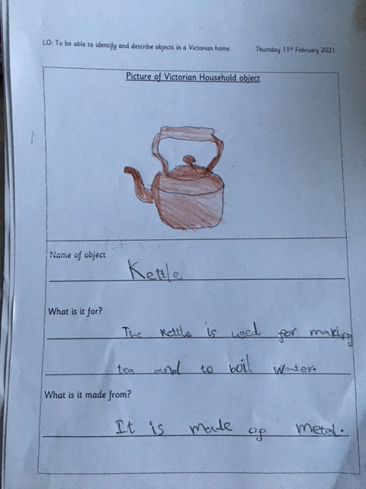
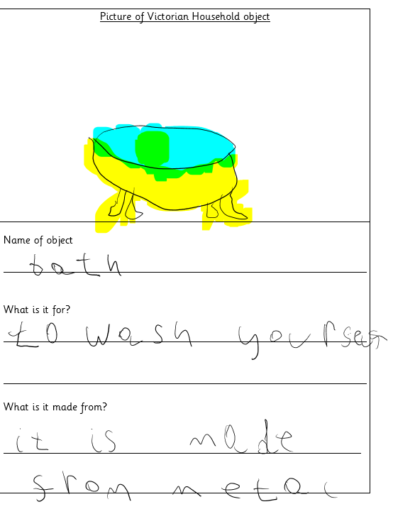
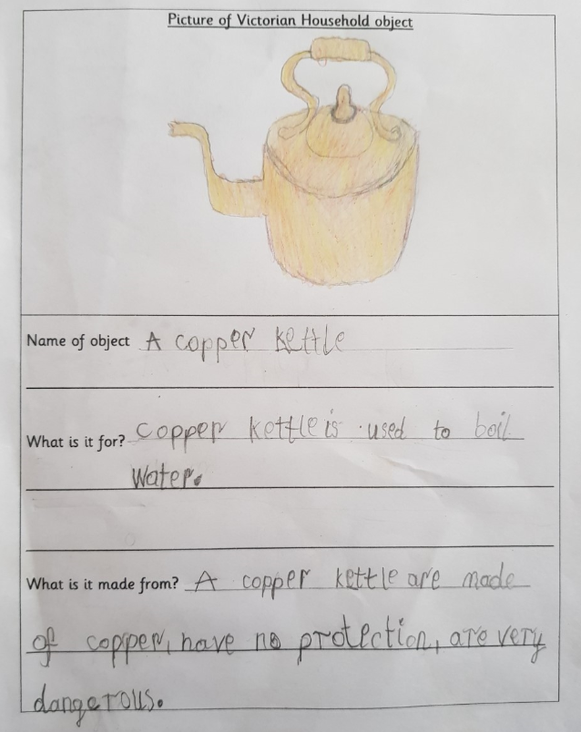
What did we find out about before half term?

Slide 5
What does a Victorian house look like?

Slide 6
Rooms in Victorian houses before patterned wallpaper was used looked like this.

Slide 7
Rooms in Victorian houses with patterned wallpaper

Slide 8
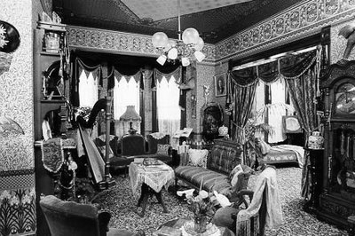

Slide 9
Can you spot any themes in the work?

Slide 10



Are your walls painted different colours?
Do you have any wallpaper?

Slide 11
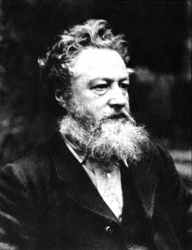
Who is this man?
William Morris was born on 24th March, 1834.
He was the son of a wealthy business man.
He originally was going to become a priest but decided to devote his life to art instead.
He became a poet, artist and manufacturer.
His career in designing started when he decorated his own house in London.

Slide 12
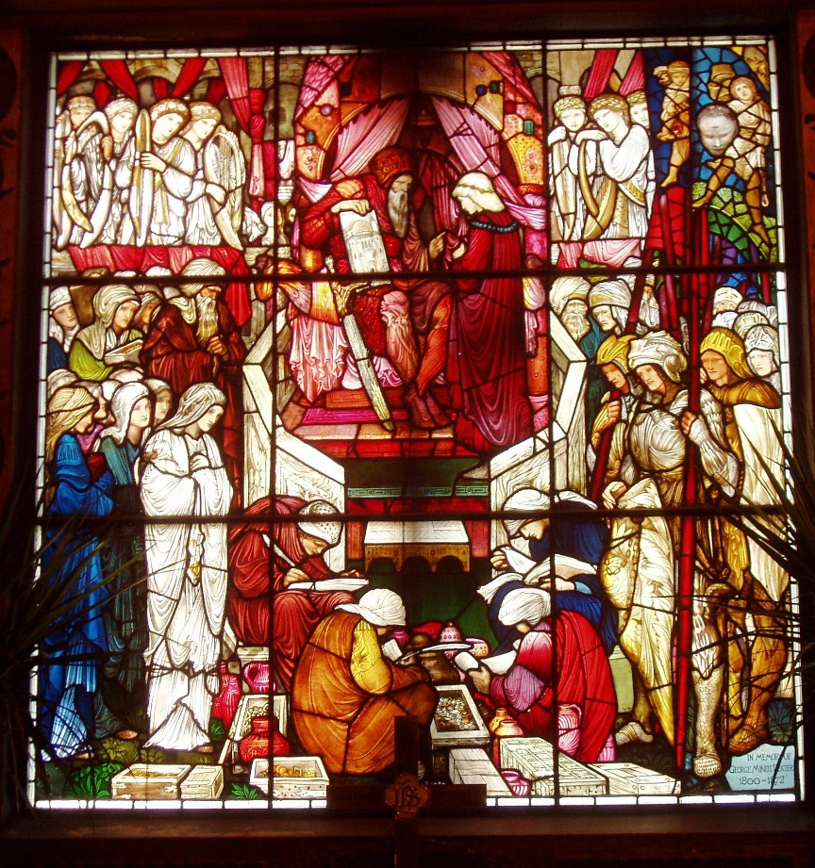
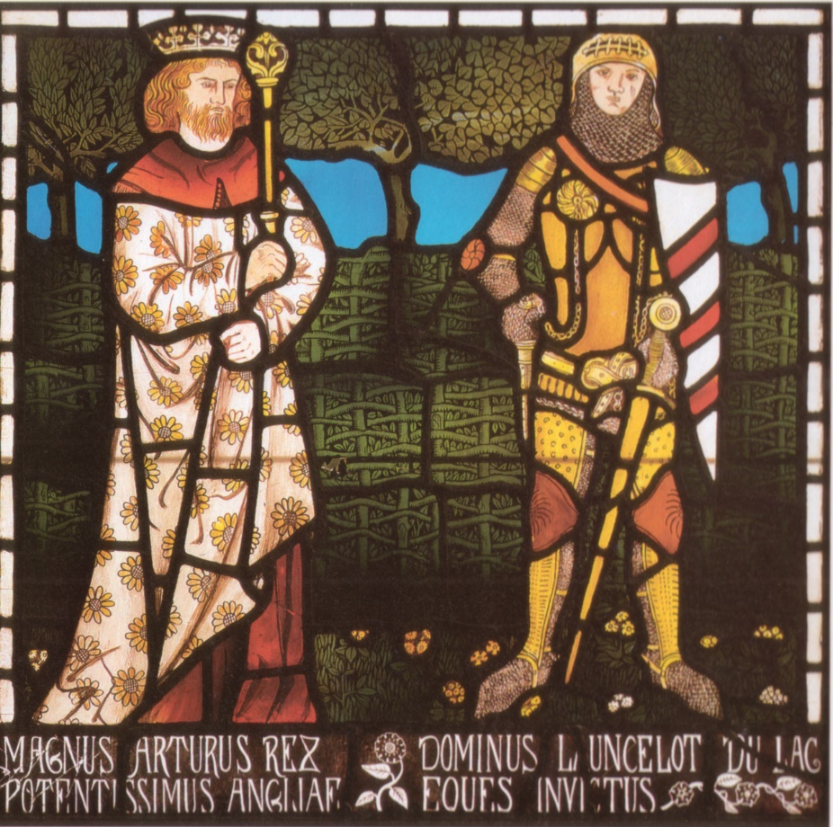
Who Was William Morris
He made stained glass windows…

Slide 13
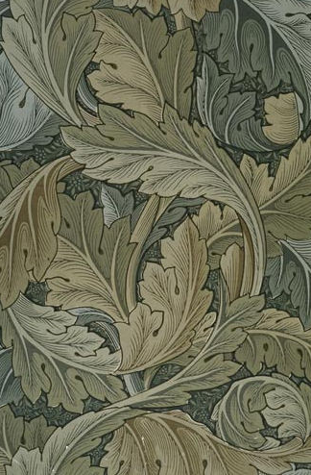
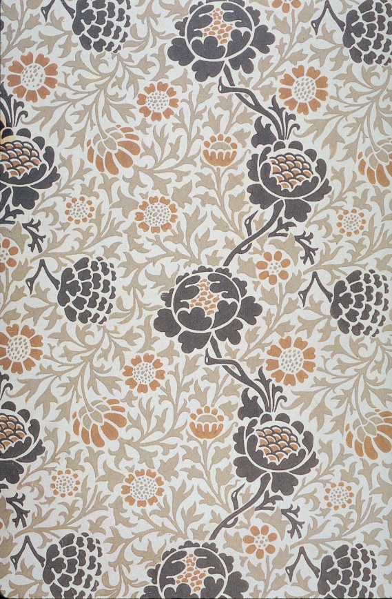
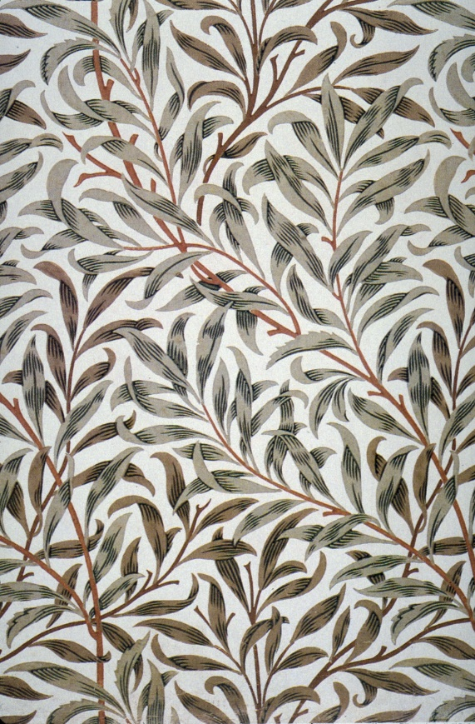
Who Was William Morris
He made patterned wallpaper…

Slide 14
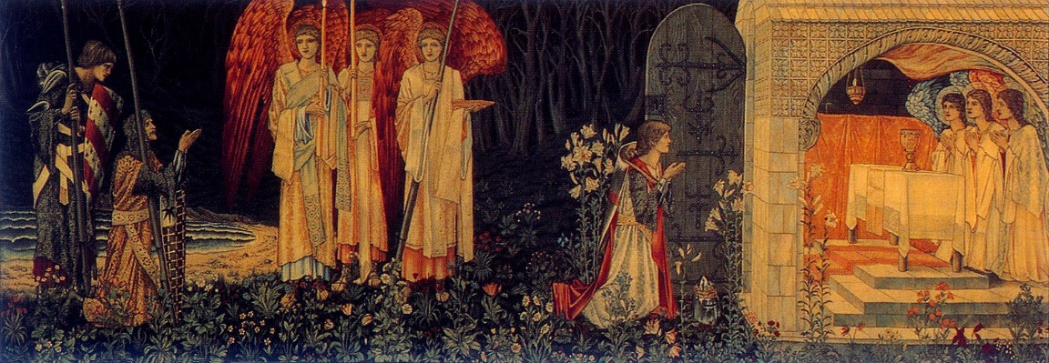
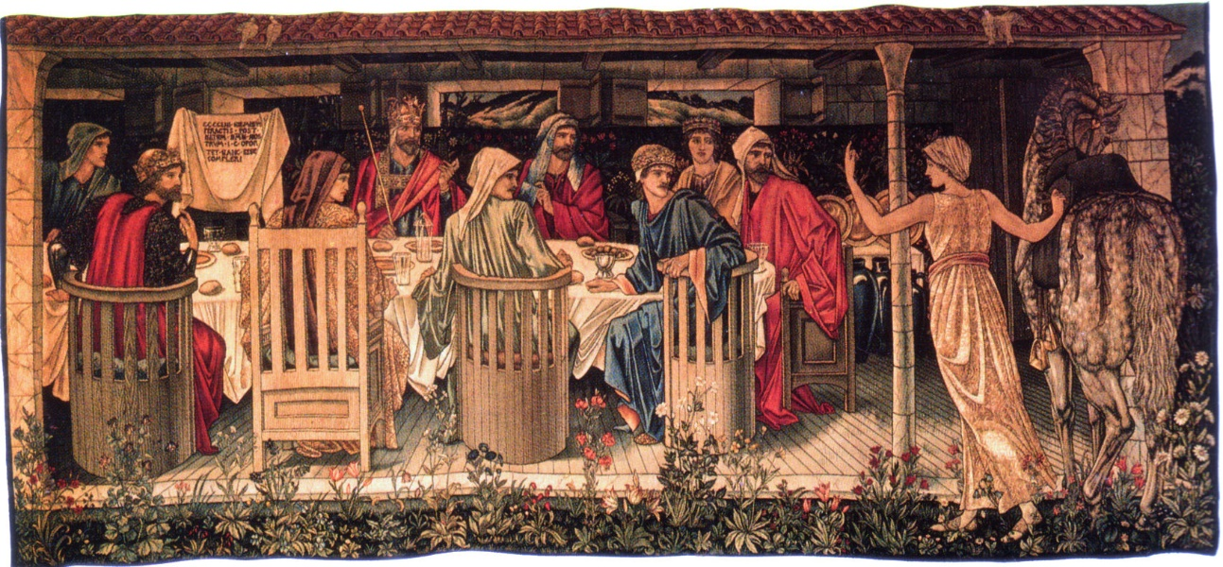
Who Was William Morris
He made tapestries…

Slide 15
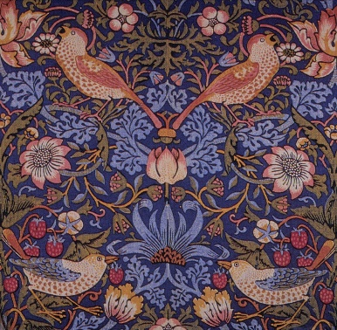
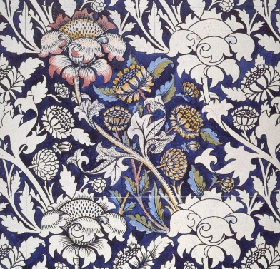
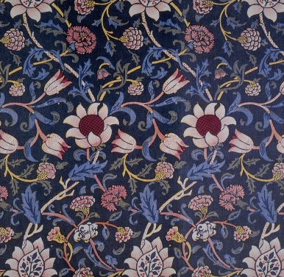
William Morris – The Style
William Morris is very famous for his wallpaper designs. He created some beautiful designs, the likes of which had never been used before. In fact, wallpaper before his day was quite plain.
The Victorian era was the era of industrialisation; factories were being built in the cities in Britain, especially London. People flocked to the cities to work in these factories or run them, and the cities grew bigger and bigger. As a result, people led more urban lifestyles and grew to miss the countryside. Wealthier people did have gardens, but still, it was desirable to feel closer to nature.
William Morris, who was also an environmental campaigner, created designs of floral patterns (patterns inspired by flowers and plants) which were repeated many times by block printing.

Slide 16
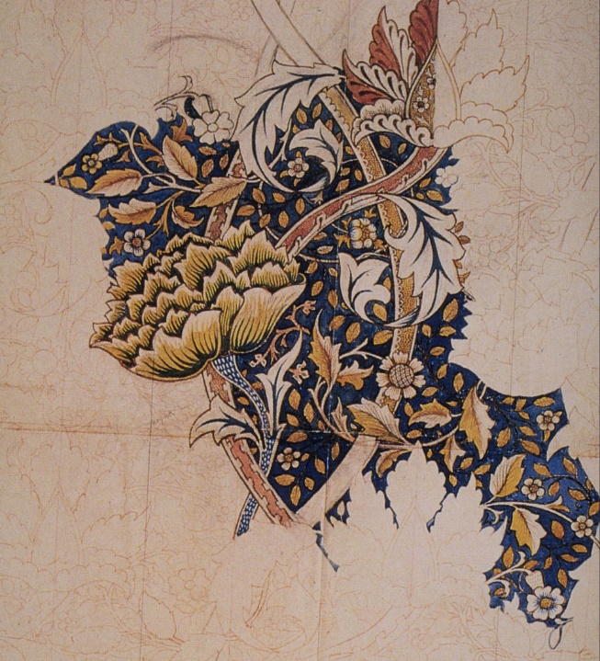
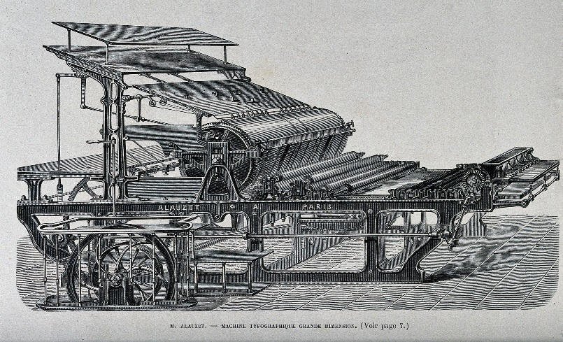
William Morris – The Technique
What William Morris did was to make designs of floral patterns (patterns inspired by flowers and plants) that could be repeated many times by block printing techniques on large pieces of paper to make patterned wallpaper.
“Machine Typographique Ghande Dimension” courtesy of Wellcome Library, London via Creative Commons Wikimedia is licensed under CC BY 2.0
This process was later improved through advances in technology, using printing machines and synthetic coloured inks.

Slide 17

An Influential Artist
“Windrush” 1881-1883

Slide 18
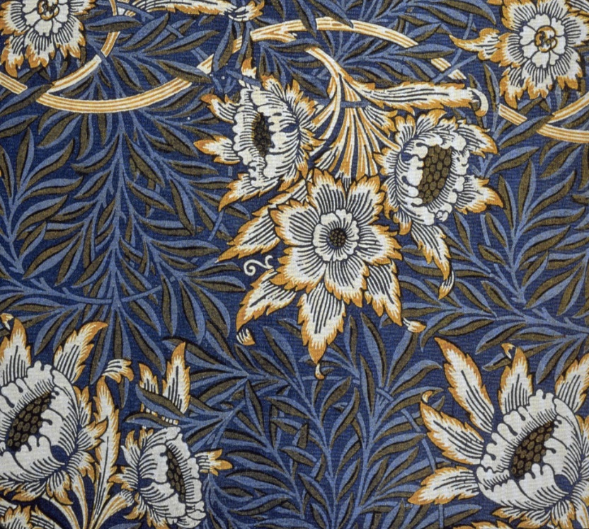
An Influential Artist
“Tulip and Willow” 1873

Slide 19
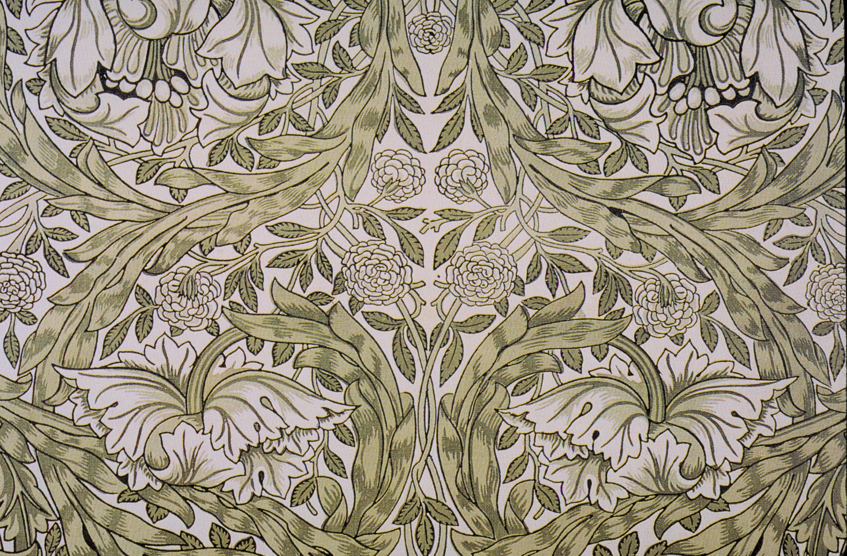
An Influential Artist
“African Marigold” 1876

Slide 20
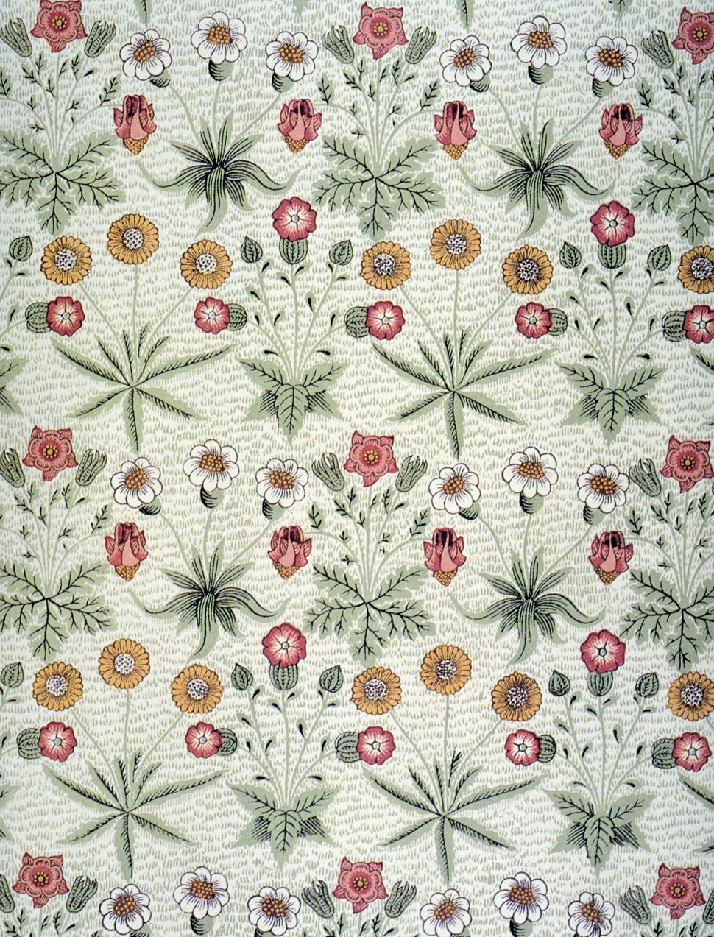
An Influential Artist
“Daisy” 1864

Slide 21
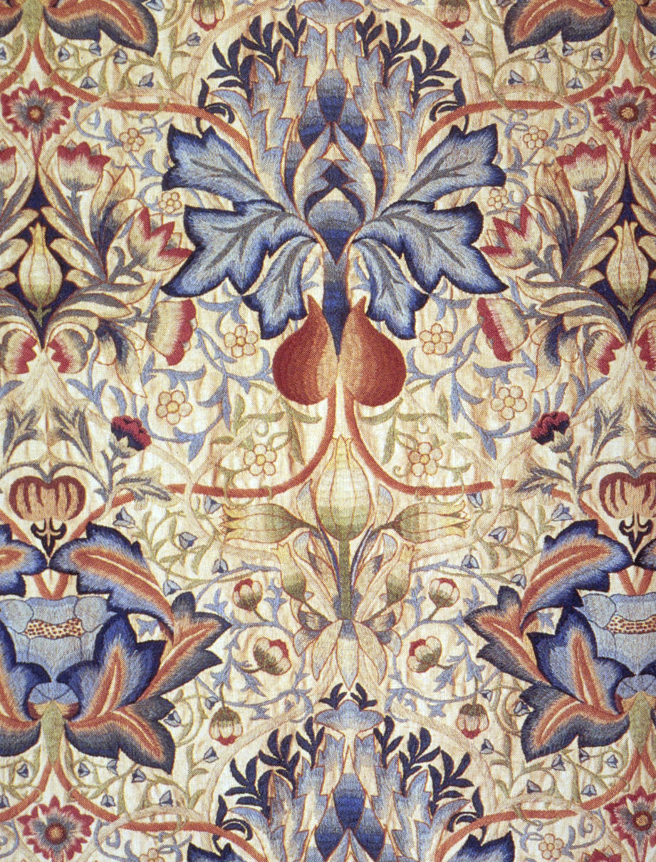
An Influential Artist
“Acanthus” 1875

Slide 22

An Influential Artist
“Strawberry Thief” 1883

Slide 23
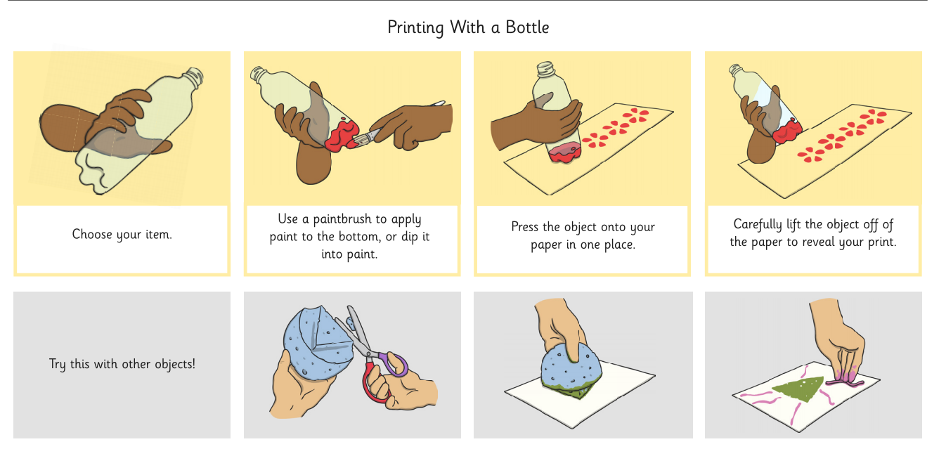
Can you have a go at home to make a pattern like William Morris?

Slide 24
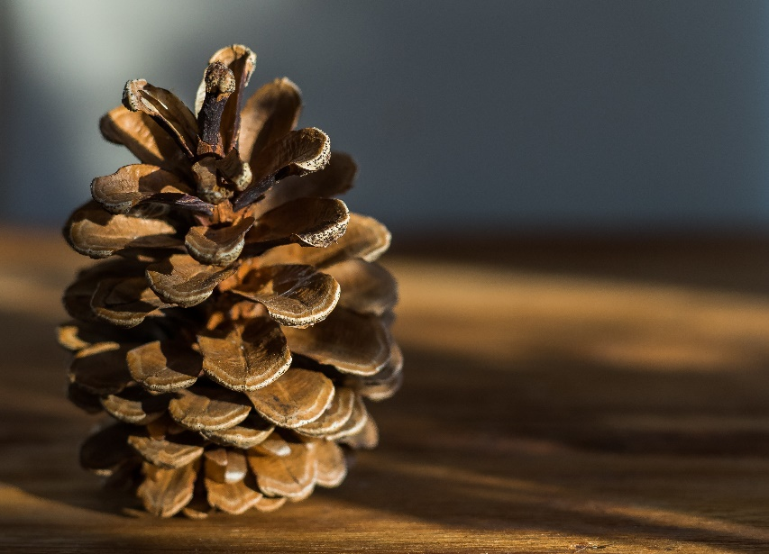
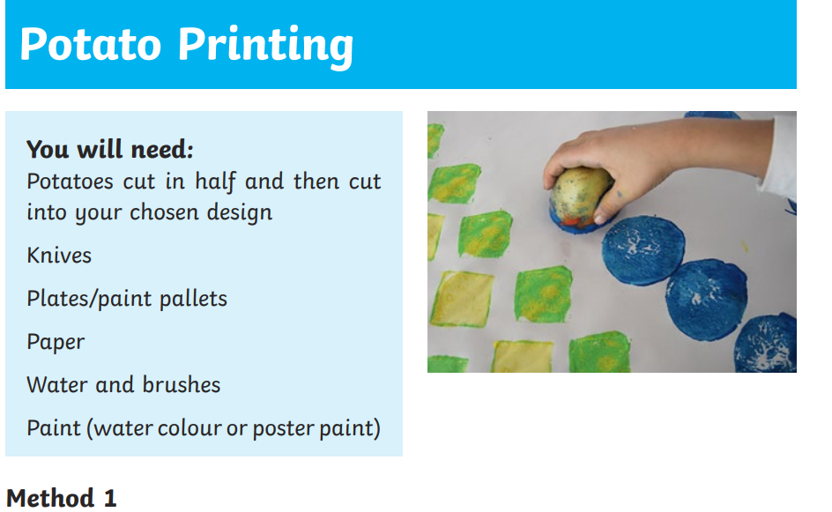
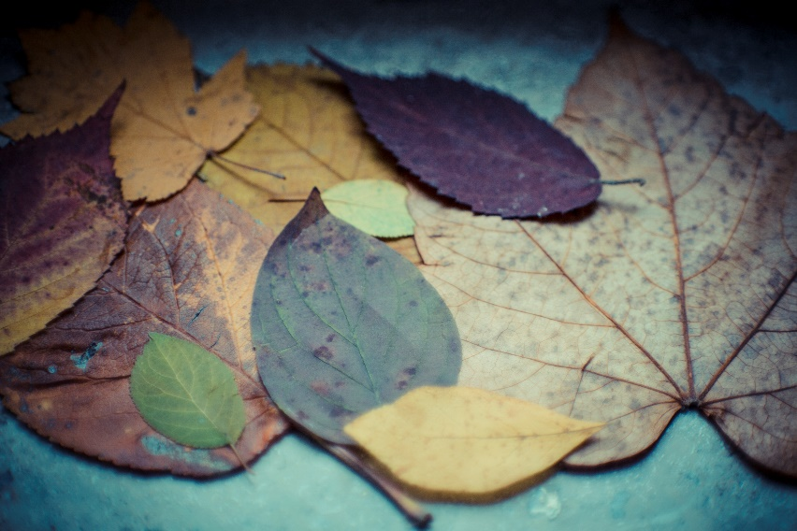
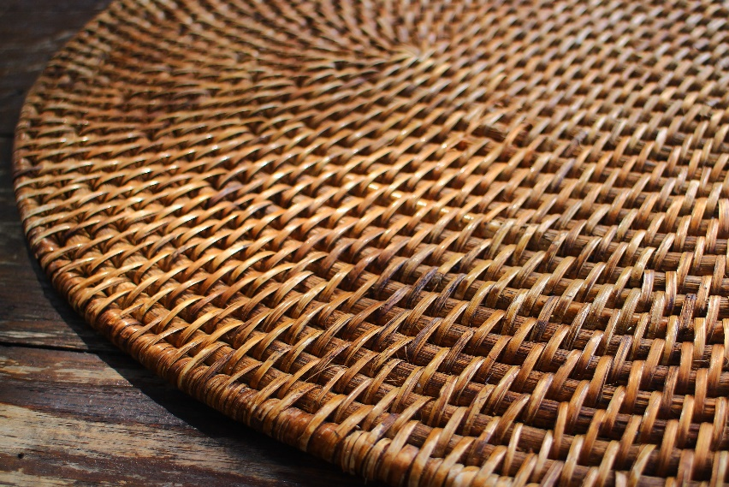
Can you have a go at home to make a pattern like William Morris?

Slide 25

Task: To have a go at making a pattern with the printing technique.
If you don’t have any paint at home you could use:
Ink
Coffee granules diluted with a little water
Homemade Paint recipe
1/2 cup flour.
1 cup water.
pinch of salt (optional)
extra water.
Food colouring
year1@holyroodprimary.co.uk

Slide 26
Plenary
What objects did we learn about today?

Slide 27
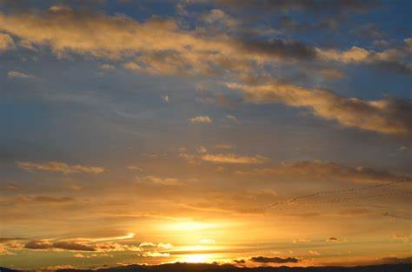
Now the day is over, we lift our hands and say
Thank you heavenly Father for today.
We’re sorry for the wrong things, but glad about the right.
Keep us Heavenly Father, in your love tonight.
Amen

