Slide 1
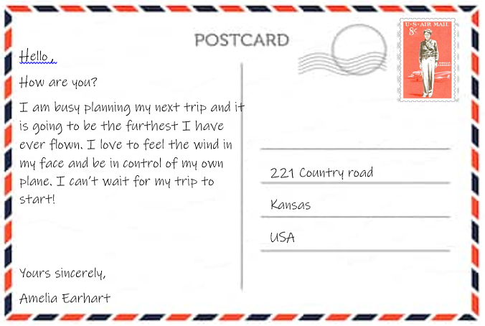


Slide 2
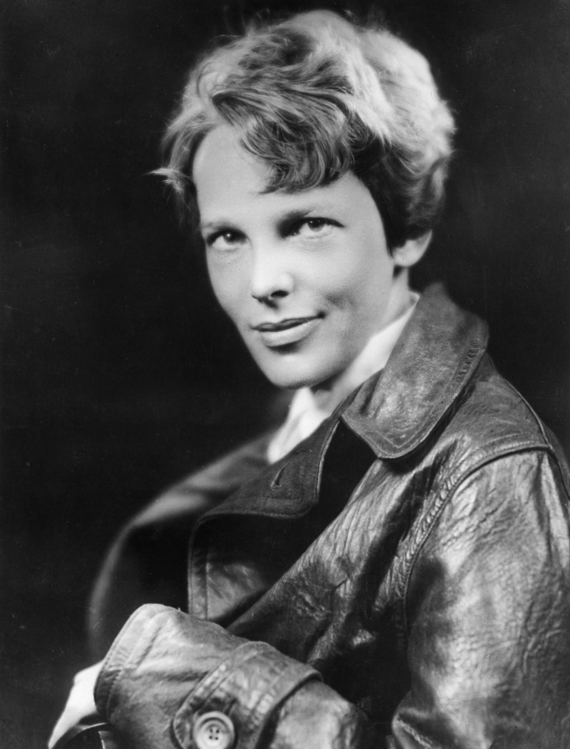
We received a post card from Amelia Earhart.
Who do you think Amelia is?
What clues are in the postcard?

Slide 3
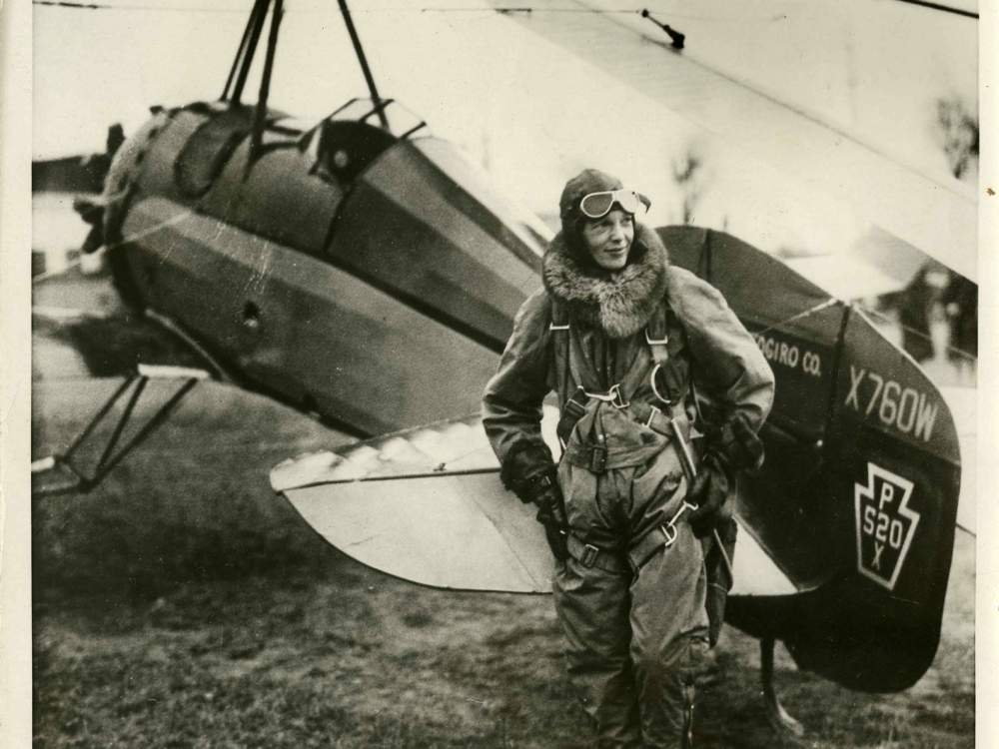
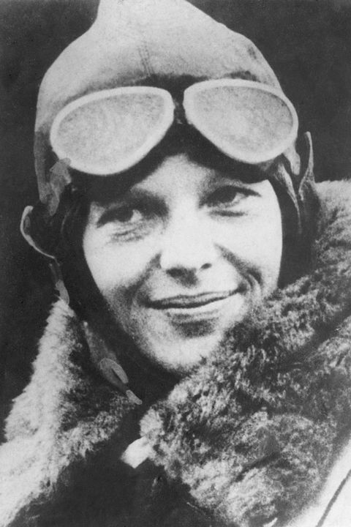

Amelia Earhart
Amelia Earhart was an American aviator. An aviator is a Pilot. This means
she flew planes.

Slide 4
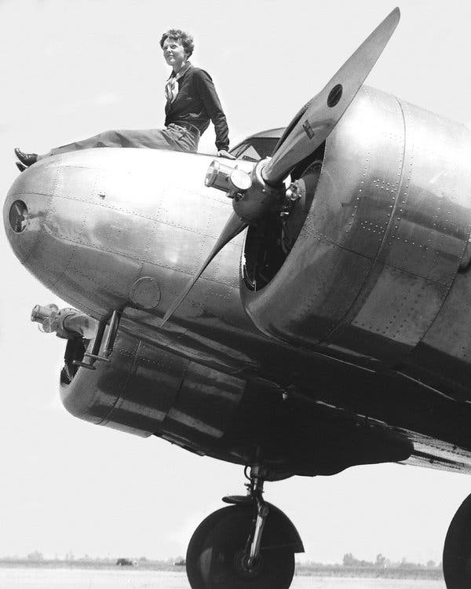
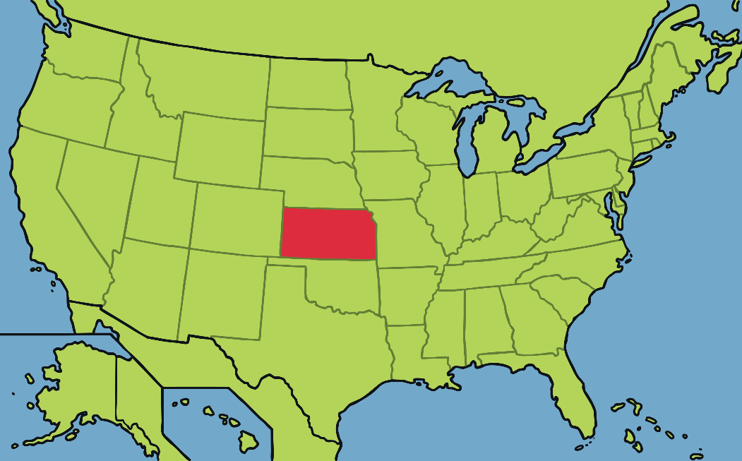
Amelia Earhart born in Kansas, United States on 24th July 1897.
Kansas

Slide 5
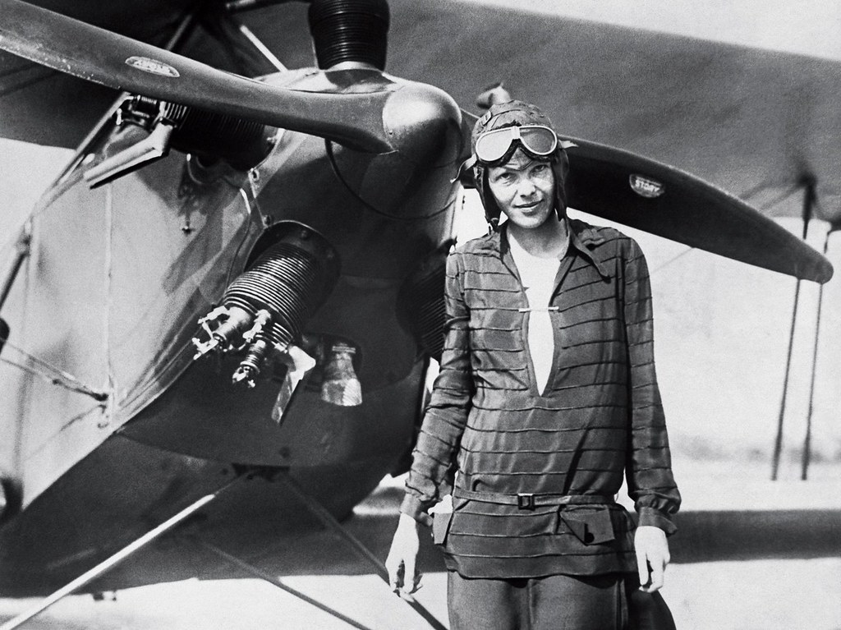
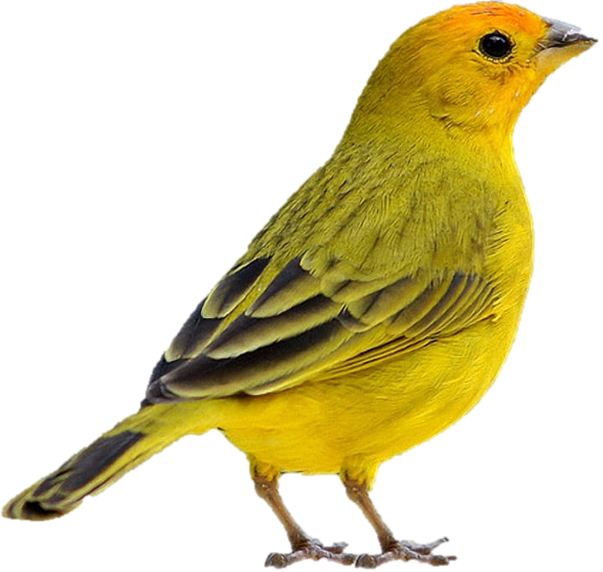
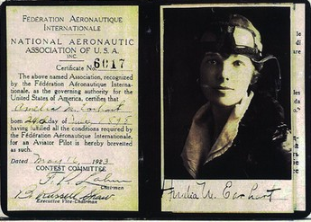
Amelia took her first flight as a passenger on 28th December 1920. This flight inspired her to become an aviator and she had her first flying lesson aged 23.
In 1921, Amelia bought her first plane. Her plane was bright yellow and nicknamed the “Canary”.
In May 1923, she got her pilot's licence. Amelia was the 16th woman in the world to earn one.

Slide 6

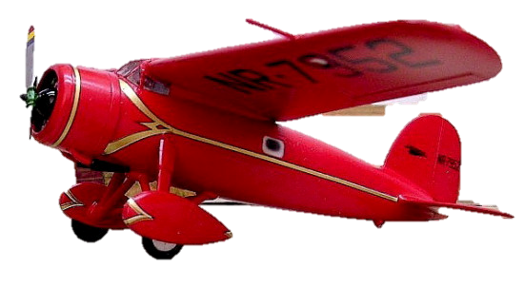
Amelia Earhart was a record breaker!
In October 1922, Amelia broke
the women's altitude record.
In June 1928, she became the first woman to fly across the Atlantic Ocean as a passenger, alongside two other male pilots.
In May 1932, she became the first woman to fly solo across the Atlantic Ocean. She set off from Canada and landed in Ireland.

Slide 7
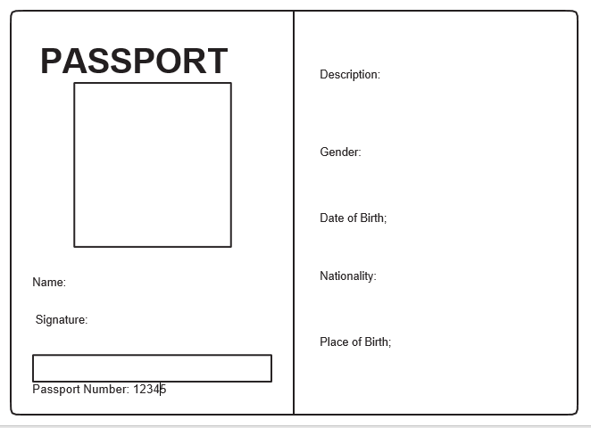
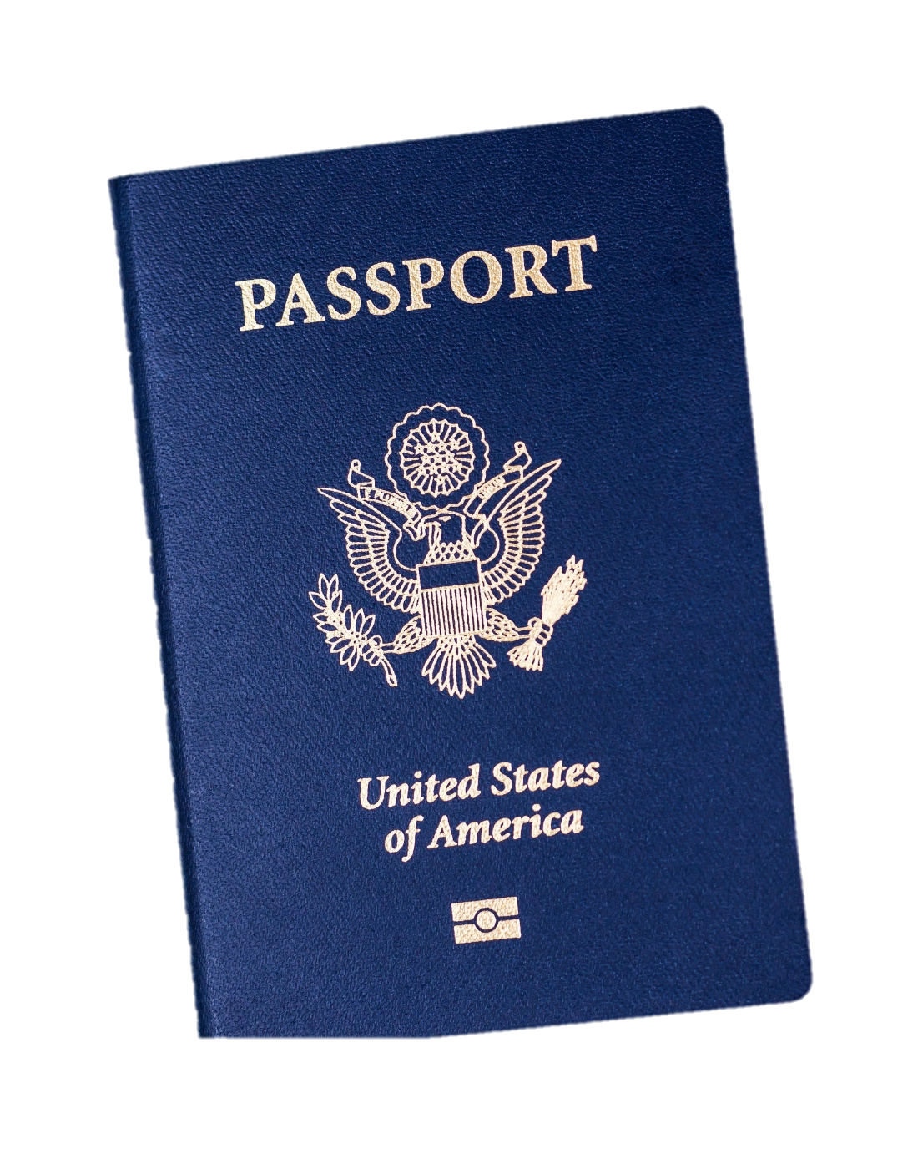
Activity
Make Amelia Earhart a passport.

Slide 8


