Slide 1
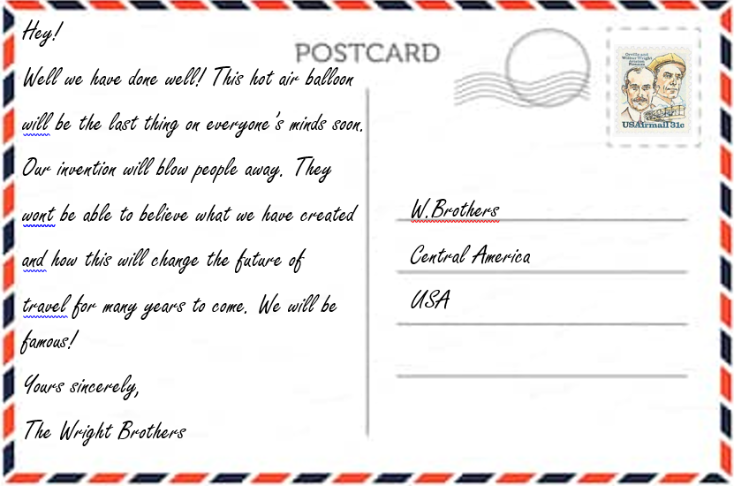

Slide 2
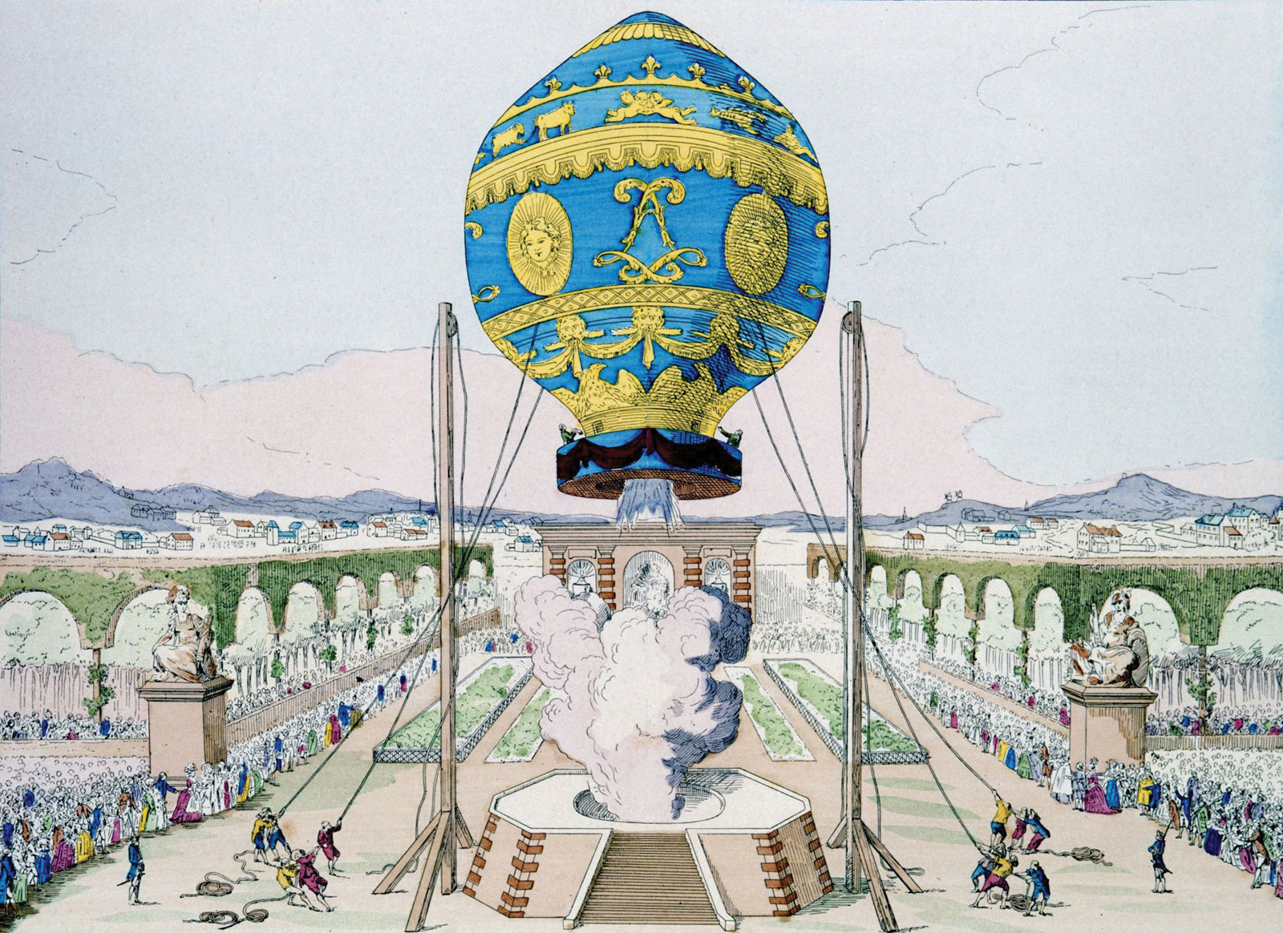

What did we learn about last week?

Slide 3


What other ways can we fly?
Think Pair Share

Slide 4
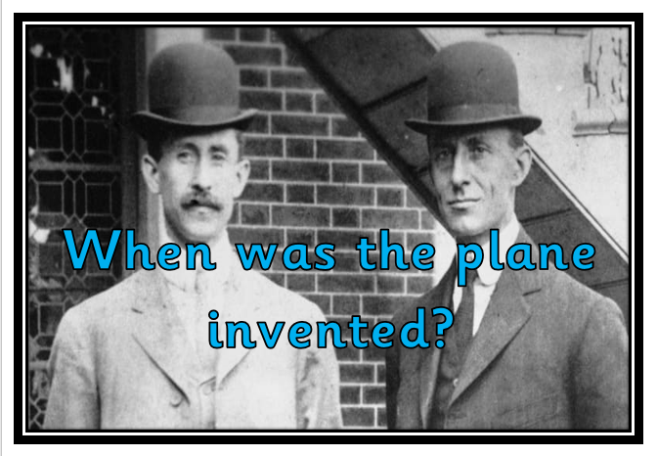
Today we are going to be answering the question

Slide 5
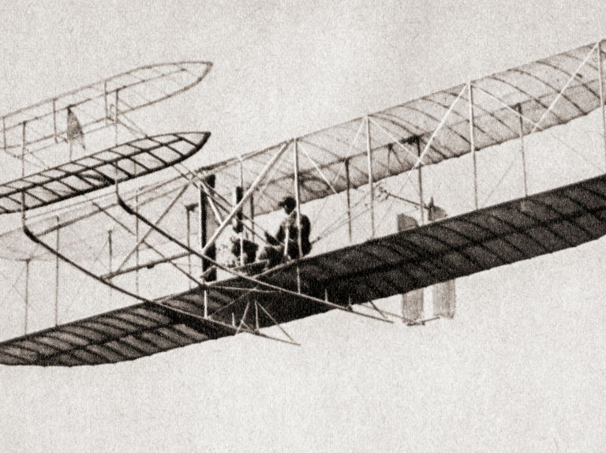
https://www.youtube.com/watch?v=MaUYLZsOA9Q
Notes:
https://www.youtube.com/watch?v=MaUYLZsOA9Q

Slide 6
What happened in the video?
Can you remember any facts?
Notes:
https://www.youtube.com/watch?v=MaUYLZsOA9Q

Slide 7
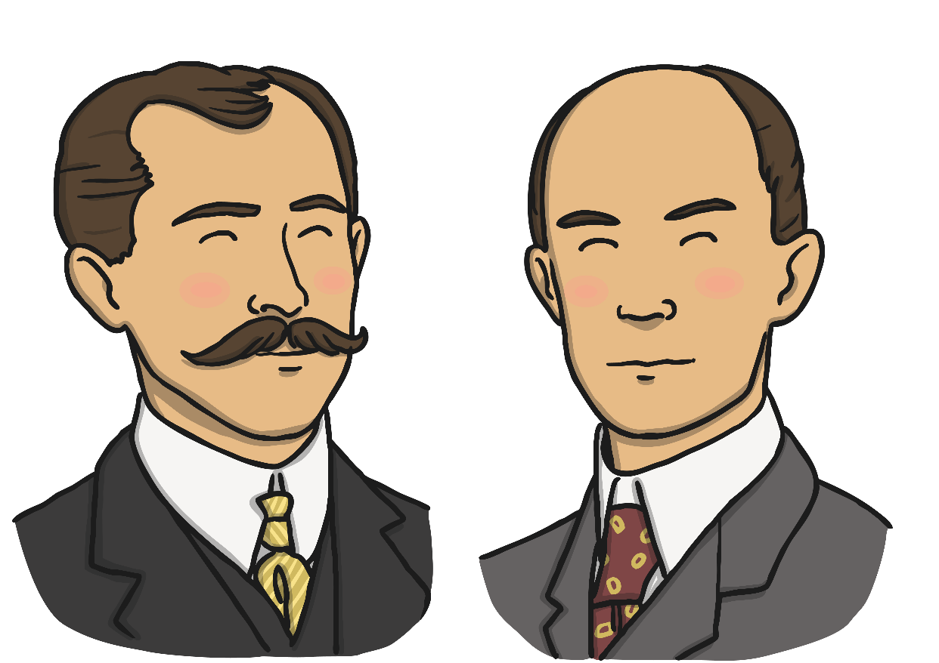
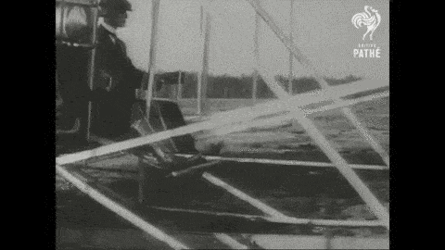
The Wright brothers
Orville and Wilbur Wright invented the aeroplane. They called their aeroplane The Wright Flyer. This was a huge milestone in the world of international transportation.

Slide 8
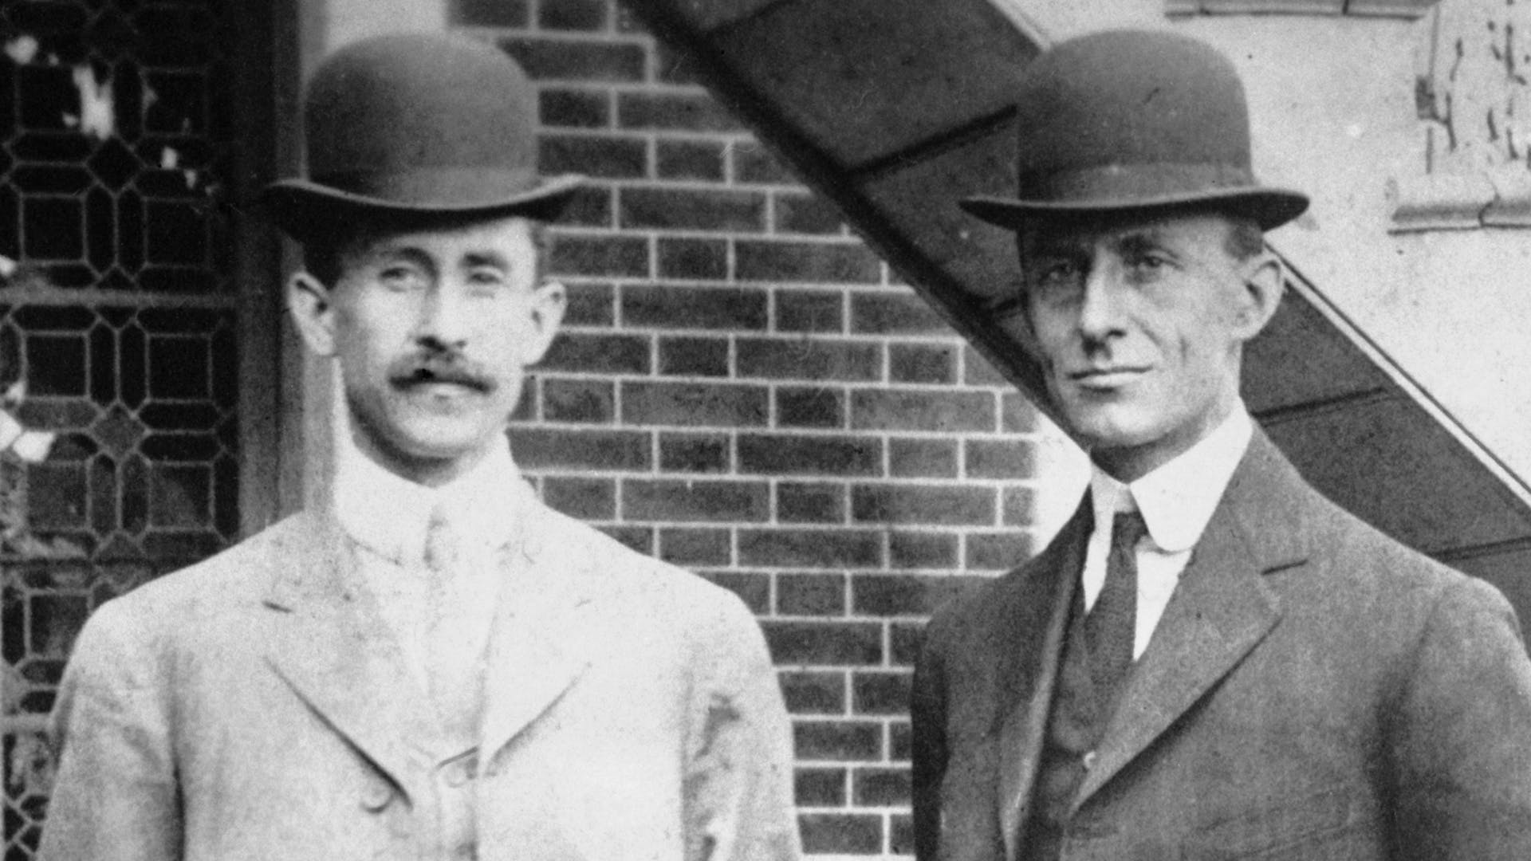
The Wright brothers
The Wright brothers loved to think of new ideas and invent things when they were children. Their interest in flight began when their father gave them a toy helicopter that flew with the help of rubber bands. Wilbur and Orville spent time watching how birds fly. This helped them to understand how to make wings for their aircraft.
As they grew up, they found out how to make propellers. Propellers use turning blades to help a plane to move forward. The Wright brothers also learnt how to make an engine to power their plane. They made sure that it was light so that their plane could take off.

Slide 9
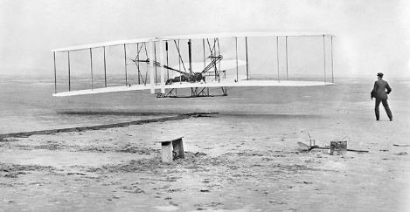
Orville Wright made the first flight in North Carolina, America in December 1903.
He flew 120 feet and the flight lasted 12 seconds.
As the day went on, both brothers had flights which lasted for increasingly longer periods of time.

Slide 10
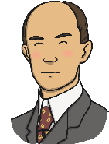

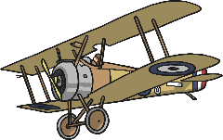
Timeline of air travel
First flight of a hot air balloon (1783)
Wilbur Wright born (1867)
First flight of an aeroplane (1903)
1700
1800
1900
2000
Orville Wright born (1871)

Slide 11
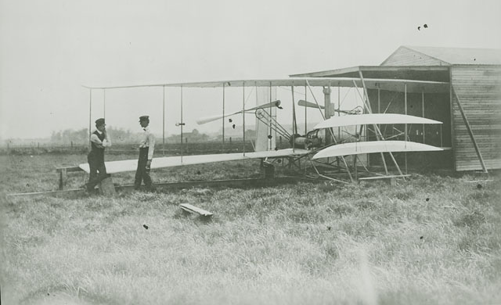
In November 1904, using a newly designed craft named Flyer II, Wilbur took to the skies.
This flight lasted for over 5 minutes.

Slide 12
Why is the first flight significant?
Today people can take trips that previously would have taken months by train or boat, now taking a few hours by plane.

Slide 13
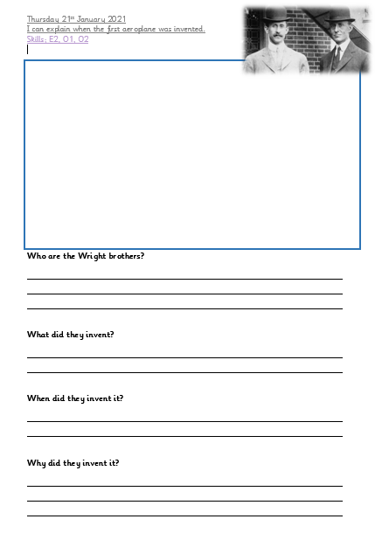

Slide 14



