Slide 1
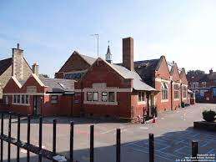
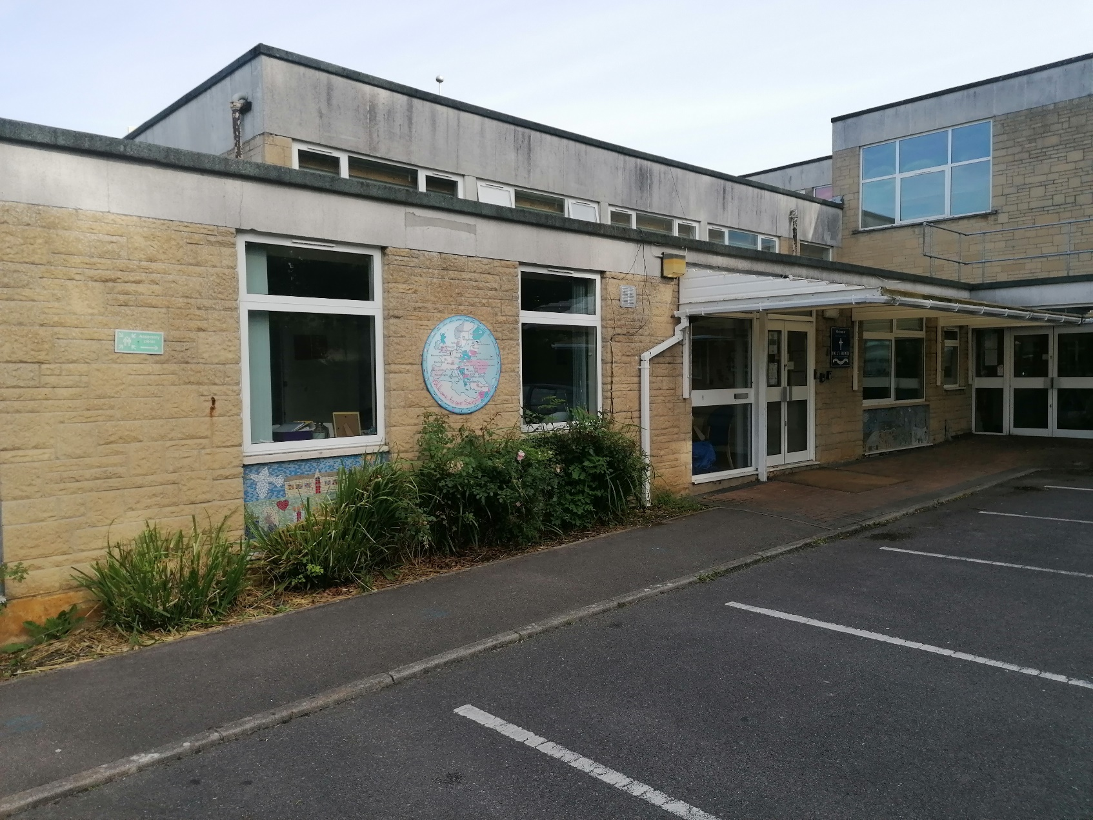
Welcome
Year 2 to Year 3 Transition Meeting
Monday 30th June 2025
Notes:
Verity
In September, your child will be moving into Year 3 (Key Stage 2). This is the transition from the infant part of the school to the juniors.
As your child moves into Year 3 there are some changes we need to make you aware of…

Slide 2

Prayer
God of Wisdom, we thank you for all the gifts you have given us throughout this school year. We praise you for giving us life, for saving us in Christ, and for choosing us to be your people.
As we come to the end of this school year, we voice our gratitude for the good things you have done in us, and we praise you for all who have shared in the work of this school.
Amen
Notes:
Verity

Slide 3
Staff
Miss Glennon- Year 2 class teacher and Key Stage 1 manager
Mrs Mendham- Year 2 class teacher
Miss Foy- Year 3 class teacher and Lower Key Stage 2 manager
Miss Tucker- Year 3 class teacher
Notes:
Verity

Slide 4
Key Information
• Welcome and staff introduction
• About our school
• What to expect
• A day in the life of Year 3
• A message from our Year 3 pupils
• Exciting opportunities in Year 3
• How to prepare your child for Year 3
• Questions
Notes:
Verity

Slide 5
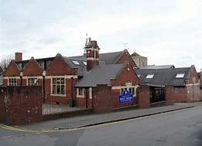
Holy Rood Catholic Primary School
Groundwell Road – Infant site
Reception, Year 1 and Year 2
Key Stage 1
Upham Road – Junior site
Year 3 & Year 4
Lower Key Stage 2
Year 5 and Year 6
Upper Key Stage 2
Key Stage 2
Your child has finished Key Stage 1 (infants)
Now your child will enter Key Stage 2 (juniors) which will take them through to secondary school
Notes:
Verity

Slide 6

What to expect
What is my classroom like?
Do we have a computing suite?
Will I go to mass in church?
Do we have a library?
What is the playground like?
Notes:
Verity

Slide 7
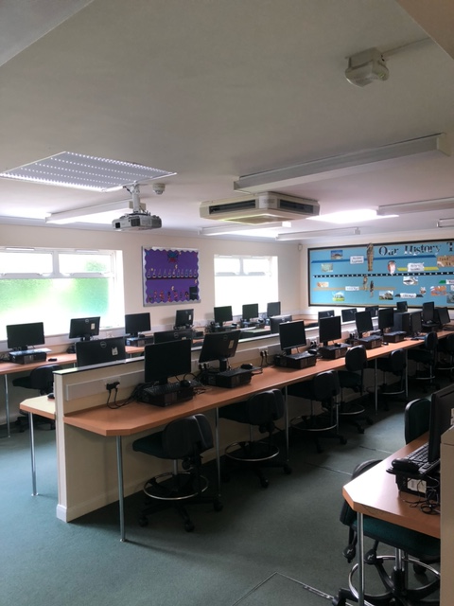
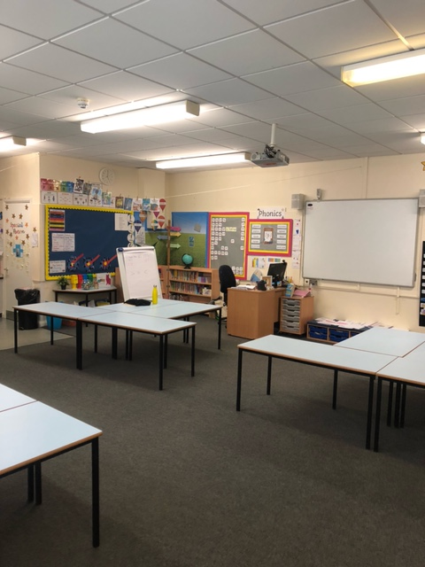
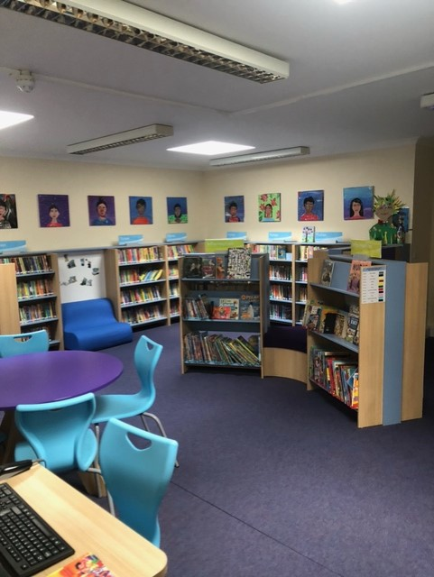
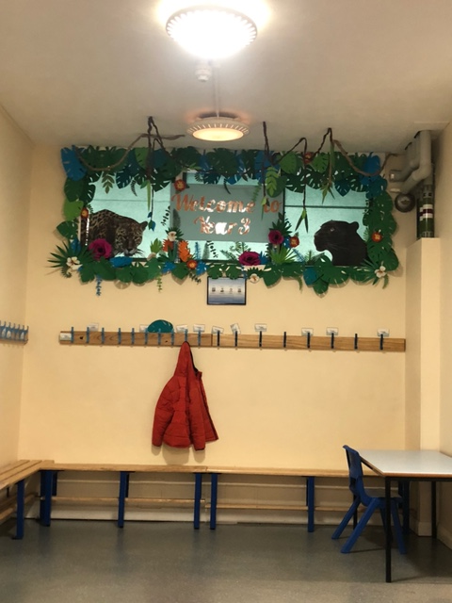
Welcoming
classrooms
Engaging library
space with
lots of
exciting books
Modern
computing
suite
Notes:
Verity

Slide 8
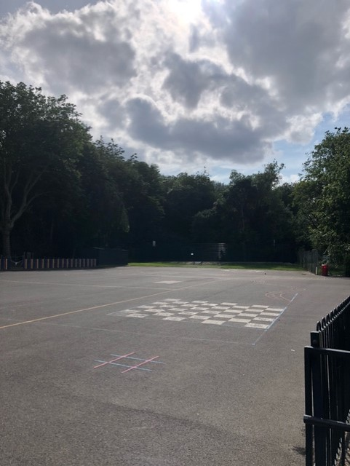
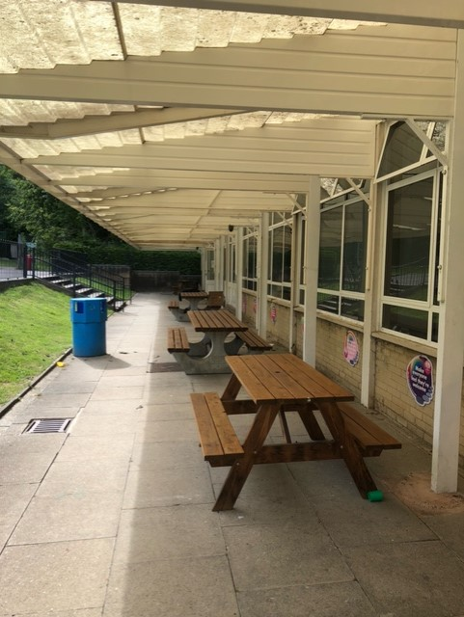
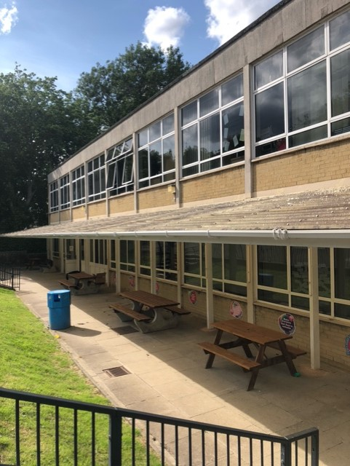
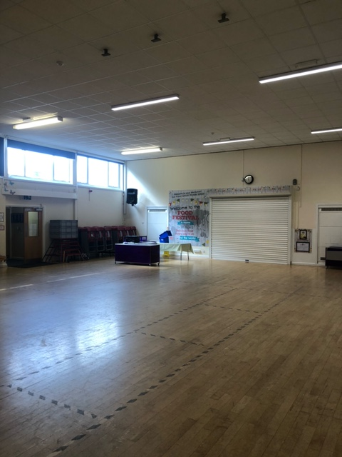
Large
school
hall
Exciting
playground
Notes:
Verity

Slide 9
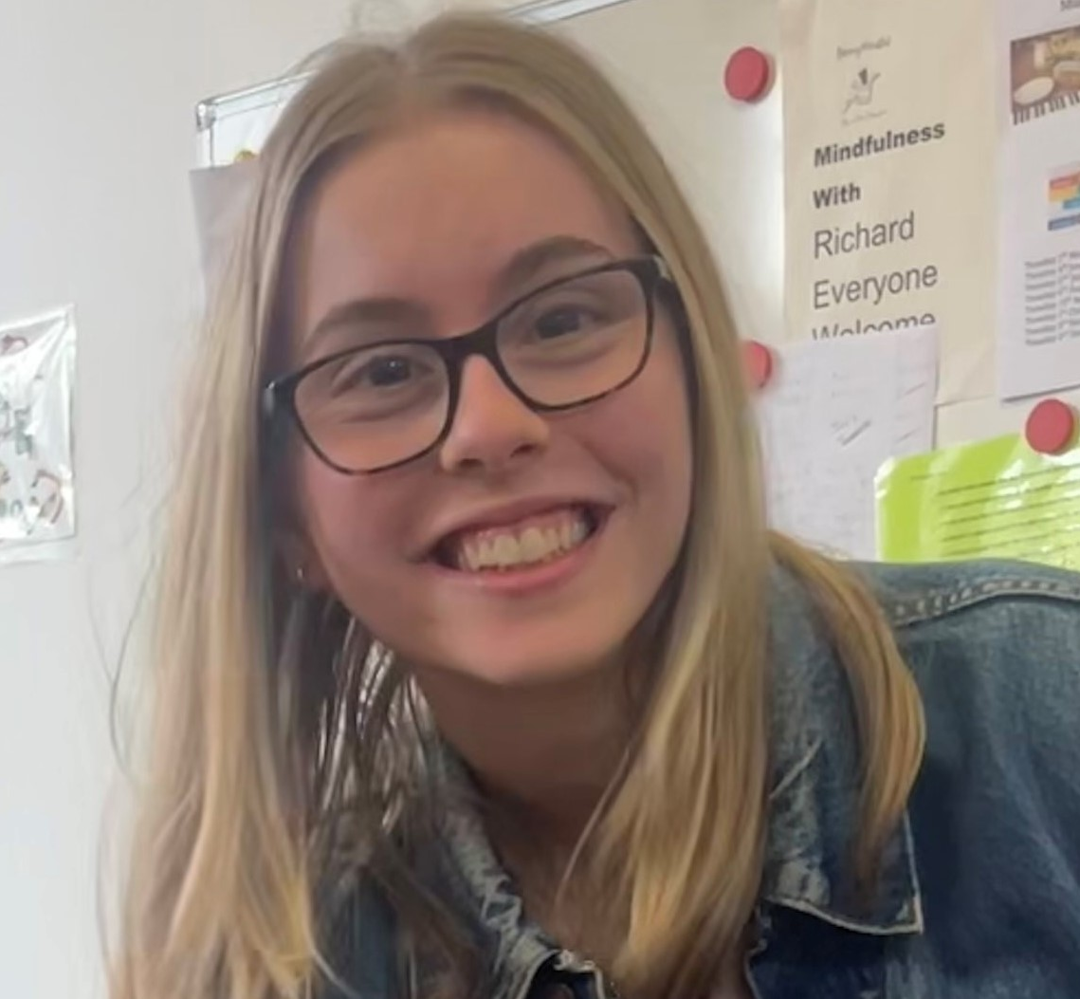
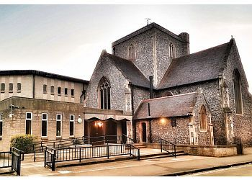
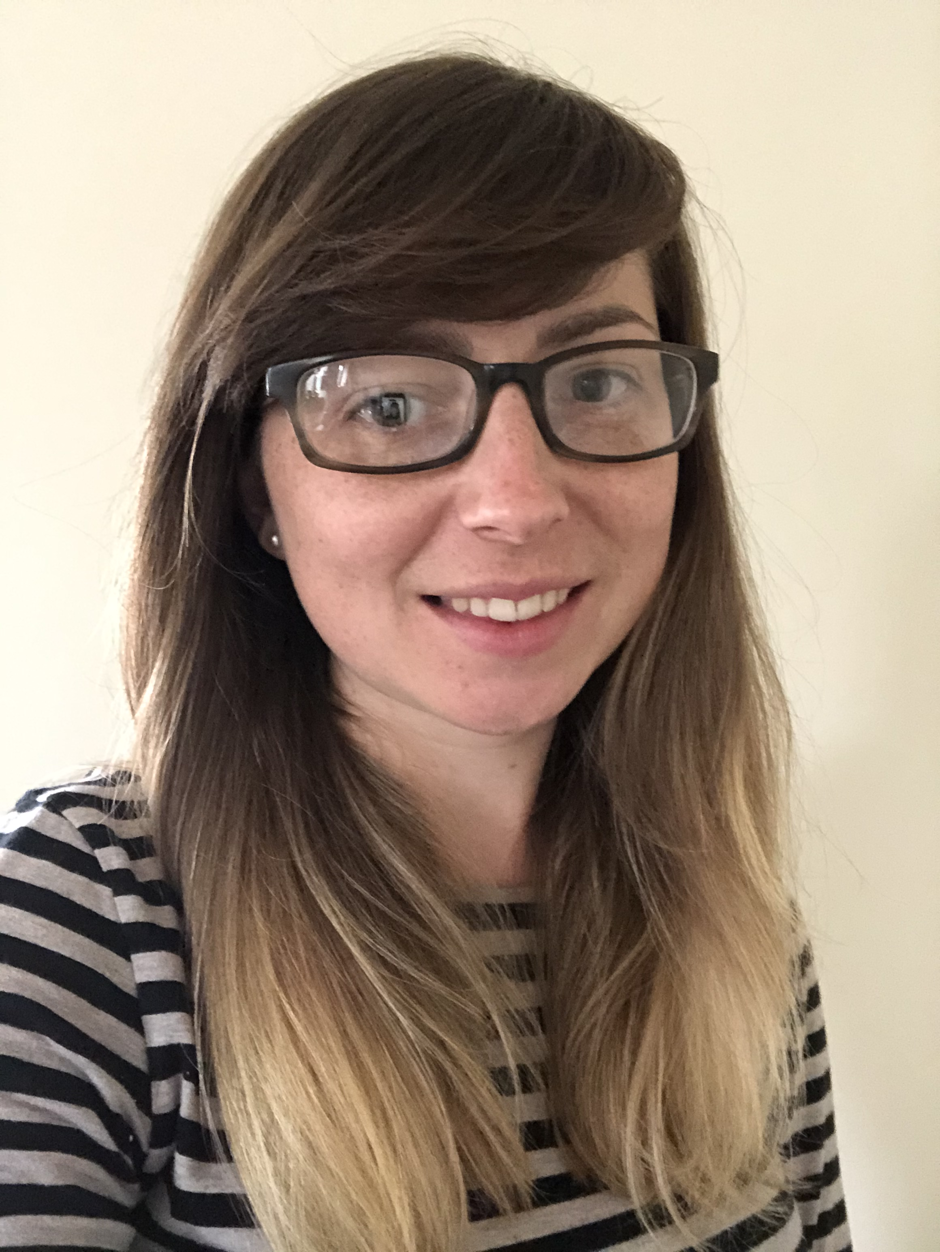
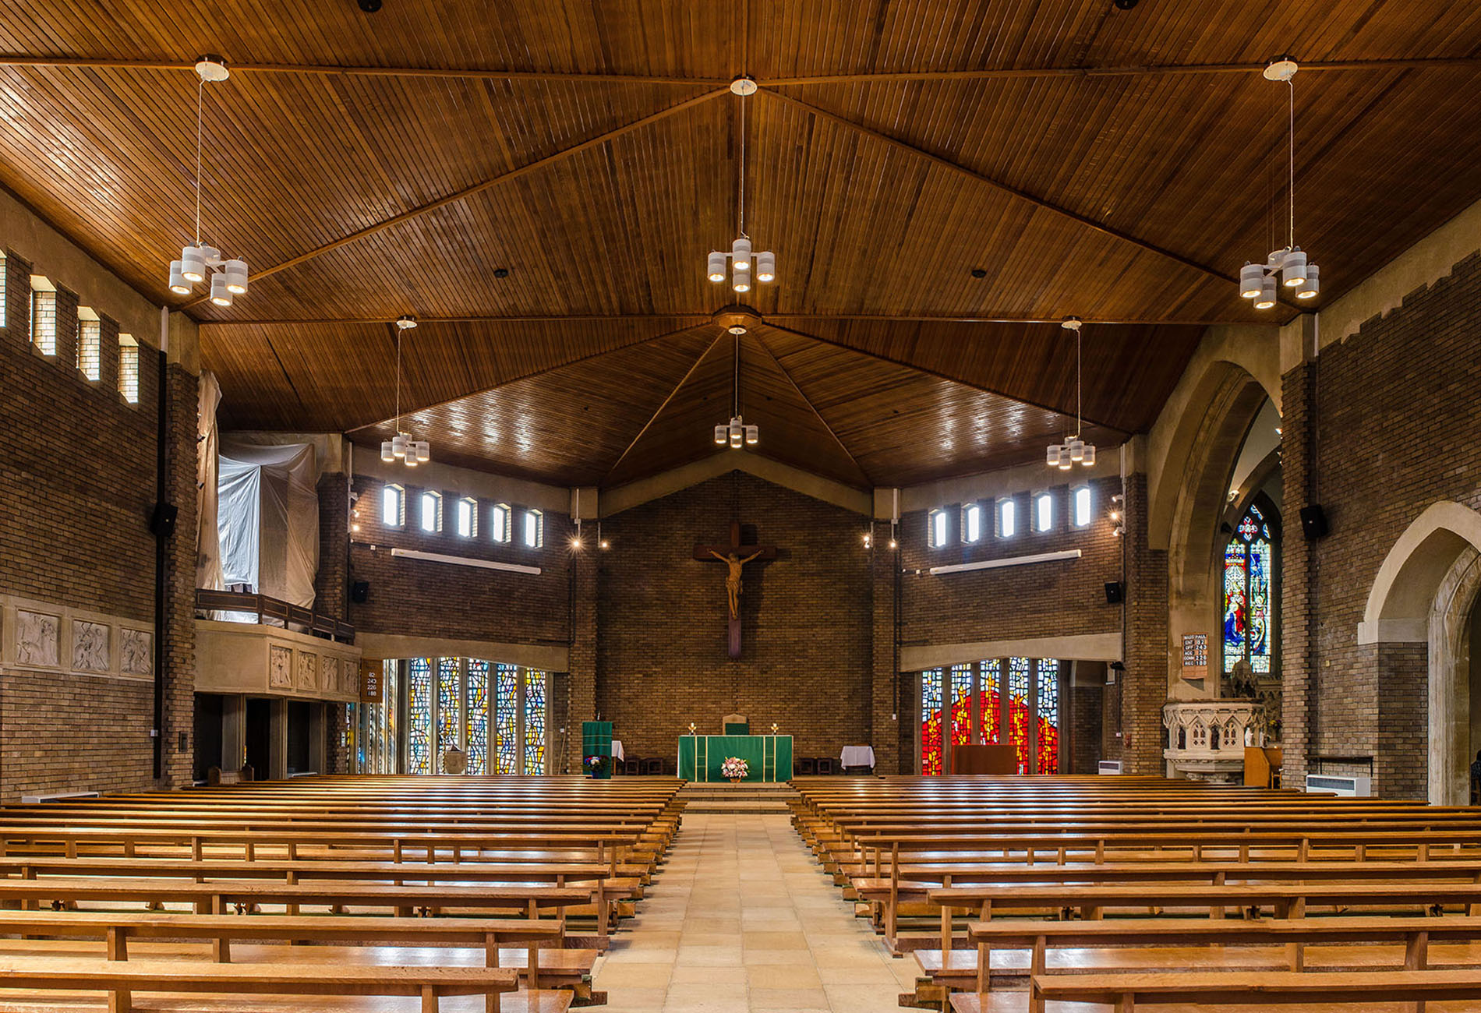
Friendly
staff
One
community
☺
Notes:
Emily

Slide 10
What’s the same?
• one school
• teachers working across both sites
• subjects (English, maths, RE, Prayer and Liturgy, science, phonics, guided reading, history, geography, computing, PE, DT, art, PSHE)
• school values and ethos
• whole school Mass
But what’s different?
Notes:
Emily

Slide 11
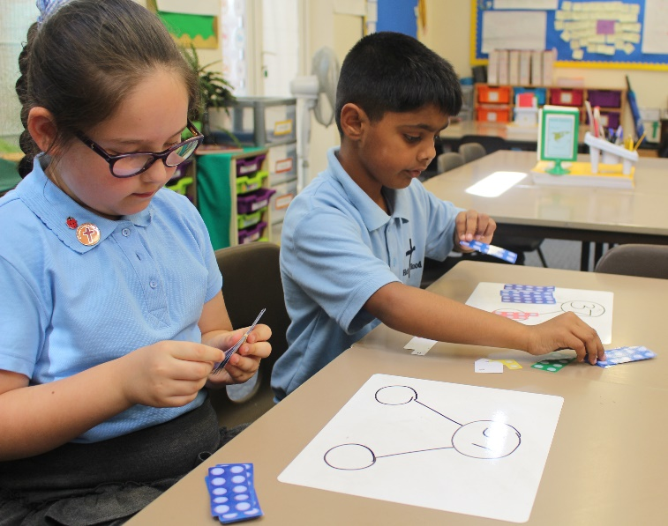
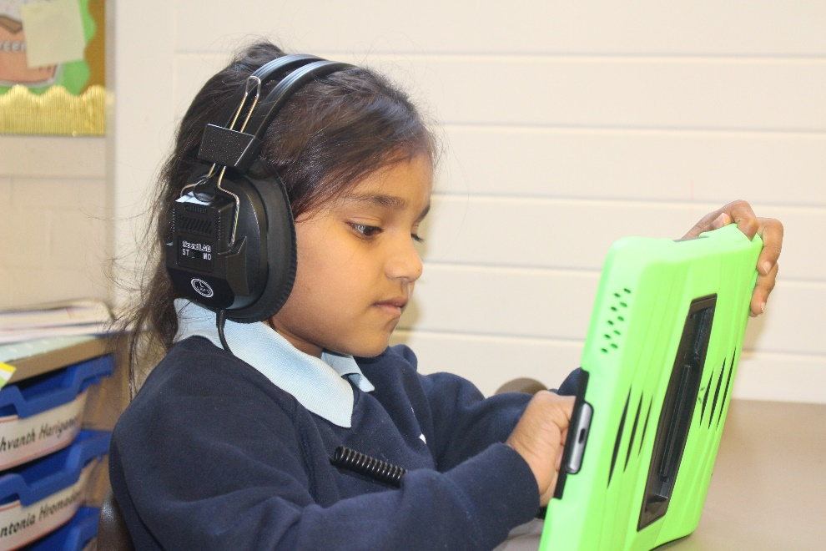

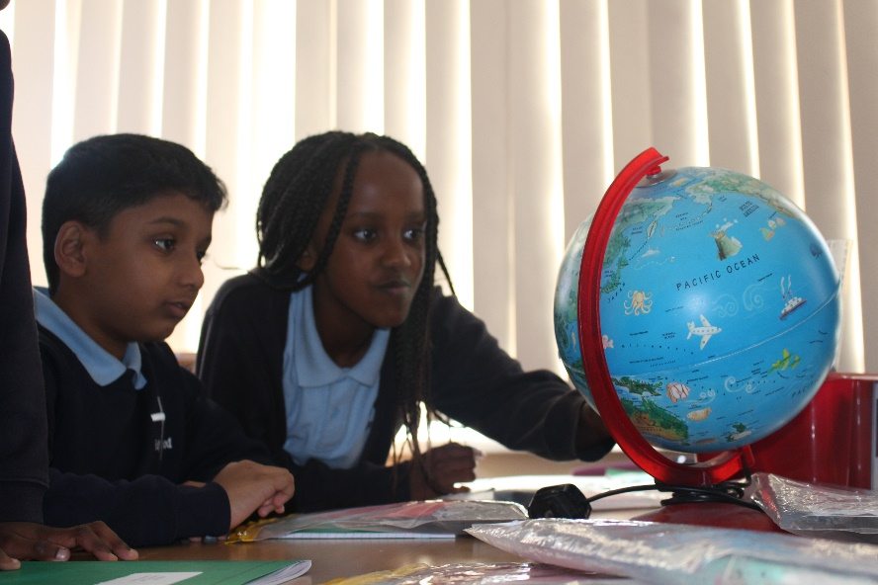
A day in the life of Year 3
8.40am
Registration
Early morning work
Prayers
9.00am – 12.30pm
Morning lessons: reading, maths, English, Maths on Track, whole class reading time
15 minute break 10.30 – 10.45am
Lunch
15 minutes outside play
30 minutes to eat
1.15pm – 3.10pm
Registration
Afternoon lessons: RE, history, geography, art, DT, PSHE, music, computing, PE, French
Notes:
Emily

Slide 12

We asked the children what they like about Year 3.
We plan our own Prayer and Liturgies to feel closer to God.
The prayer garden is nice for quiet reflection.
To help our well-being and our hearts we have the golden mile.
The tuck shop means we can choose our own snack.
Notes:
Jenna

Slide 13
We asked the children what they like about Year 3.
Swimming is an amazing life skill – splashing the teachers was also funny!
We have morning quiz books to keep our learning fresh.
There are lots of roles in KS2 such as sports leaders and Chaplains.
Our class readers are enjoyable and some are really funny stories.
Notes:
Jenna

Slide 14

What advice would the children give?
There are so many adults to help you.
The ICT suite is the best…but don’t swivel on your chairs.
Being on time helps you feel settled into routine.
The Year 4’s know how you feel, they will be your buddies.
Be CONFIDENT! You’ve got this ☺
Notes:
Jenna

Slide 15







Exciting opportunities in Year 3
Pupil Leadership
Prayer & Liturgy
French
School Mass
Trips
Swimming
Clubs
Notes:
Jenna

Slide 16
How to prepare your child for Year 3
Eating independently within a limited time
  Can your child manage their lunchbox / hot meal without adult help?
  Can your child finish their food within 30 minutes so they are not late for afternoon lessons?
Tying shoelaces (Year 2 Holy Rood 42 challenge!)
  Can your child fasten their own school shoes and PE trainers?
Managing earrings
  Can your child remove their own earrings if necessary?
Notes:
Beth

Slide 17






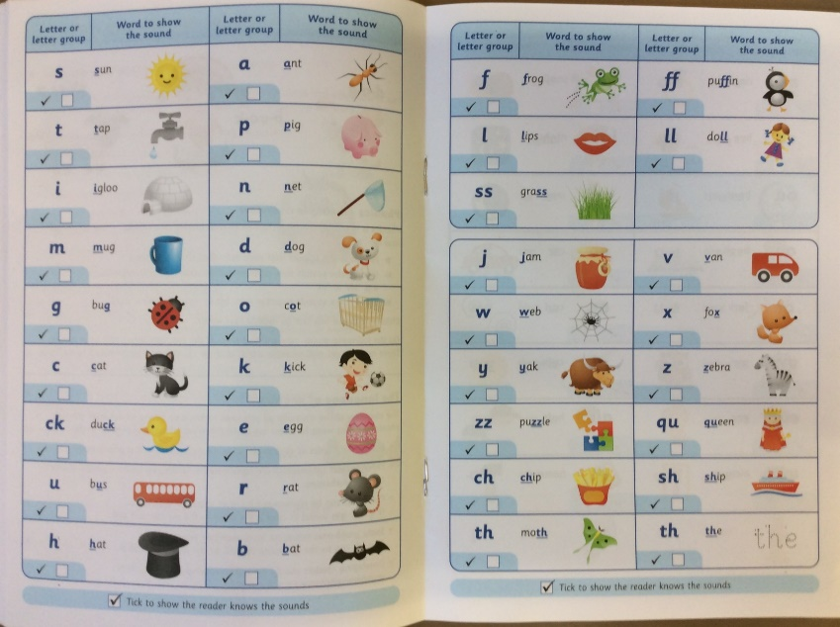



• Read, read, read!
Free eBook library | Oxford Owl from Oxford University Press
• Times Tables Rockstars
Times Tables Rock Stars: Play (ttrockstars.com)
Numbots
www.play.numbots.com
Notes:
Beth

Slide 18
Key changes
School Meals
Please remember your child’s entitlement to Universal Infant Free School Meals expired at the end of Year 2 and meals must be paid for in advance via Parent Pay, at a cost of £2.65 per meal.
If you believe you may be entitled to free school meals, due to your economic circumstances, please ensure you apply as soon as possible. Please contact the school office for more information.
Snack
Key Stage 2 children are not entitled to free fruit at break time. Please provide your child with a healthy snack from home eg. Fruit, raisins, vegetable sticks (not crisps or chocolate covered cereal bars). Alternatively, we also have a 50p tuck shop.
Notes:
Beth

Slide 19
Parent Welcome Evening – September 2025
There will be a Parent Welcome Evening in September – date to be confirmed.
We will give you detailed information about:
  homework
  reading records
  arrangements for swimming
It is important that you attend this meeting.
Notes:
Emily

Slide 20
Thank you for your time this afternoon.
If you have any questions, please don’t hesitate to ask us or contact the
school office on 01793 523802
Notes:
Emily

