Slide 1
Birds and reptiles
Week 6

Slide 2
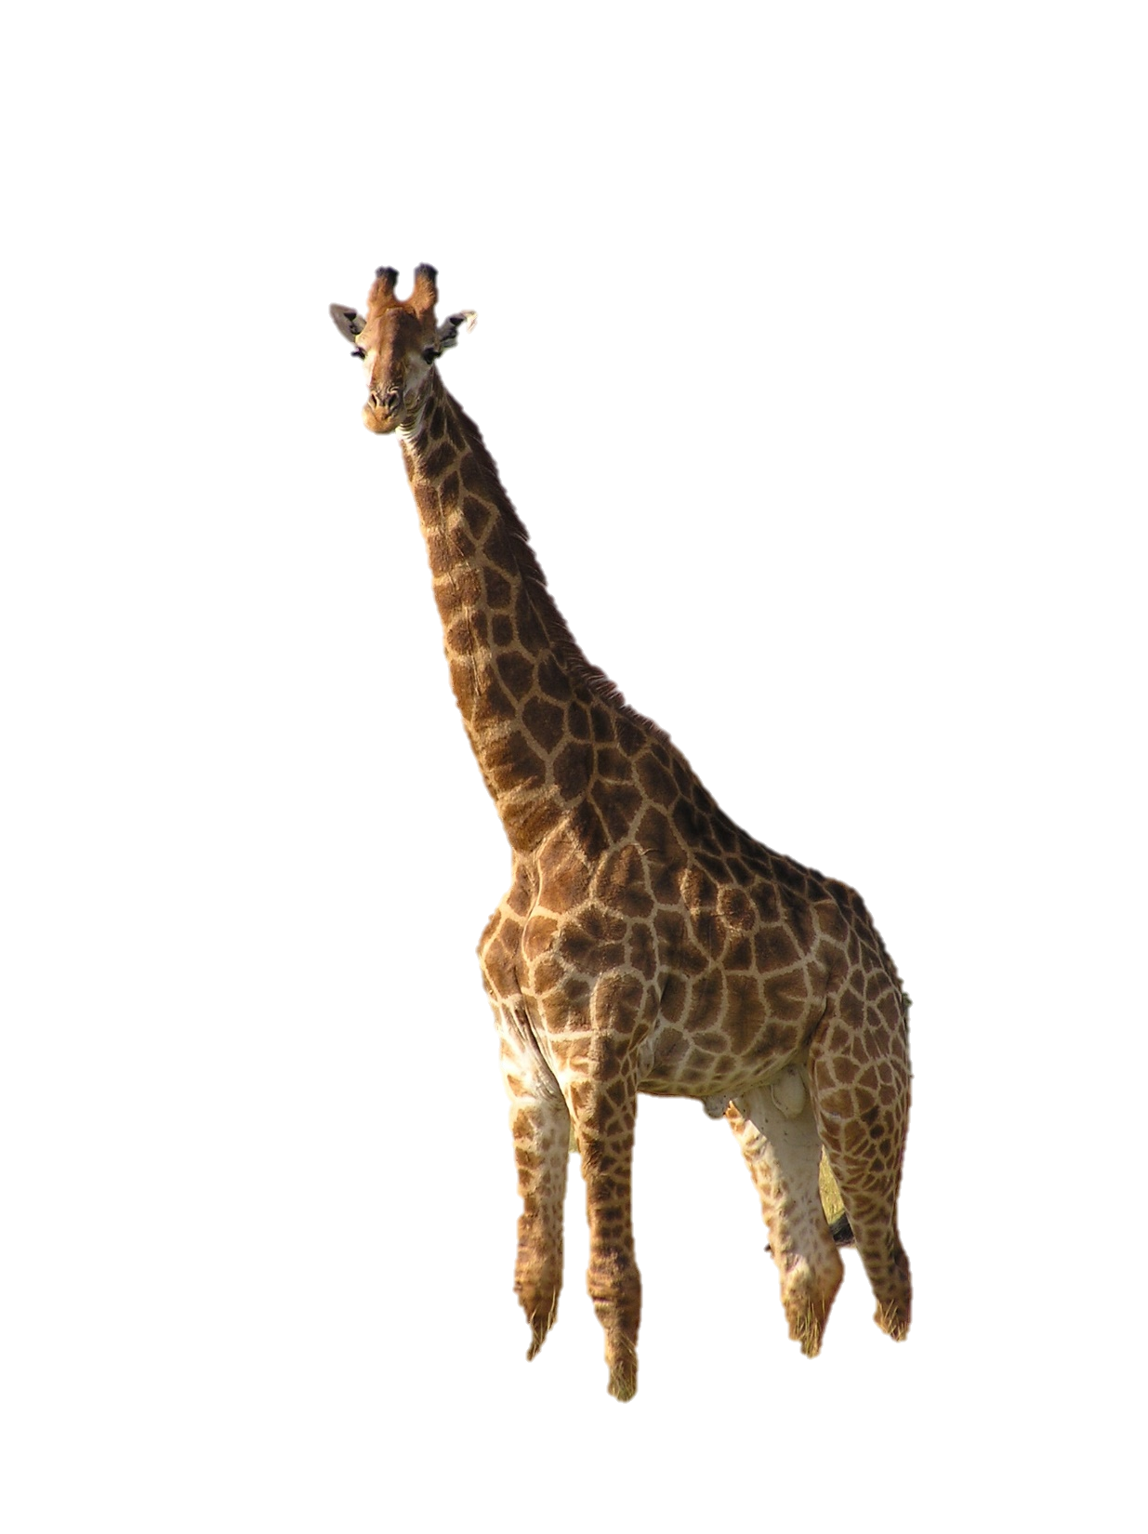
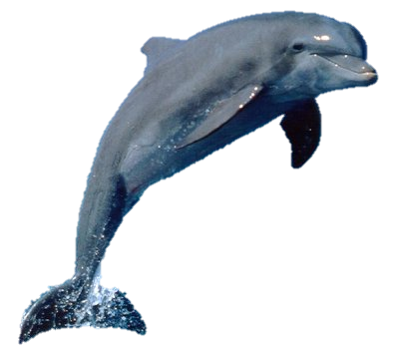
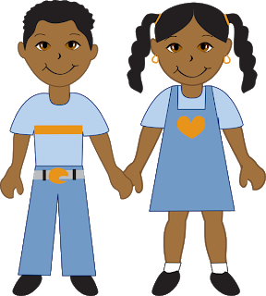
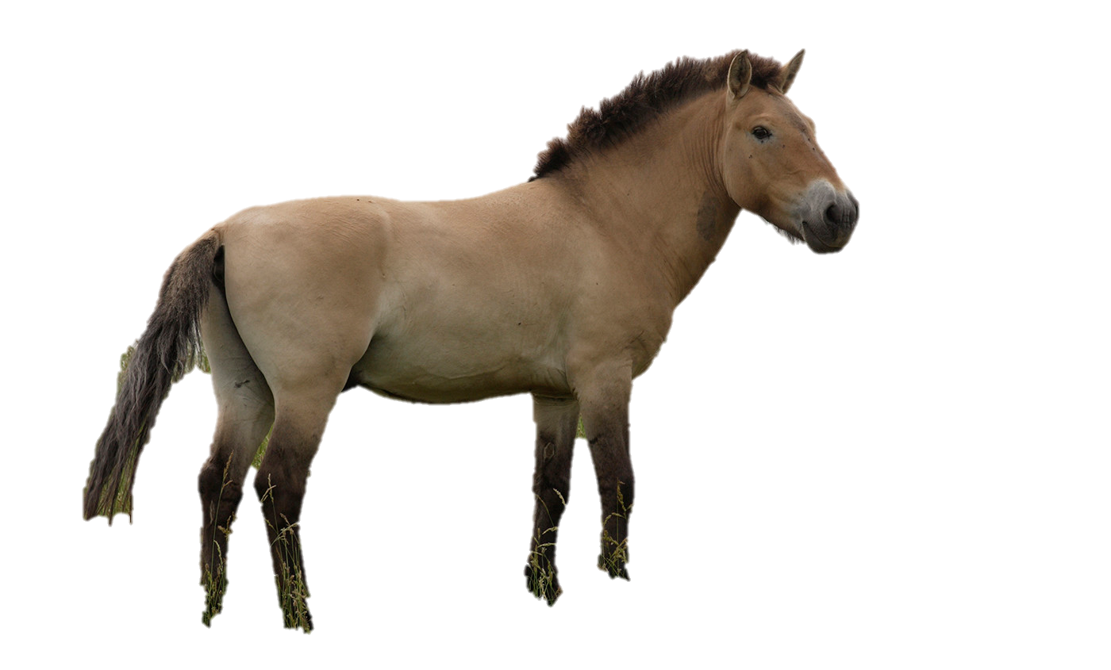
What do we remember about mammals?
Warm-blooded
Hair or fur
Feed their young with their own milk.
Vertebrates
Give birth to their young.
Which other mammals can you remember?

Slide 3
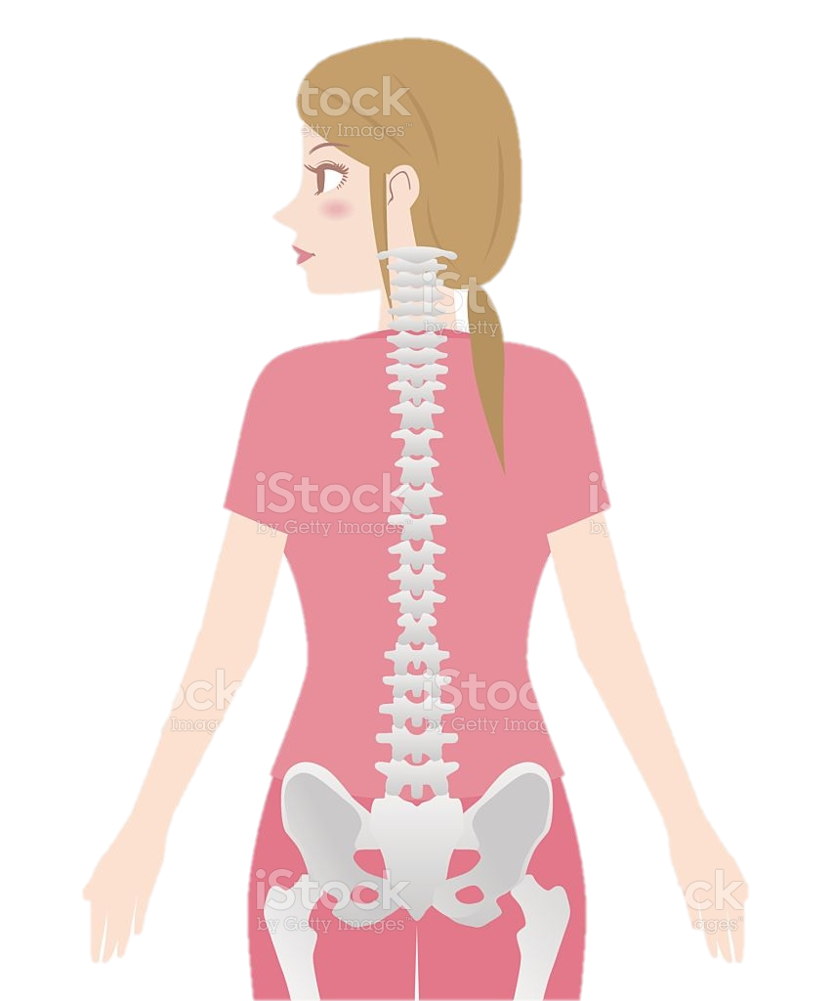

What is a vertebrate?
Talk about it…

Slide 4
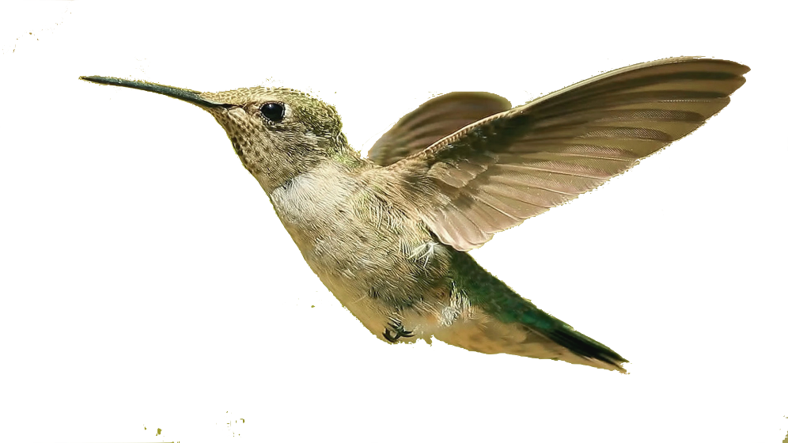
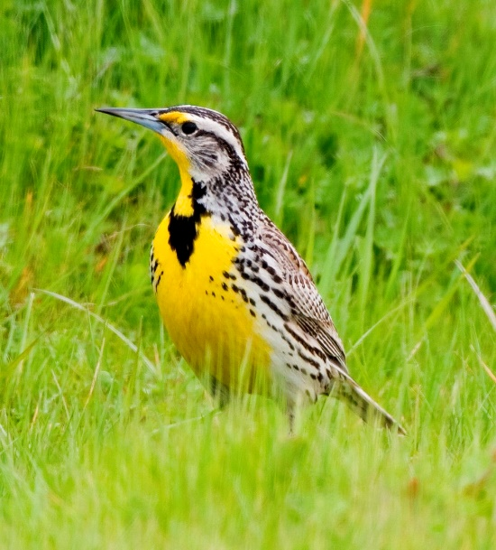
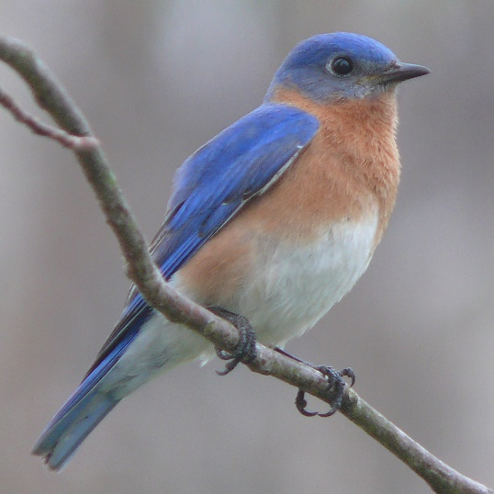
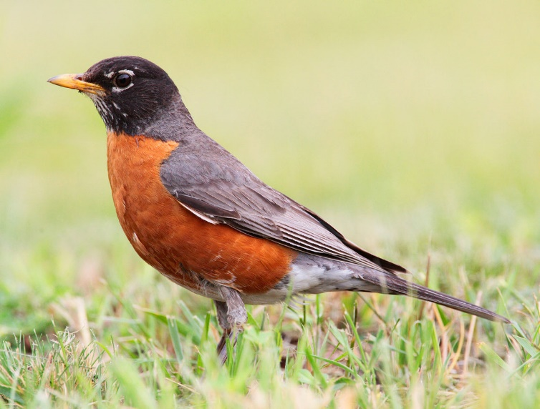
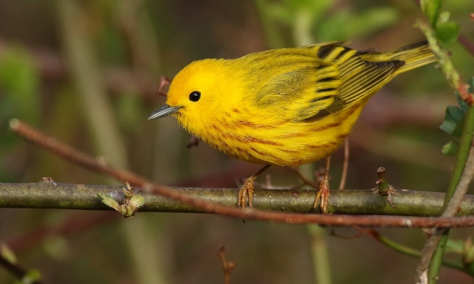
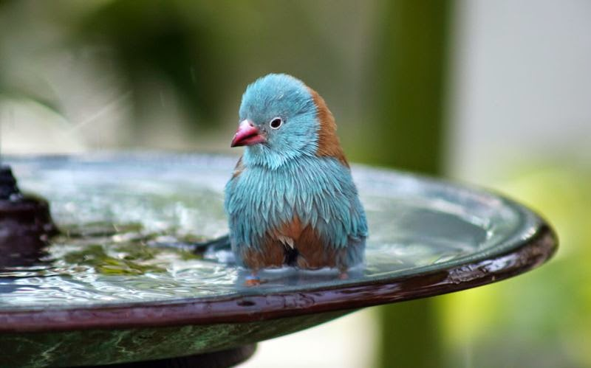
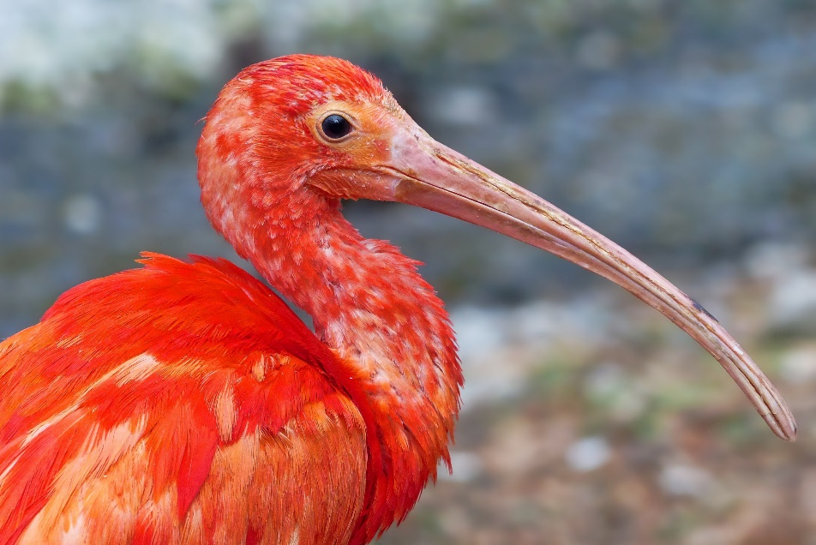
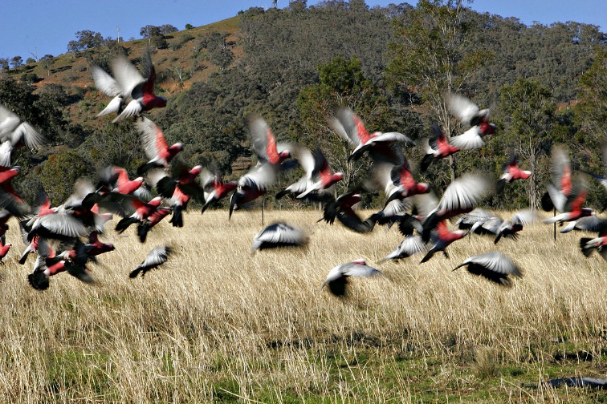
Vertebrates
Beak
Warm-blooded
Feathers
Birds
What do you remember about birds?
Tell your partner.
Wings
Lays eggs

Slide 5
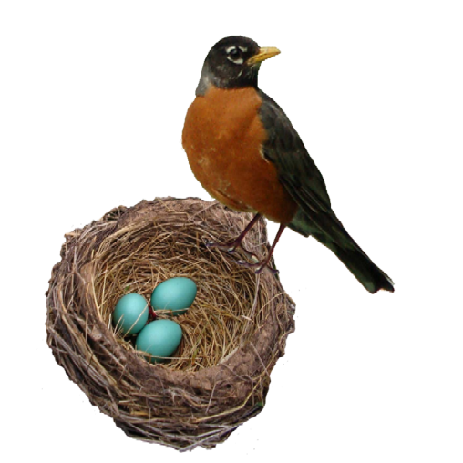
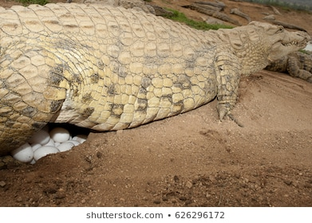

Is this a bird?
What do you notice?

Slide 6
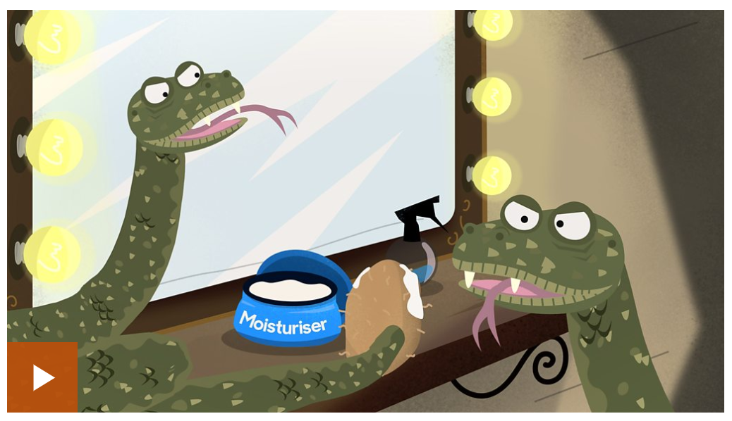

Slide 7
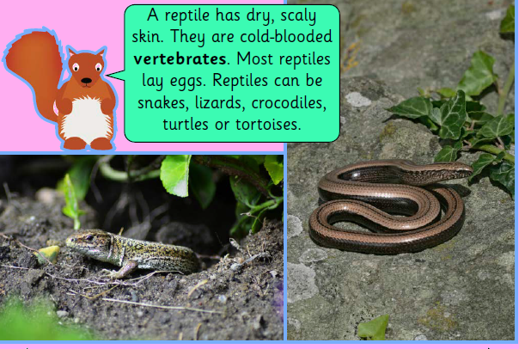

Slide 8

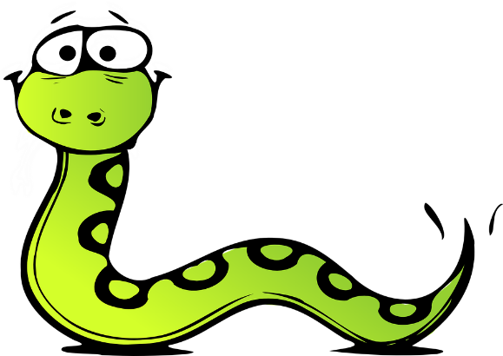
Birds and reptiles
Both reptiles and birds lay eggs.
Birds eat insects. So do most reptiles.
Reptiles also eat other form of animal life such as birds, amphibians and also other mammals.

Slide 9
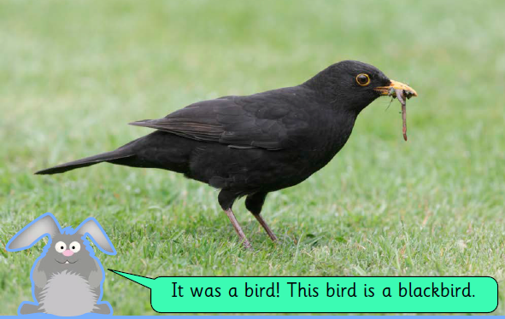
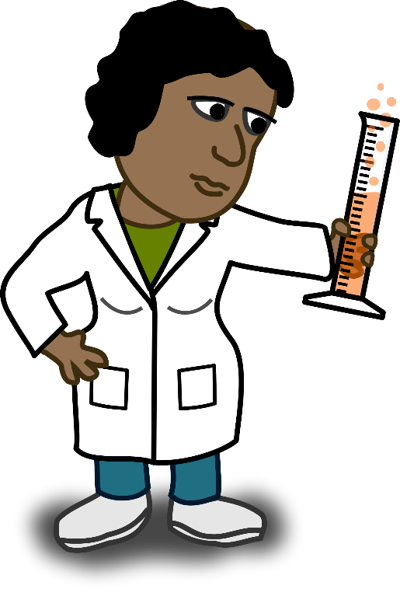
Bird or reptile?
It’s warm-blooded. It lays eggs. It has feathers and it loves to eat insects and worms.

Slide 10
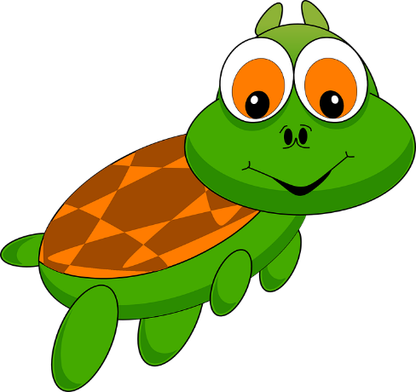
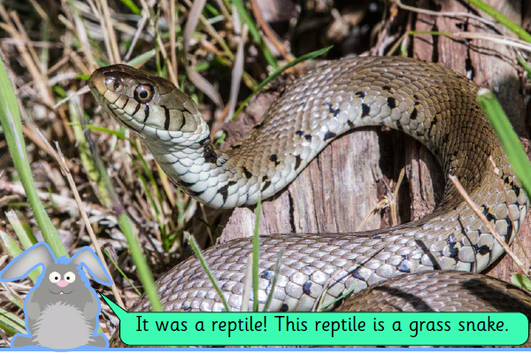
Bird or reptile?
It’s cold-blooded. It lays eggs. It has dry scales and likes to live near water.

Slide 11


