Slide 1

CEW Revisit/Teach
Revisit CEW incorrect/ tricky or commonly used.
Teach new CEW when necessary.
Phonics
Common Exception Words
Our common exception words this week are:
called
Mr. Mrs.

Slide 2



Revisit and review
Practise previously learned letters.
Practise oral blending and segmentation.
Remember…
Notes:
https://www.phonicsplay.co.uk/resources/phase/5/flashcards-time-challenge

Slide 3

Teach
Teach a new letter.
Teach blending & segmenting.
Revisit and review
Practise previously learned letters.
Practise oral blending and segmentation.
Today we are going to look at an alternative spelling for the grapheme:
ow

Slide 4

Teach
Teach a new letter.
Teach blending & segmenting.
What do you notice about where this sound comes in the word?
Revisit and review
Practise previously learned letters.
Practise oral blending and segmentation.
Let’s practise reading these ow words together.
how crown
brow now

Slide 5

Teach
Teach a new letter.
Teach blending & segmenting.
New sound- ou
Can you say our new sound?
ou
Can you notice this sound anywhere else on this slide?

Slide 6
Teach
Teach a new letter.
Teach blending & segmenting.
New sound- ou
shout
Where would the sound buttons go?

Slide 7

Teach
Teach a new letter.
Teach blending & segmenting.
New sound- ou
shout
Where would the sound buttons go?

Slide 8
Teach
Teach a new letter.
Teach blending & segmenting.
New sound- ou
around
Where would the sound buttons go?

Slide 9

Teach
Teach a new letter.
Teach blending & segmenting.
New sound- ou
around
Where would the sound buttons go?

Slide 10
Teach
Teach a new letter.
Teach blending & segmenting.
New sound- ou
cloud
Where would the sound buttons go?

Slide 11

Teach
Teach a new letter.
Teach blending & segmenting.
New sound- ou
cloud
Where would the sound buttons go?

Slide 12
Teach
Teach a new letter.
Teach blending & segmenting.
New sound- ou
proud
Where would the sound buttons go?

Slide 13

Teach
Teach a new letter.
Teach blending & segmenting.
New sound- ou
proud
Where would the sound buttons go?

Slide 14
Teach
Teach a new letter.
Teach blending & segmenting.
New sound- ou
out
Where would the sound buttons go?

Slide 15

Teach
Teach a new letter.
Teach blending & segmenting.
New sound- ou
out
Where would the sound buttons go?

Slide 16
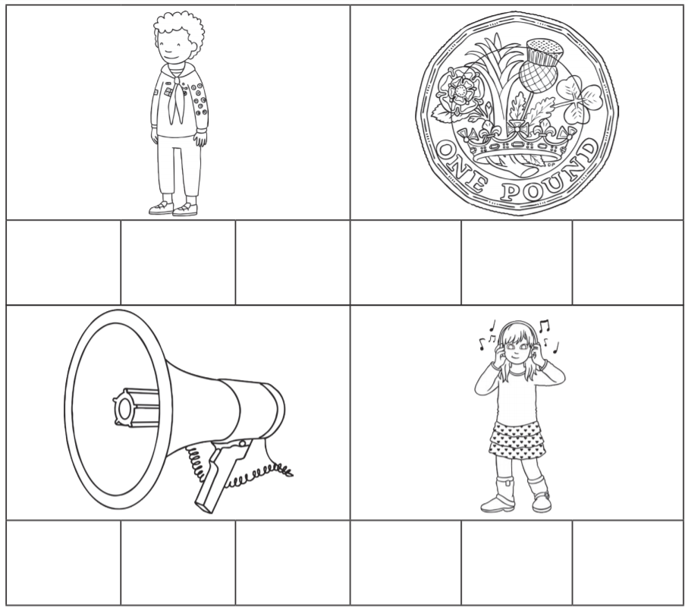
Practise
Practise reading and/or spelling words with the new letter.
New sound- ou
What could these words be?
Remember to think about our new
sound.

Slide 17
Practise
Practise reading and/or spelling words with the new letter.
New sound- ou
loud
sound
scout
pound

Slide 18

Apply
Read or write application
Include CEW in sentences.
She found a sprout in her roast.
It was the loudest sound.

