Slide 1

CEW Revisit/Teach
Revisit CEW incorrect/ tricky or commonly used.
Teach new CEW when necessary.
Phonics
Common Exception Words
Our common exception words this week are:
called
Mr. Mrs.

Slide 2



Revisit and review
Practise previously learned letters.
Practise oral blending and segmentation.
Remember…
Notes:
https://www.phonicsplay.co.uk/resources/phase/5/flashcards-time-challenge

Slide 3

Teach
Teach a new letter.
Teach blending & segmenting.
Revisit and review
Practise previously learned letters.
Practise oral blending and segmentation.
Today we are going to look at an alternative spelling for the grapheme:
oi

Slide 4

Teach
Teach a new letter.
Teach blending & segmenting.
What do you notice about where this sound comes in the word?
Revisit and review
Practise previously learned letters.
Practise oral blending and segmentation.
Let’s practise reading these oi words together.
oil coin
soil toilet

Slide 5

Teach
Teach a new letter.
Teach blending & segmenting.
New sound- oy
Can you say our new sound?
oy
As we look through these words, think about where this sound comes in the word.

Slide 6
Teach
Teach a new letter.
Teach blending & segmenting.
New sound- oy
boy
Where would the sound buttons go?

Slide 7
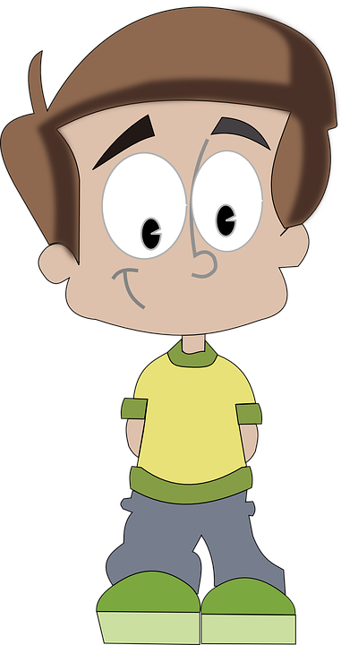
Teach
Teach a new letter.
Teach blending & segmenting.
New sound- oy
boy
Where would the sound buttons go?

Slide 8
Teach
Teach a new letter.
Teach blending & segmenting.
New sound- oy
coy
Where would the sound buttons go?

Slide 9

Teach
Teach a new letter.
Teach blending & segmenting.
New sound- oy
coy
Where would the sound buttons go?

Slide 10
Teach
Teach a new letter.
Teach blending & segmenting.
New sound- oy
soy
Where would the sound buttons go?

Slide 11

Teach
Teach a new letter.
Teach blending & segmenting.
New sound- oy
soy
Where would the sound buttons go?

Slide 12
Teach
Teach a new letter.
Teach blending & segmenting.
New sound- oy
enjoy
Where would the sound buttons go?

Slide 13

Teach
Teach a new letter.
Teach blending & segmenting.
New sound- oy
enjoy
Where would the sound buttons go?

Slide 14
Teach
Teach a new letter.
Teach blending & segmenting.
New sound- oy
toys
Where would the sound buttons go?

Slide 15
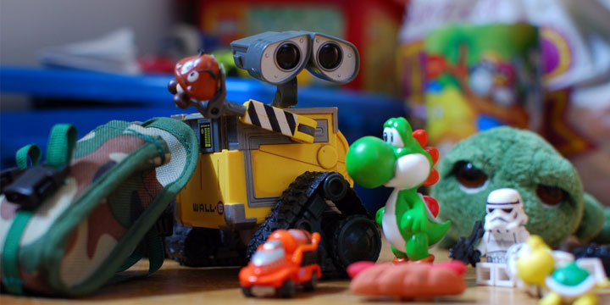
Teach
Teach a new letter.
Teach blending & segmenting.
New sound- oy
toys
Where would the sound buttons go?

Slide 16
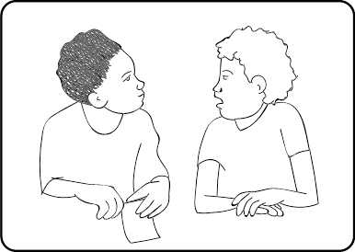
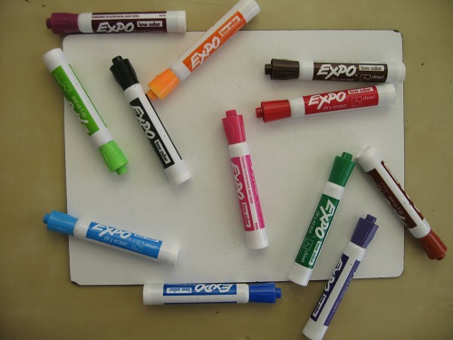
Practise
Practise reading and/or spelling words with the new letter.
New sound- oy
Write as many oy words as you can on your whiteboards. Talk to a partner to help you.

Slide 17

Apply
Read or write application
Include CEW in sentences.
I enjoy soy on my fish.
He is royal and coy.

