Slide 1

CEW Revisit/Teach
Revisit CEW incorrect/ tricky or commonly used.
Teach new CEW when necessary.
Phonics
Common Exception Words
Our common exception words this week are:
water
where
people.

Slide 2



Revisit and review
Practise previously learned letters.
Practise oral blending and segmentation.
Remember…
Notes:
https://www.phonicsplay.co.uk/resources/phase/5/flashcards-time-challenge

Slide 3

Teach
Teach a new letter.
Teach blending & segmenting.
Revisit and review
Practise previously learned letters.
Practise oral blending and segmentation.
Today we are going to look at an alternative spelling for the grapheme:
er

Slide 4

Teach
Teach a new letter.
Teach blending & segmenting.
What do you notice about where this sound comes in the word?
Revisit and review
Practise previously learned letters.
Practise oral blending and segmentation.
Let’s practise reading these er words together.
herb bigger
her stern

Slide 5

Teach
Teach a new letter.
Teach blending & segmenting.
New sound- ir
Can you say our new sound?
ir
As we look through these words, think about where this sound comes in the word.

Slide 6
Teach
Teach a new letter.
Teach blending & segmenting.
New sound- oy
girl
Where would the sound buttons go?

Slide 7
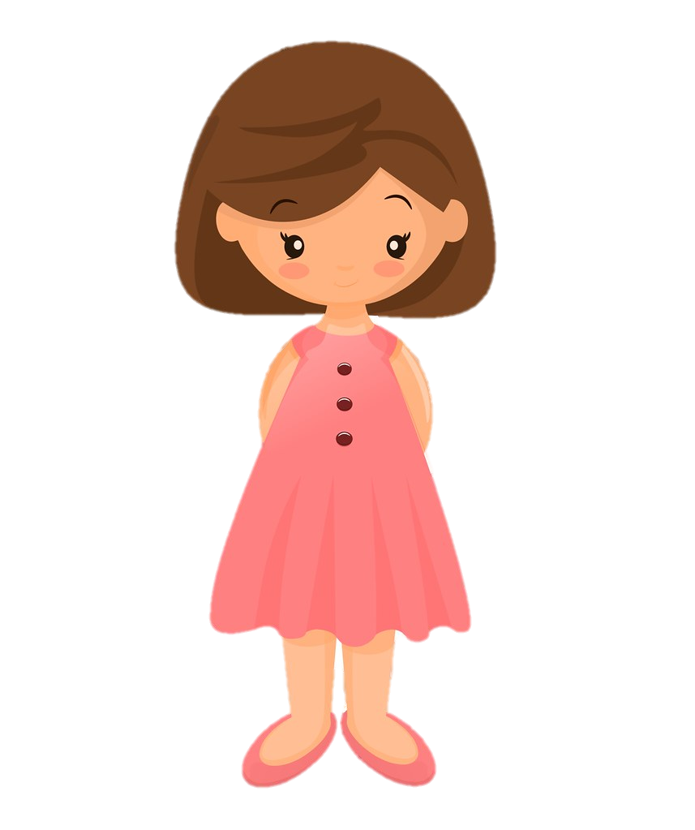
Teach
Teach a new letter.
Teach blending & segmenting.
New sound- ir
girl
Where would the sound buttons go?

Slide 8
Teach
Teach a new letter.
Teach blending & segmenting.
New sound- ir
shirt
Where would the sound buttons go?

Slide 9

Teach
Teach a new letter.
Teach blending & segmenting.
New sound- ir
shirt
Where would the sound buttons go?

Slide 10
Teach
Teach a new letter.
Teach blending & segmenting.
New sound- ir
bird
Where would the sound buttons go?

Slide 11

Teach
Teach a new letter.
Teach blending & segmenting.
New sound- ir
bird
Where would the sound buttons go?

Slide 12
Teach
Teach a new letter.
Teach blending & segmenting.
New sound- ir
thirteen
Where would the sound buttons go?

Slide 13
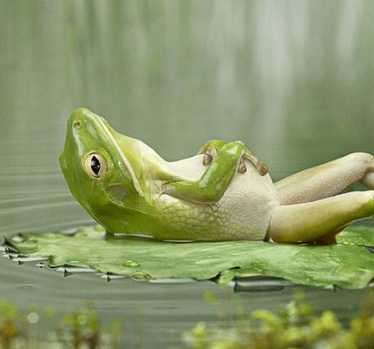
Teach
Teach a new letter.
Teach blending & segmenting.
New sound- ir
thirteen
Where would the sound buttons go?

Slide 14
Practise
Practise reading and/or spelling words with the new letter.
New sound- ir
In a race, if you come after second, you come ________.
Mary and Joseph were in a stable for the _________ of Jesus.
A _______ has feathers and lays eggs.

Slide 15
Practise
Practise reading and/or spelling words with the new letter.
New sound- ir
In a race, if you come after second, you come ________.
Mary and Joseph were in a stable for the _________ of Jesus.
A _______ has feathers and lays eggs.
third
birth
bird

Slide 16

Apply
Read or write application
Include CEW in sentences.
It was the first day of the week.
Her skirt is pink and his shirt is yellow.

