Slide 1

CEW Revisit/Teach
Revisit CEW incorrect/ tricky or commonly used.
Teach new CEW when necessary.
Phonics
Common Exception Words
Our common exception words this week are:
water
where
people

Slide 2



Revisit and review
Practise previously learned letters.
Practise oral blending and segmentation.
Remember…
Notes:
https://www.phonicsplay.co.uk/resources/phase/5/flashcards-time-challenge

Slide 3

Teach
Teach a new letter.
Teach blending & segmenting.
Revisit and review
Practise previously learned letters.
Practise oral blending and segmentation.
Today we are going to look at an alternative spelling for the grapheme:
oo

Slide 4

Teach
Teach a new letter.
Teach blending & segmenting.
What do you notice about where this sound comes in the word?
Revisit and review
Practise previously learned letters.
Practise oral blending and segmentation.
Let’s practise reading these oo words together.
food shoot
spoon

Slide 5

Teach
Teach a new letter.
Teach blending & segmenting.
New sound- ue
Can you say our new sound?
ue
As we look through these words, think about where this sound comes in the word.

Slide 6
Teach
Teach a new letter.
Teach blending & segmenting.
New sound- ue
blue
Where would the sound buttons go?

Slide 7

Teach
Teach a new letter.
Teach blending & segmenting.
New sound- ue
blue
Where would the sound buttons go?

Slide 8
Teach
Teach a new letter.
Teach blending & segmenting.
New sound- ue
clue
Where would the sound buttons go?

Slide 9

Teach
Teach a new letter.
Teach blending & segmenting.
New sound- ue
clue
Where would the sound buttons go?

Slide 10
Teach
Teach a new letter.
Teach blending & segmenting.
New sound- ue
glue
Where would the sound buttons go?

Slide 11
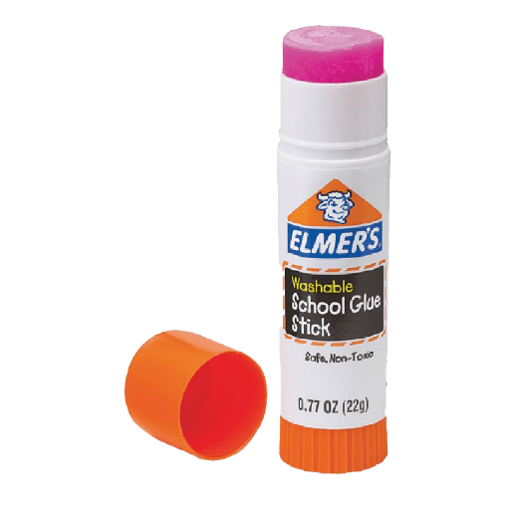
Teach
Teach a new letter.
Teach blending & segmenting.
New sound- ue
glue
Where would the sound buttons go?

Slide 12
Practise
Practise reading and/or spelling words with the new letter.
New sound- ue
I stick your sheets in your books…
I am sticky and white…
What am I?

Slide 13
Practise
Practise reading and/or spelling words with the new letter.
New sound- ue
I am the colour of the sky…
I am the colour of the sea…
What am I?

Slide 14

Apply
Read or write application
Include CEW in sentences.
The story is true.
I looked and can not see a clue.

