Slide 1

CEW Revisit/Teach
Revisit CEW incorrect/ tricky or commonly used.
Teach new CEW when necessary.
Phonics
Common Exception Words
Our common exception words this week are:
water
where
people

Slide 2



Revisit and review
Practise previously learned letters.
Practise oral blending and segmentation.
Remember…
Notes:
https://www.phonicsplay.co.uk/resources/phase/5/flashcards-time-challenge

Slide 3

Teach
Teach a new letter.
Teach blending & segmenting.
Revisit and review
Practise previously learned letters.
Practise oral blending and segmentation.
Today we are going to look at an alternative spelling for the grapheme:
f

Slide 4

What do you notice about where this sound comes in the word?
Teach
Teach a new letter.
Teach blending & segmenting.
Revisit and review
Practise previously learned letters.
Practise oral blending and segmentation.
Let’s practise reading these f words together.
fun fit
fine

Slide 5

Teach
Teach a new letter.
Teach blending & segmenting.
New sound- ph
Can you say our new sound?
ph
As we look through these words, think about where this sound comes in the word.

Slide 6
Teach
Teach a new letter.
Teach blending & segmenting.
New sound- ph
phonics
Where would the sound buttons go?

Slide 7
Teach
Teach a new letter.
Teach blending & segmenting.
New sound- ue
phonics
Where would the sound buttons go?

Slide 8
Teach
Teach a new letter.
Teach blending & segmenting.
New sound- ph
dolphin
Where would the sound buttons go?

Slide 9
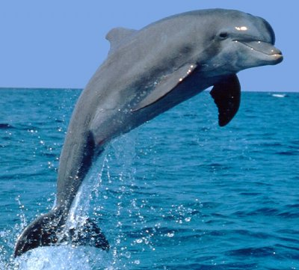
Teach
Teach a new letter.
Teach blending & segmenting.
New sound- ph
dolphin
Where would the sound buttons go?

Slide 10
Teach
Teach a new letter.
Teach blending & segmenting.
New sound- ph
elephant
Where would the sound buttons go?

Slide 11
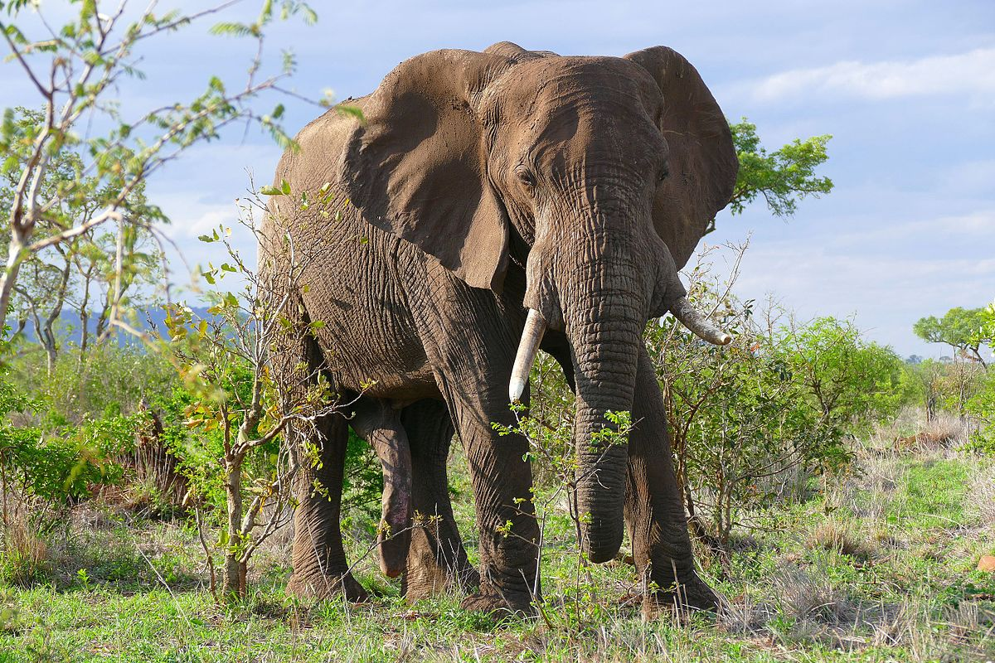
Teach
Teach a new letter.
Teach blending & segmenting.
New sound- ph
elephant
Where would the sound buttons go?

Slide 12
Practise
Practise reading and/or spelling words with the new letter.
New sound- ph
I have four legs. I have two tusks.
I am a mammal.
What am I?

Slide 13
Practise
Practise reading and/or spelling words with the new letter.
New sound- ph
I live in the sea and I am a mammal.
I like to live in a group.
What am I?

Slide 14

Apply
Read or write application
Include CEW in sentences.
Where is the dolphin in the water?
Can you see an elephant with the people?

