Slide 1

CEW Revisit/Teach
Revisit CEW incorrect/ tricky or commonly used.
Teach new CEW when necessary.
Phonics
Common Exception Words
Our common exception words this week are:
water
where
people

Slide 2



Revisit and review
Practise previously learned letters.
Practise oral blending and segmentation.
Remember…
Notes:
https://www.phonicsplay.co.uk/resources/phase/5/flashcards-time-challenge

Slide 3

Teach
Teach a new letter.
Teach blending & segmenting.
Revisit and review
Practise previously learned letters.
Practise oral blending and segmentation.
Today we are going to look at an alternative spelling for the grapheme:
w

Slide 4

What do you notice about where this sound comes in the word?
Teach
Teach a new letter.
Teach blending & segmenting.
Revisit and review
Practise previously learned letters.
Practise oral blending and segmentation.
Let’s practise reading these w words together.
win will
wicked

Slide 5

Teach
Teach a new letter.
Teach blending & segmenting.
New sound- wh
Can you say our new sound?
wh
As we look through these words, think about where this sound comes in the word.

Slide 6
Teach
Teach a new letter.
Teach blending & segmenting.
New sound- wh
whisk
Where would the sound buttons go?

Slide 7
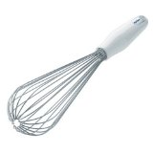
Teach
Teach a new letter.
Teach blending & segmenting.
New sound- wh
whisk
Where would the sound buttons go?

Slide 8
Teach
Teach a new letter.
Teach blending & segmenting.
New sound- wh
wheel
Where would the sound buttons go?

Slide 9
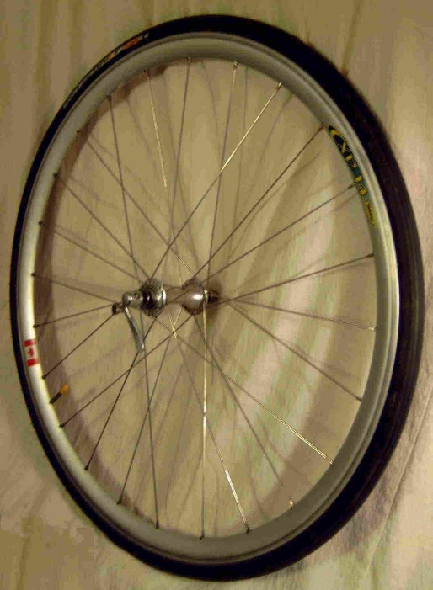
Teach
Teach a new letter.
Teach blending & segmenting.
New sound- wh
wheel
Where would the sound buttons go?

Slide 10
Teach
Teach a new letter.
Teach blending & segmenting.
New sound- wh
white
Where would the sound buttons go?

Slide 11
Teach
Teach a new letter.
Teach blending & segmenting.
New sound- wh
white
Where would the sound buttons go?

Slide 12
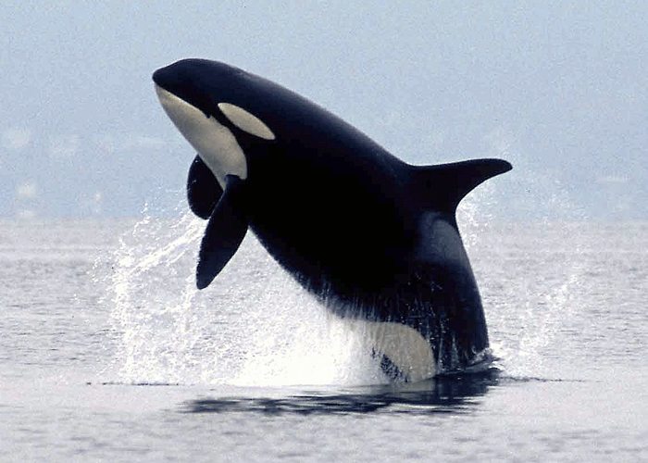
Practise
Practise reading and/or spelling words with the new letter.
New sound- wh
What could these words be?

Slide 13
Practise
Practise reading and/or spelling words with the new letter.
New sound- wh
whisk wheel whale

Slide 14

Apply
Read or write application
Include CEW in sentences.
Where is the whale in the water?
Can you see a white wheel near the people?

