Slide 1

CEW Revisit/Teach
Revisit CEW incorrect/ tricky or commonly used.
Teach new CEW when necessary.
Phonics
Common Exception Words
Our common exception words this week are:
who
work
again
oh

Slide 2



Revisit and review
Practise previously learned letters.
Practise oral blending and segmentation.
Remember…
Notes:
https://www.phonicsplay.co.uk/resources/phase/5/flashcards-time-challenge

Slide 3

Teach
Teach a new letter.
Teach blending & segmenting.
Revisit and review
Practise previously learned letters.
Practise oral blending and segmentation.
Today we are going to look at an alternative spelling for the grapheme:
or

Slide 4

Teach
Teach a new letter.
Teach blending & segmenting.
What do you notice about where this sound comes in the word?
Revisit and review
Practise previously learned letters.
Practise oral blending and segmentation.
Let’s practise reading these er words together.
worn cornet
fork storm

Slide 5

Teach
Teach a new letter.
Teach blending & segmenting.
New sound- au
Can you say our new sound?
au
As we look through these words, think about where this sound comes in the word.

Slide 6
Teach
Teach a new letter.
Teach blending & segmenting.
New sound- au
haul
Where would the sound buttons go?

Slide 7
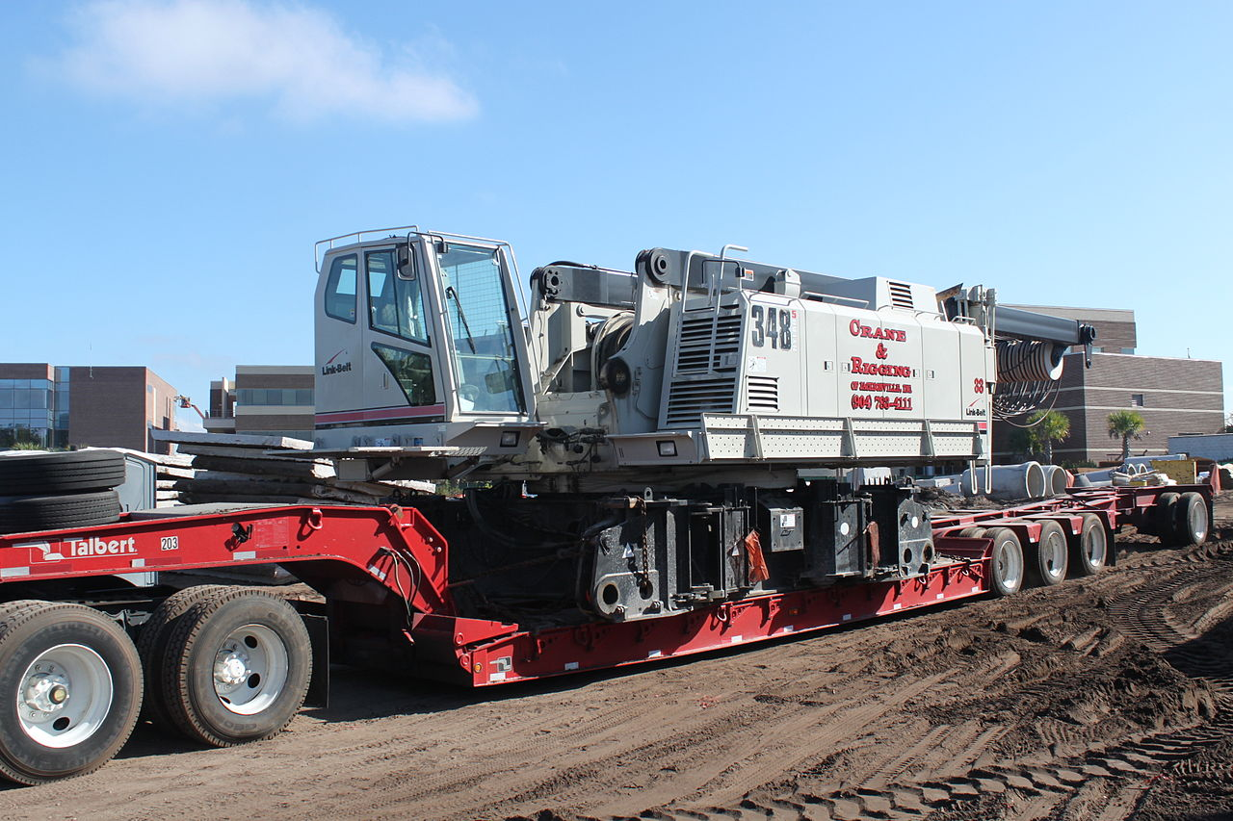
New sound- au
Teach
Teach a new letter.
Teach blending & segmenting.
haul
Where would the sound buttons go?

Slide 8
Teach
Teach a new letter.
Teach blending & segmenting.
New sound- ir
launch
Where would the sound buttons go?

Slide 9
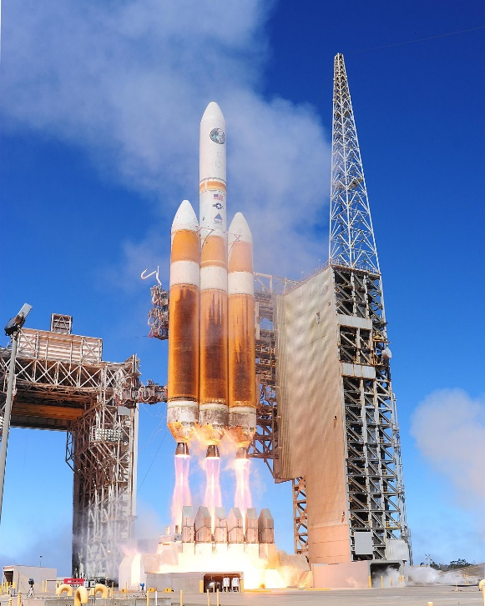
Teach
Teach a new letter.
Teach blending & segmenting.
New sound- au
launch
Where would the sound buttons go?

Slide 10
Teach
Teach a new letter.
Teach blending & segmenting.
New sound- au
haunted
Where would the sound buttons go?

Slide 11

Teach
Teach a new letter.
Teach blending & segmenting.
New sound- au
haunted
Where would the sound buttons go?

Slide 12
Teach
Teach a new letter.
Teach blending & segmenting.
New sound- au
August
Where would the sound buttons go?

Slide 13

Teach
Teach a new letter.
Teach blending & segmenting.
New sound- au
August
Where would the sound buttons go?

Slide 14
Practise
Practise reading and/or spelling words with the new letter.
New sound- au
If you write a book, you are called an ________.
The month after July is called _________.
When you push a boat into the water, it is called a ____________.

Slide 15
Practise
Practise reading and/or spelling words with the new letter.
New sound- au
If you write a book, you are called an ________.
The month after July is called _________.
When you push a boat into the water, it is called a ____________.
author
August
launch

Slide 16

Apply
Read or write application
Include CEW in sentences.
Do you go to work in August?
Who can I say will be an author when
they grow up?

