Slide 1

CEW Revisit/Teach
Revisit CEW incorrect/ tricky or commonly used.
Teach new CEW when necessary.
Phonics
Common Exception Words
Our common exception words this week are:
who
work
again
oh

Slide 2



Revisit and review
Practise previously learned letters.
Practise oral blending and segmentation.
Remember…
Notes:
https://www.phonicsplay.co.uk/resources/phase/5/flashcards-time-challenge

Slide 3

Teach
Teach a new letter.
Teach blending & segmenting.
Revisit and review
Practise previously learned letters.
Practise oral blending and segmentation.
Today we are going to look at an alternative spelling for the grapheme:
or / au

Slide 4

Teach
Teach a new letter.
Teach blending & segmenting.
What do you notice about where this sound comes in the word?
Revisit and review
Practise previously learned letters.
Practise oral blending and segmentation.
Let’s practise reading these or words together.
torn forget
fort sport

Slide 5

Teach
Teach a new letter.
Teach blending & segmenting.
New sound- aw
Can you say our new sound?
aw
As we look through these words, think about where this sound comes in the word.

Slide 6
Teach
Teach a new letter.
Teach blending & segmenting.
New sound- aw
claw
Where would the sound buttons go?

Slide 7
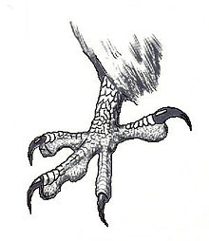
New sound- aw
Teach
Teach a new letter.
Teach blending & segmenting.
claw
Where would the sound buttons go?

Slide 8
New sound- aw
Teach
Teach a new letter.
Teach blending & segmenting.
lawn
Where would the sound buttons go?

Slide 9
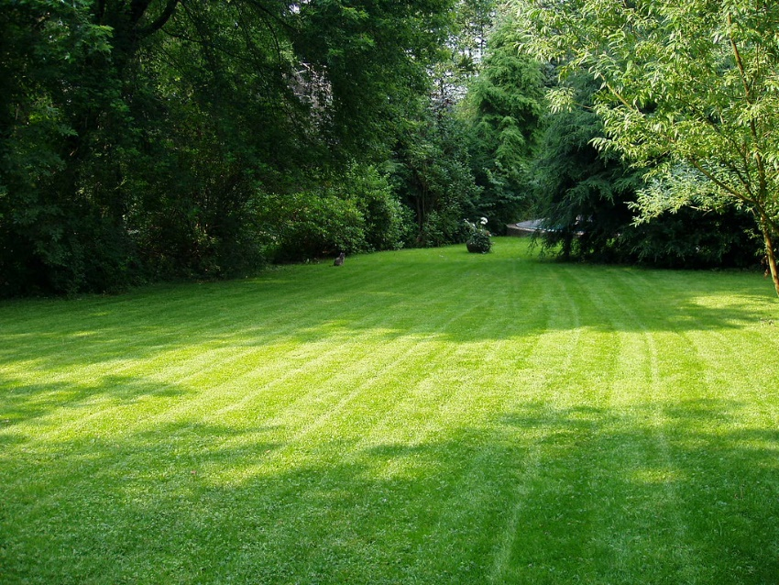
Teach
Teach a new letter.
Teach blending & segmenting.
New sound- aw
lawn
Where would the sound buttons go?

Slide 10
Teach
Teach a new letter.
Teach blending & segmenting.
New sound- aw
drawer
Where would the sound buttons go?

Slide 11
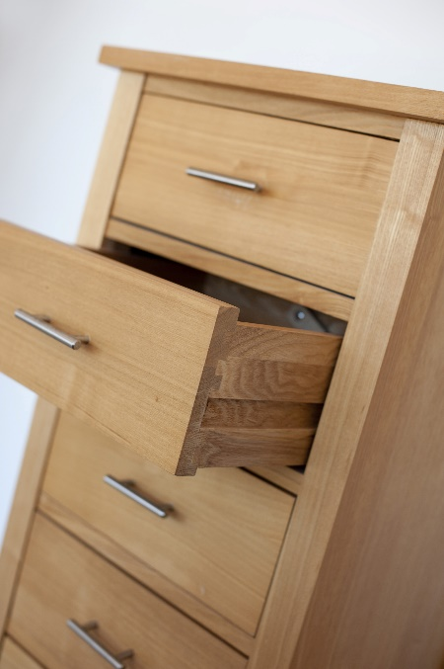
Teach
Teach a new letter.
Teach blending & segmenting.
New sound- aw
drawer
Where would the sound buttons go?

Slide 12
Teach
Teach a new letter.
Teach blending & segmenting.
New sound- aw
shawl
Where would the sound buttons go?

Slide 13
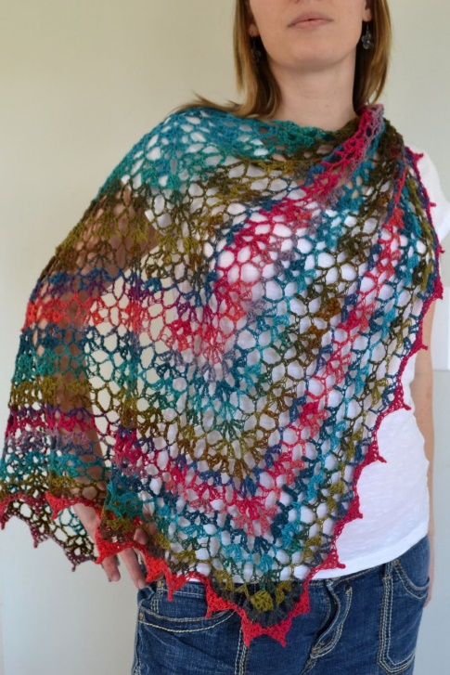
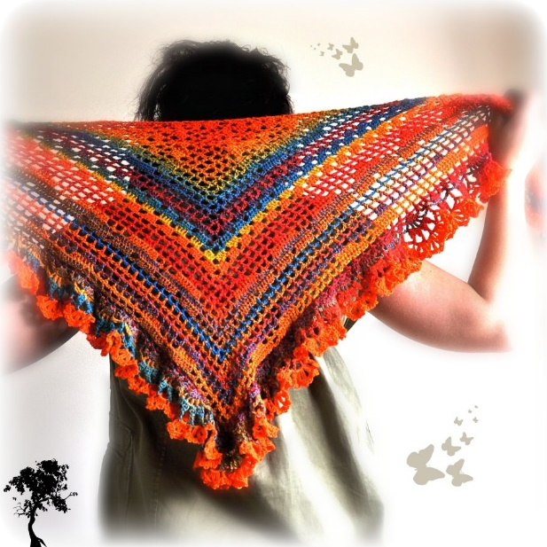
Teach
Teach a new letter.
Teach blending & segmenting.
New sound- aw
shawl
Where would the sound buttons go?

Slide 14
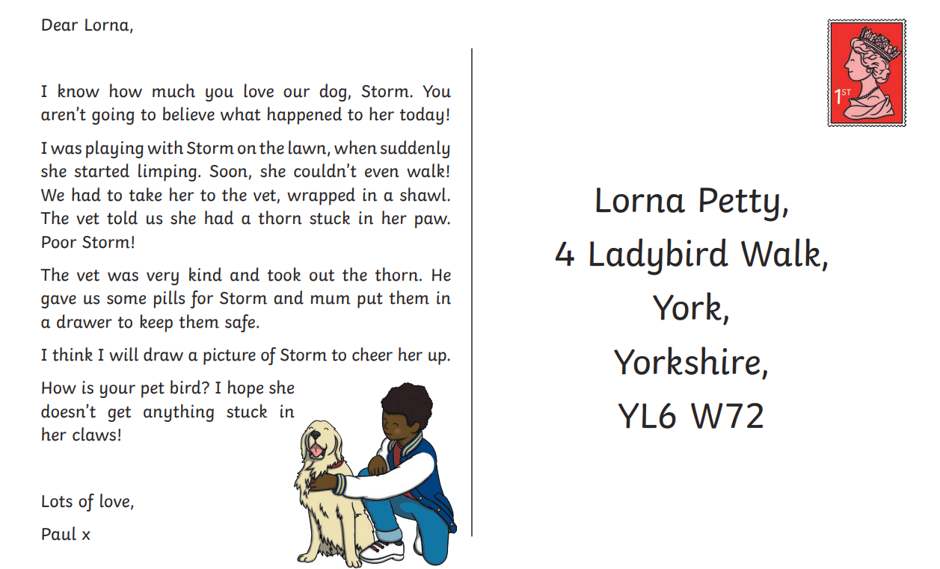
New sound- aw
Practise
Practise reading and/or spelling words with the new letter.
Can you list all the aw words that you can find in the postcard?

Slide 15
Practise
Practise reading and/or spelling words with the new letter.
New sound- aw

Slide 16

Apply
Read or write application
Include CEW in sentences.
Oh I saw that you went on the lawn again.
Who has seen my shawl?

