Slide 1

CEW Revisit/Teach
Revisit CEW incorrect/ tricky or commonly used.
Teach new CEW when necessary.
Phonics
Common Exception Words
Our common exception words this week are:
who work
again oh

Slide 2



Revisit and review
Practise previously learned letters.
Practise oral blending and segmentation.
Remember…
Notes:
https://www.phonicsplay.co.uk/resources/phase/5/flashcards-time-challenge

Slide 3

Teach
Teach a new letter.
Teach blending & segmenting.
Revisit and review
Practise previously learned letters.
Practise oral blending and segmentation.
Put the sound buttons under each word to help you read them. What do you notice?
tooth
true

Slide 4





Teach
Teach a new letter.
Teach blending & segmenting.
What do you notice about where this sound comes in the word?
Revisit and review
Practise previously learned letters.
Practise oral blending and segmentation.
Let’s practise reading these oo pseudo words together.
shoop flooch
phoom trool

Slide 5

Teach
Teach a new letter.
Teach blending & segmenting.
New sound- ew
Can you say our new sound?
ew
As we look through these words, think about where this sound comes in the word.

Slide 6
Teach
Teach a new letter.
Teach blending & segmenting.
New sound- ew
grew
Where would the sound buttons go?

Slide 7

Teach
Teach a new letter.
Teach blending & segmenting.
New sound- ew
grew
Where would the sound buttons go?

Slide 8
Teach
Teach a new letter.
Teach blending & segmenting.
New sound- ew
screw
Where would the sound buttons go?

Slide 9

Teach
Teach a new letter.
Teach blending & segmenting.
New sound- ew
screw
Where would the sound buttons go?

Slide 10
Teach
Teach a new letter.
Teach blending & segmenting.
New sound- ew
chew
Where would the sound buttons go?

Slide 11
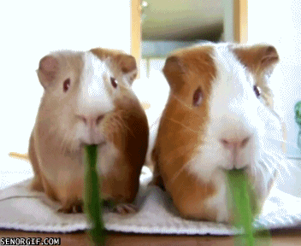
Teach
Teach a new letter.
Teach blending & segmenting.
New sound- ew
chew
Where would the sound buttons go?

Slide 12



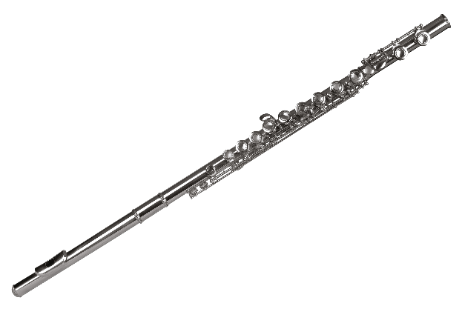
Practise
Practise reading and/or spelling words with the new letter.
Look carefully at the pictures.
oo , ue, u-e or ew
flute
boot
clue
flew

Slide 13



Practise
Practise reading and/or spelling words with the new letter.
Look carefully at the pictures.
oo , u-e or ew
rude
drew
moon

Slide 14

Apply
Read or write application
Include CEW in sentences.
New sound- ew
He had to brew the tea again.
Where is the screw?

