Slide 1

CEW Revisit/Teach
Revisit CEW incorrect/ tricky or commonly used.
Teach new CEW when necessary.
Phonics
Common Exception Words
Our common exception words this week are:
because looked
their

Slide 2



Revisit and review
Practise previously learned letters.
Practise oral blending and segmentation.
Remember…
Notes:
https://www.phonicsplay.co.uk/resources/phase/5/flashcards-time-challenge

Slide 3

Teach
Teach a new letter.
Teach blending & segmenting.
Revisit and review
Practise previously learned letters.
Practise oral blending and segmentation.
Put the sound buttons under each word to help you read them. What do you notice?
fort
haul

Slide 4
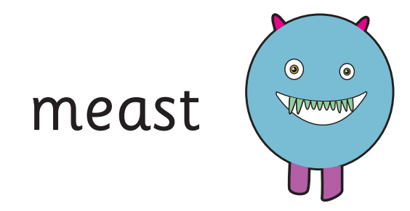

Teach
Teach a new letter.
Teach blending & segmenting.
Pseudo words
What does this mean?
Where would the sound buttons go?

Slide 5
Teach
Teach a new letter.
Teach blending & segmenting.
Pseudo words
What does this mean?
Where would the sound buttons go?

Slide 6

Teach
Teach a new letter.
Teach blending & segmenting.
Pseudo words
Where would the sound buttons go?

Slide 7
Teach
Teach a new letter.
Teach blending & segmenting.
Pseudo words
Where would the sound buttons go?

Slide 8

Teach
Teach a new letter.
Teach blending & segmenting.
Pseudo words
Where would the sound buttons go?

Slide 9
Teach
Teach a new letter.
Teach blending & segmenting.
Pseudo words
Where would the sound buttons go?

Slide 10
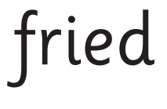

Practise
Practise reading and/or spelling words with the new letter.
Do you like eggs?
Read the questions. Are there any pseudo words in the sentence. Answer yes or no with your thumbs.

Slide 11

Practise
Practise reading and/or spelling words with the new letter.
The bird had a red .
Read the questions. Are there any pseudo words in the sentence. Answer yes or no with your thumbs.

Slide 12


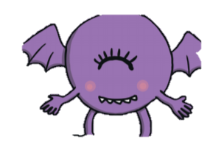

Apply
Read or write application
Include CEW in sentences.
Use your phonics knowledge to write these pseudo words.
vear
jawl
preal

