Slide 1

CEW Revisit/Teach
Revisit CEW incorrect/ tricky or commonly used.
Teach new CEW when necessary.
Phonics
Common Exception Words
Our common exception words this week are:
because looked
their

Slide 2



Revisit and review
Practise previously learned letters.
Practise oral blending and segmentation.
Remember…
Notes:
https://www.phonicsplay.co.uk/resources/phase/5/flashcards-time-challenge

Slide 3
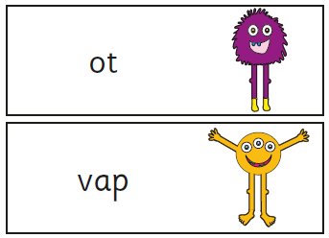
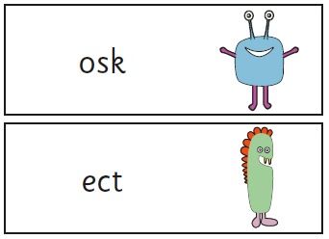
Teach
Teach a new letter.
Teach blending & segmenting.
Revisit and review
Practise previously learned letters.
Practise oral blending and segmentation.
Can you read these pseudo words?

Slide 4
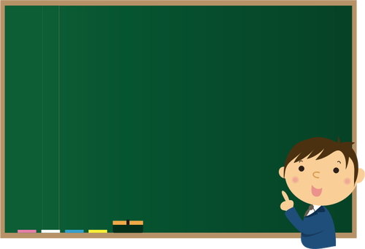
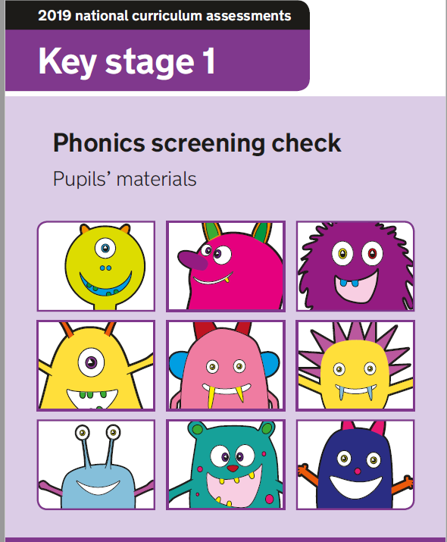
Teach
Teach a new letter.
Teach blending & segmenting.
Practise phonics paper
Today we are going to looking at a past phonics screening paper.
Can we try and read the sounds together?

Slide 5
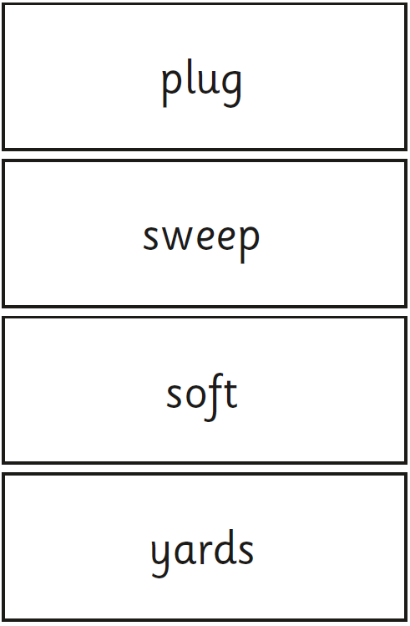

Practise phonics paper
Teach
Teach a new letter.
Teach blending & segmenting.
Where would the sound buttons go?

Slide 6
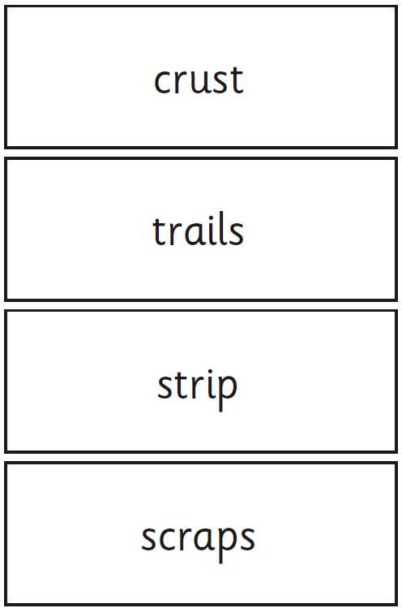
Teach
Teach a new letter.
Teach blending & segmenting.
Practise phonics paper
Where would the sound buttons go?

Slide 7

Practise
Practise reading and/or spelling words with the new letter.
She likes a films.
Can you write a sentence with the word in it?

Slide 8

Practise
Practise reading and/or spelling words with the new letter.
Oh I saw the dog again.
Can you write a sentence with the word in it?

Slide 9

Apply
Read or write application
Include CEW in sentences.
I like the crust on my toast.
Who looked at the trails?

