Slide 1

CEW Revisit/Teach
Revisit CEW incorrect/ tricky or commonly used.
Teach new CEW when necessary.
Phonics
Common Exception Words
Our common exception words this week are:
because looked
their

Slide 2



Revisit and review
Practise previously learned letters.
Practise oral blending and segmentation.
Remember…
Notes:
https://www.phonicsplay.co.uk/resources/phase/5/flashcards-time-challenge

Slide 3

Teach
Teach a new letter.
Teach blending & segmenting.
Revisit and review
Practise previously learned letters.
Practise oral blending and segmentation.
Look at these sounds. What do you notice?
elephant
found

Slide 4
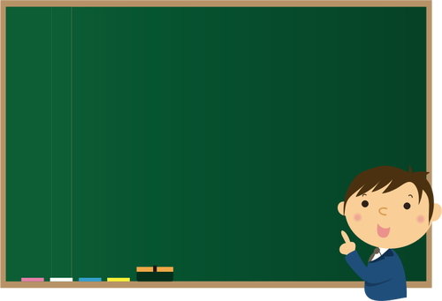
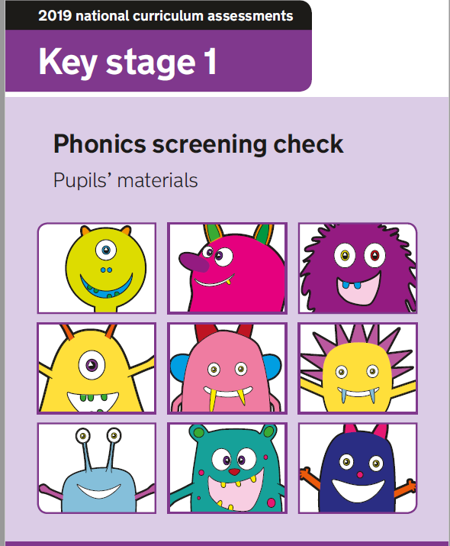
Teach
Teach a new letter.
Teach blending & segmenting.
Practise phonics paper
Today we are going to looking at a past phonics screening paper.
Can we try and read the sounds together?

Slide 5
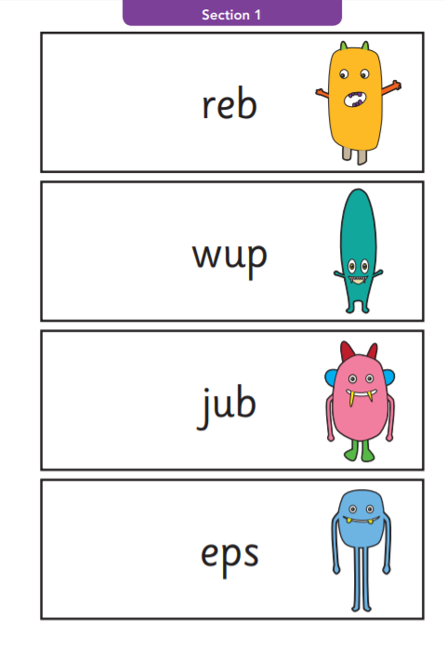

Practise phonics paper
Teach
Teach a new letter.
Teach blending & segmenting.
Where would the sound buttons go?

Slide 6
Practise phonics paper
Teach
Teach a new letter.
Teach blending & segmenting.
Where would the sound buttons go?

Slide 7
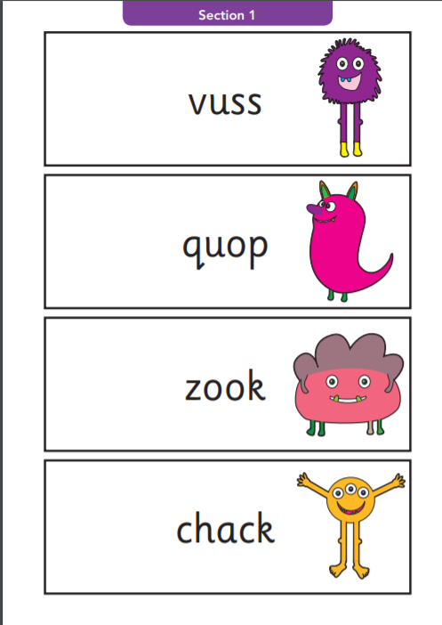
Teach
Teach a new letter.
Teach blending & segmenting.
Practise phonics paper
Where would the sound buttons go?

Slide 8
Teach
Teach a new letter.
Teach blending & segmenting.
Practise phonics paper
Where would the sound buttons go?

Slide 9
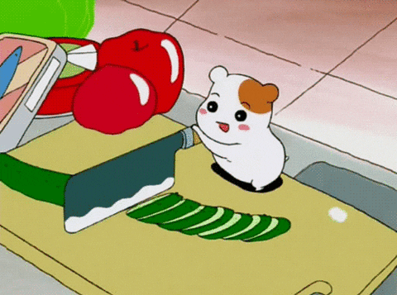
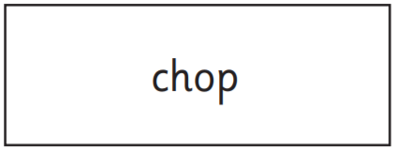
Practise
Practise reading and/or spelling words with the new letter.
Can you show me how you would…
?

Slide 10
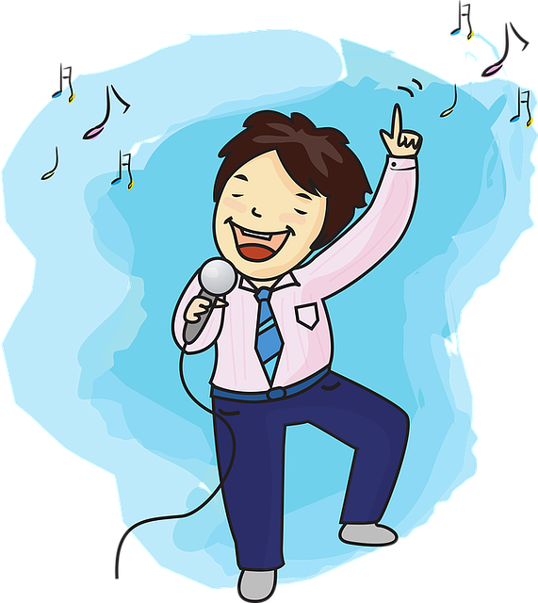
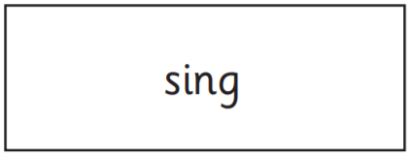
Practise
Practise reading and/or spelling words with the new letter.
Can you show me how you would…
?

Slide 11
Practise
Practise reading and/or spelling words with the new letter.
Can you show me how you would…
?

Slide 12
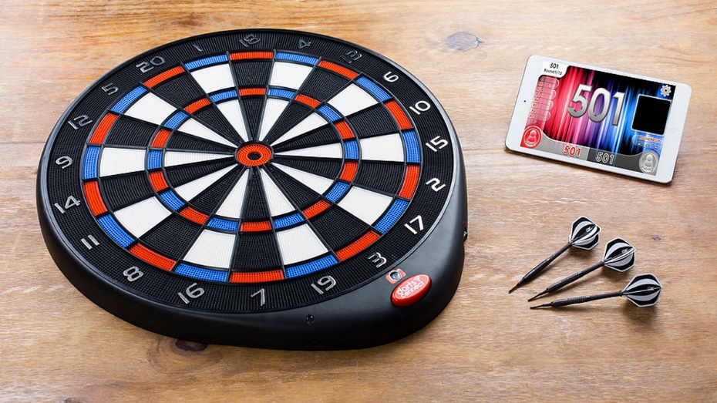
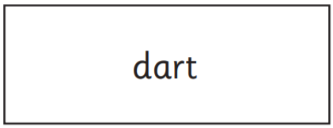
Practise
Practise reading and/or spelling words with the new letter.
Read the sentence:
She threw the
because she likes the game.

Slide 13

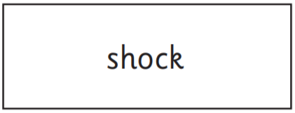
Practise
Practise reading and/or spelling words with the new letter.
Read the sentence:
Handa had a when she found
out that the animals had no food.

Slide 14

Apply
Read or write application
Include CEW in sentences.
The house was haunted.
The bird flies in the air.

