Slide 1

CEW Revisit/Teach
Revisit CEW incorrect/ tricky or commonly used.
Teach new CEW when necessary.
Phonics
Common Exception Words
Our common exception words this week are:
any
many
laughed

Slide 2



Revisit and review
Practise previously learned letters.
Practise oral blending and segmentation.
Remember…
Notes:
https://www.phonicsplay.co.uk/resources/phase/5/flashcards-time-challenge

Slide 3

Revisit/Teach/Practise
Revisit CEW incorrect/ tricky or commonly used.
Teach new CEW when necessary.
Teach
Teach a new letter.
Teach blending & segmenting.
Today we are going to revise the graphemes:
sh ch ng th

Slide 4

Teach
Teach a new letter.
Teach blending & segmenting.
What do you notice about where this sound comes in the word?
Revisit and review
Practise previously learned letters.
Practise oral blending and segmentation.
Let’s practise reading these sh words together.
rush shock
crash shampoo

Slide 5
Teach
Teach a new letter.
Teach blending & segmenting.
What do you notice about where this sound comes in the word?
Revisit and review
Practise previously learned letters.
Practise oral blending and segmentation.
Let’s practise reading these th words together.
thin thrust
think thick

Slide 6
Teach
Teach a new letter.
Teach blending & segmenting.
What do you notice about where this sound comes in the word?
Revisit and review
Practise previously learned letters.
Practise oral blending and segmentation.
Let’s practise reading these ch words together.
chunk bunch
lunch drench

Slide 7
Teach
Teach a new letter.
Teach blending & segmenting.
What do you notice about where this sound comes in the word?
Revisit and review
Practise previously learned letters.
Practise oral blending and segmentation.
Let’s practise reading these ng words together.
rung thing
twisting floating

Slide 8


Revision of sh ch th and ng
Practise
Practise reading and/or spelling words with the new letter.
Are there pseudo words in the sentences?
Did a shroam go to town?

Slide 9

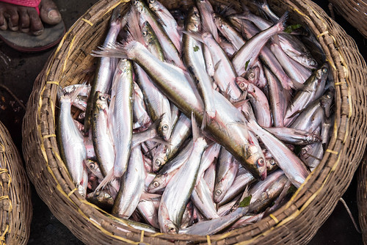
Revision of sh ch th and ng
Practise
Practise reading and/or spelling words with the new letter.
Are there pseudo words in the sentences?
The grunch went to get fresh fish?

Slide 10


Revision of sh ch th and ng
Practise
Practise reading and/or spelling words with the new letter.
Can you read the yes/no question sentence?
Can you see throp bumping into
a shelf?

Slide 11

Revision of sh ch th and ng
Practise
Practise reading and/or spelling words with the new letter.
Can you read the yes/no question sentence?
It is fun to camp in the brang.

Slide 12

Apply
Read or write application
Include CEW in sentences.
Many of the champions went floating
By in the boats.
The tenth king laughed and went to his shelter in the trench.

