Slide 1

CEW Revisit/Teach
Revisit CEW incorrect/ tricky or commonly used.
Teach new CEW when necessary.
Phonics
Common Exception Words
Our common exception words this week are:
any
many
laughed

Slide 2
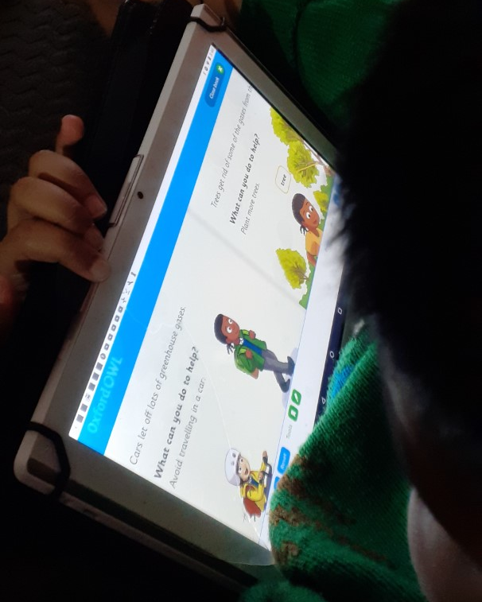

Slide 3



Revisit and review
Practise previously learned letters.
Practise oral blending and segmentation.
Remember…
Notes:
https://www.phonicsplay.co.uk/resources/phase/5/flashcards-time-challenge

Slide 4

Teach
Teach a new letter.
Teach blending & segmenting.
Revisit and review
Practise previously learned letters.
Practise oral blending and segmentation.
Today we are going to revise the graphemes:
sh ch ng th

Slide 5

Teach
Teach a new letter.
Teach blending & segmenting.
What do you notice about where this sound comes in the word?
Revisit and review
Practise previously learned letters.
Practise oral blending and segmentation.
Let’s practise reading these sh words together.
ship shelf
hush shift

Slide 6
Teach
Teach a new letter.
Teach blending & segmenting.
What do you notice about where this sound comes in the word?
Revisit and review
Practise previously learned letters.
Practise oral blending and segmentation.
Let’s practise reading these th words together.
thin thick
moth thump

Slide 7
Teach
Teach a new letter.
Teach blending & segmenting.
What do you notice about where this sound comes in the word?
Revisit and review
Practise previously learned letters.
Practise oral blending and segmentation.
Let’s practise reading these ch words together.
chug chimp
chest crunch

Slide 8
Teach
Teach a new letter.
Teach blending & segmenting.
What do you notice about where this sound comes in the word?
Revisit and review
Practise previously learned letters.
Practise oral blending and segmentation.
Let’s practise reading these ng words together.
wing string
swing bring

Slide 9



Revision of sh ch th and ng
Practise
Practise reading and/or spelling words with the new letter.
Can you read the yes/no question sentence?
Did a shark ever jump up a tree?

Slide 10
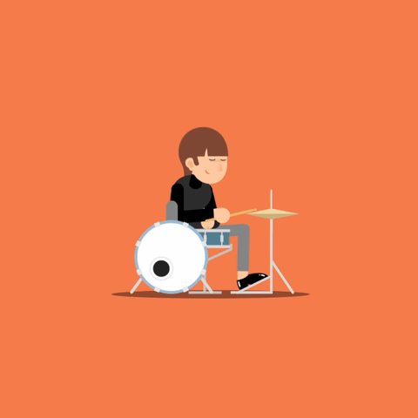
Revision of sh ch th and ng
Practise
Practise reading and/or spelling words with the new letter.
Can you read the yes/no question sentence?
Can you bang on a big drum?

Slide 11
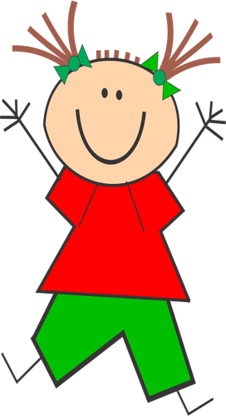

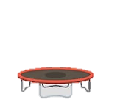
Revision of sh ch th and ng
Practise
Practise reading and/or spelling words with the new letter.
Can you read the yes/no question sentence?
Can you see a girl jumping
on a bench?

Slide 12
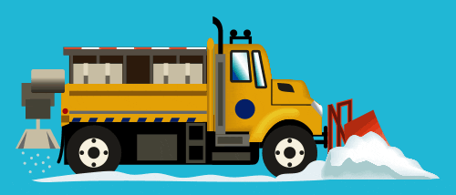
Revision of sh ch th and ng
Practise
Practise reading and/or spelling words with the new letter.
Can you read the yes/no question sentence?
Can you hear the thundering
trucks on the road?

Slide 13

Apply
Read or write application
Include CEW in sentences.
The thrush laughed because I was singing in the tree.
Have you seen any of the snow
shrinking.

