Slide 1

CEW Revisit/Teach
Revisit CEW incorrect/ tricky or commonly used.
Teach new CEW when necessary.
Phonics
Common Exception Words
Our common exception words this week are:
any
many
laughed

Slide 2



Revisit and review
Practise previously learned letters.
Practise oral blending and segmentation.
Remember…
Notes:
https://www.phonicsplay.co.uk/resources/phase/5/flashcards-time-challenge

Slide 3

Teach
Teach a new letter.
Teach blending & segmenting.
Revisit and review
Practise previously learned letters.
Practise oral blending and segmentation.
Today we are going to revise the graphemes we have learnt already this year.

Slide 4
m
p
p
m
c
o

Slide 5



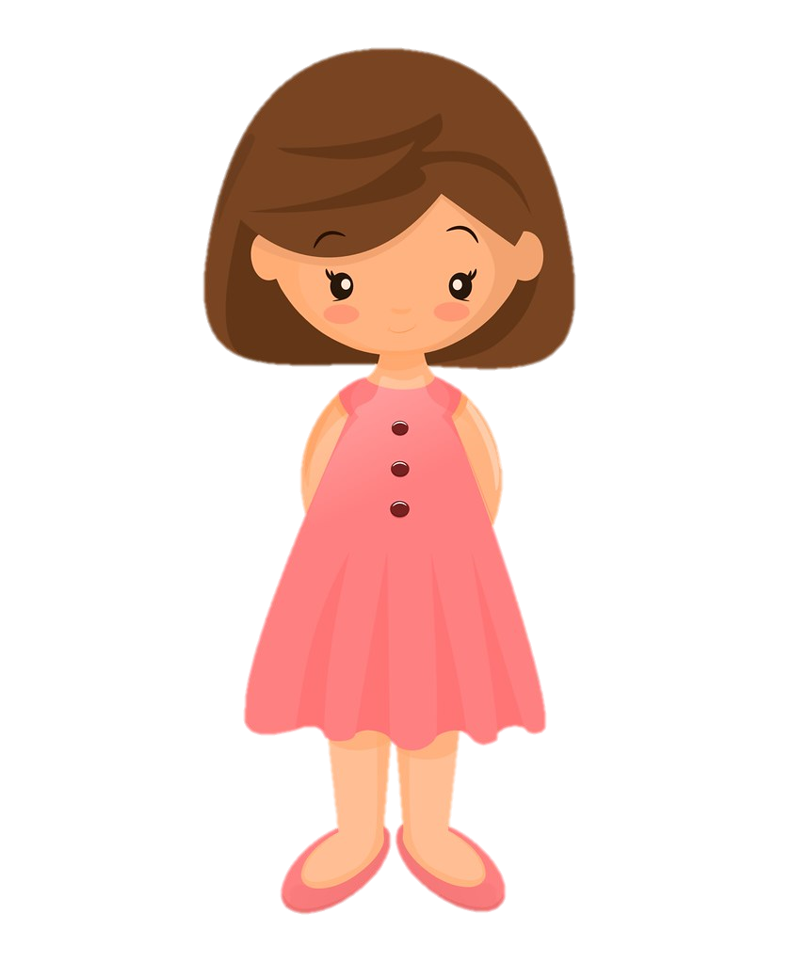
Teach
Teach a new letter.
Teach blending & segmenting.
What do you notice about where this sound comes in the word?
Revisit and review
Practise previously learned letters.
Practise oral blending and segmentation.
Let’s practise reading these words together.
jacket jet-lag
Jen

Slide 6
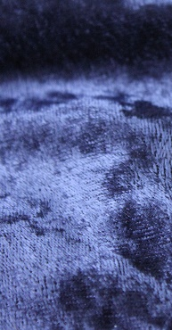

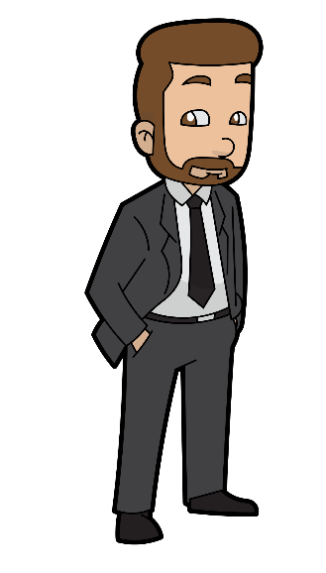
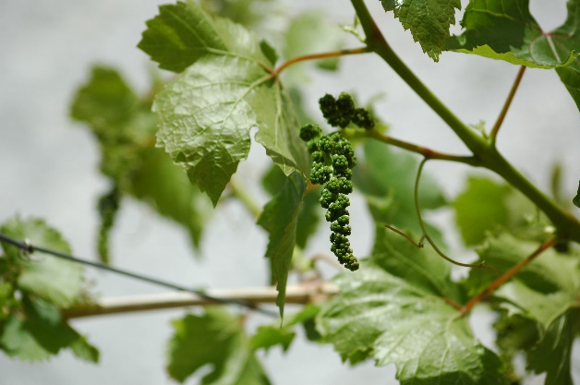
Teach
Teach a new letter.
Teach blending & segmenting.
What do you notice about where this sound comes in the word?
Revisit and review
Practise previously learned letters.
Practise oral blending and segmentation.
Let’s practise reading these words together.
Kevin velvet
Vic vine

Slide 7
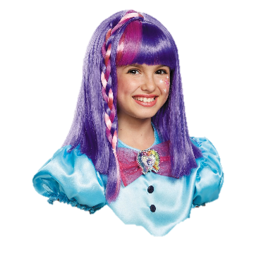


Teach
Teach a new letter.
Teach blending & segmenting.
What do you notice about where this sound comes in the word?
Revisit and review
Practise previously learned letters.
Practise oral blending and segmentation.
Let’s practise reading these words together.
wig cobweb
wicked web

Slide 8
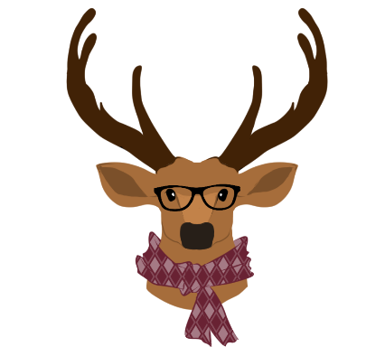
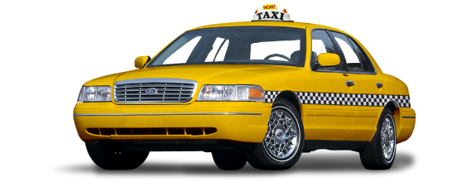


Teach
Teach a new letter.
Teach blending & segmenting.
What do you notice about where this sound comes in the word?
Revisit and review
Practise previously learned letters.
Practise oral blending and segmentation.
Let’s practise reading these words together.
vixen taxi
six tax

Slide 9
Revision of j v w and x
Practise
Practise reading and/or spelling words with the new letter.
Quick read
wag
mix
van
Jill

Slide 10

Revision of j v w x
Practise
Practise reading and/or spelling words with the new letter.
Can you read the yes/no question sentence?
Can you drive a van?

Slide 11

Revision of j v w and x
Practise
Practise reading and/or spelling words with the new letter.
Can you read the yes/no question sentence?
Can you feel a wig?

Slide 12
Revision of w v and x
Practise
Practise reading and/or spelling words with the new letter.
Can you read the yes/no question sentence?
Can you do a jump?

Slide 13

Apply
Read or write application
Include CEW in sentences.
cobweb
jacket
velvet
tax

