Slide 1

CEW Revisit/Teach
Revisit CEW incorrect/ tricky or commonly used.
Teach new CEW when necessary.
Phonics
Common Exception Words
Our common exception words this week are:
thought
different
eyes

Slide 2



Revisit and review
Practise previously learned letters.
Practise oral blending and segmentation.
Remember…
Notes:
https://www.phonicsplay.co.uk/resources/phase/5/flashcards-time-challenge

Slide 3

Teach
Teach a new letter.
Teach blending & segmenting.
Revisit and review
Practise previously learned letters.
Practise oral blending and segmentation.
Today we are going to revise the graphemes we have learnt already this year.

Slide 4
f
t
s
h
i
k

Slide 5

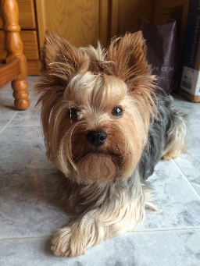

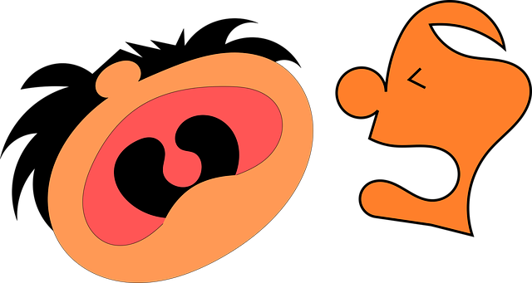
Teach
Teach a new letter.
Teach blending & segmenting.
What do you notice about where this sound comes in the word?
Revisit and review
Practise previously learned letters.
Practise oral blending and segmentation.
Let’s practise reading these words together.
yap yes
yet yell

Slide 6

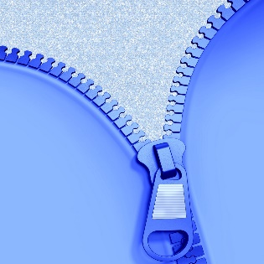

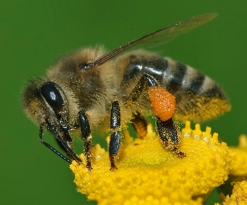
Teach
Teach a new letter.
Teach blending & segmenting.
What do you notice about where this sound comes in the word?
Revisit and review
Practise previously learned letters.
Practise oral blending and segmentation.
Let’s practise reading these words together.
zip zap
buzz jazz

Slide 7
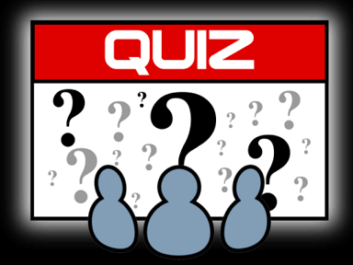

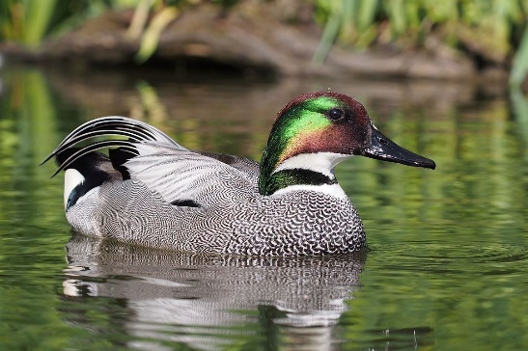
Teach
Teach a new letter.
Teach blending & segmenting.
What do you notice about where this sound comes in the word?
Revisit and review
Practise previously learned letters.
Practise oral blending and segmentation.
Let’s practise reading these words together.
quiz quit
quick quack

Slide 8
Revision of y, z, zz and qu
Practise
Practise reading and/or spelling words with the new letter.
Quick read
yum-yum
zigzag
liquid
fizz

Slide 9

Revision of y, z, zz and qu
Practise
Practise reading and/or spelling words with the new letter.
Can you read the yes/no question sentence?
Can you hear a fizz?

Slide 10

Revision of v w and x
Practise
Practise reading and/or spelling words with the new letter.
Can you read the yes/no question sentence?
Can you hear a quack?

Slide 11
Revision of w v and x
Practise
Practise reading and/or spelling words with the new letter.
Can you read the yes/no question sentence?
Can you hear a zip?

Slide 12

Apply
Read or write application
Include CEW in sentences.
yes
Zak
quilt
quiz

