Slide 1

CEW Revisit/Teach
Revisit CEW incorrect/ tricky or commonly used.
Teach new CEW when necessary.
Phonics
Common Exception Words
Our common exception words this week are:
thought
different
eyes

Slide 2



Revisit and review
Practise previously learned letters.
Practise oral blending and segmentation.
Remember…
Notes:
https://www.phonicsplay.co.uk/resources/phase/5/flashcards-time-challenge

Slide 3

Teach
Teach a new letter.
Teach blending & segmenting.
Revisit and review
Practise previously learned letters.
Practise oral blending and segmentation.
Today we are going to revise the graphemes we have learnt already this year.

Slide 4
h
n
p
e
t
K

Slide 5

Teach
Teach a new letter.
Teach blending & segmenting.
What do you notice about where this sound comes in the word?
Revisit and review
Practise previously learned letters.
Practise oral blending and segmentation.
Let’s practise reading these words together.
high sigh
light might

Slide 6
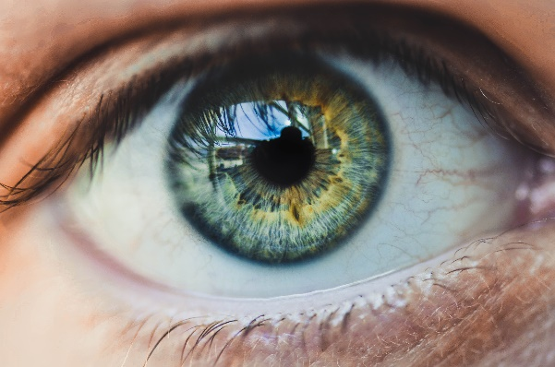
Teach
Teach a new letter.
Teach blending & segmenting.
What do you notice about where this sound comes in the word?
Revisit and review
Practise previously learned letters.
Practise oral blending and segmentation.
Let’s practise reading these words together.
night right
sight fight

Slide 7
Teach
Teach a new letter.
Teach blending & segmenting.
What do you notice about where this sound comes in the word?
Revisit and review
Practise previously learned letters.
Practise oral blending and segmentation.
Let’s practise reading these words together.
coat load
goat loaf

Slide 8
Teach
Teach a new letter.
Teach blending & segmenting.
What do you notice about where this sound comes in the word?
Revisit and review
Practise previously learned letters.
Practise oral blending and segmentation.
Let’s practise reading these words together.
road soap
oak toad

Slide 9
Revision of ight oa
Practise
Practise reading and/or spelling words with the new letter.
Quick read
tight
tonight
foal
boatman

Slide 10

Revision of ight oa
Practise
Practise reading and/or spelling words with the new letter.
Can you read the yes/no question sentence?
Did he fight the foal?

Slide 11
Revision of ight oa
Practise
Practise reading and/or spelling words with the new letter.
Can you read the yes/no question sentence?
Is this the right goat?

Slide 12
Revision of ight oa
Practise
Practise reading and/or spelling words with the new letter.
Will you eat toad tonight?

Slide 13

Apply
Read or write application
Include CEW in sentences.
night
fight
oak
boatman

