Slide 1

CEW Revisit/Teach
Revisit CEW incorrect/ tricky or commonly used.
Teach new CEW when necessary.
Phonics
Common Exception Words
Our common exception words this week are:
thought
different
eyes

Slide 2



Revisit and review
Practise previously learned letters.
Practise oral blending and segmentation.
Remember…
Notes:
https://www.phonicsplay.co.uk/resources/phase/5/flashcards-time-challenge

Slide 3

Teach
Teach a new letter.
Teach blending & segmenting.
Revisit and review
Practise previously learned letters.
Practise oral blending and segmentation.
Today we are going to revise the graphemes we have learnt already this year.

Slide 4
p
j
g
h
u
r

Slide 5

Teach
Teach a new letter.
Teach blending & segmenting.
What do you notice about where this sound comes in the word?
Revisit and review
Practise previously learned letters.
Practise oral blending and segmentation.
Let’s practise reading these words together.
ring song
long thing

Slide 6
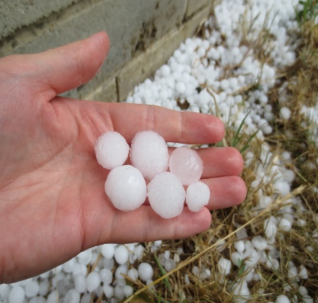
Teach
Teach a new letter.
Teach blending & segmenting.
What do you notice about where this sound comes in the word?
Revisit and review
Practise previously learned letters.
Practise oral blending and segmentation.
Let’s practise reading these words together.
wait Gail
hail pain

Slide 7

Teach
Teach a new letter.
Teach blending & segmenting.
What do you notice about where this sound comes in the word?
Revisit and review
Practise previously learned letters.
Practise oral blending and segmentation.
Let’s practise reading these words together.
see feel
weep feet

Slide 8
Revision of ng ai ee
Practise
Practise reading and/or spelling words with the new letter.
Quick read
rang
hang
aim
seem

Slide 9

Revision of ng ai ee
Practise
Practise reading and/or spelling words with the new letter.
Can you read the yes/no question sentence?
Have you seen the rain?

Slide 10
Revision of ng ai ee
Practise
Practise reading and/or spelling words with the new letter.
Can you read the yes/no question sentence?
Is it the start of the week?

Slide 11

Revision of ng ai ee
Practise
Practise reading and/or spelling words with the new letter.
Will you use bait to catch fish?

Slide 12

Apply
Read or write application
Include CEW in sentences.
ping-pong
main
sail
deep

