Slide 1

CEW Revisit/Teach
Revisit CEW incorrect/ tricky or commonly used.
Teach new CEW when necessary.
Phonics
Common Exception Words
Our common exception words this week are:
thought
different
eyes

Slide 2



Revisit and review
Practise previously learned letters.
Practise oral blending and segmentation.
Remember…
Notes:
https://www.phonicsplay.co.uk/resources/phase/5/flashcards-time-challenge

Slide 3

Teach
Teach a new letter.
Teach blending & segmenting.
Revisit and review
Practise previously learned letters.
Practise oral blending and segmentation.
Today we are going to revise the graphemes we have learnt already this year.

Slide 4
j
t
c
o
r
h

Slide 5


Teach
Teach a new letter.
Teach blending & segmenting.
What do you notice about where this sound comes in the word?
Revisit and review
Practise previously learned letters.
Practise oral blending and segmentation.
Let’s practise reading these words together.
chop chin
chug check

Slide 6
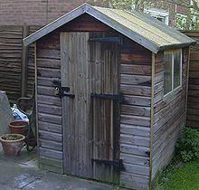
Teach
Teach a new letter.
Teach blending & segmenting.
What do you notice about where this sound comes in the word?
Revisit and review
Practise previously learned letters.
Practise oral blending and segmentation.
Let’s practise reading these words together.
ship shop
shed shell

Slide 7

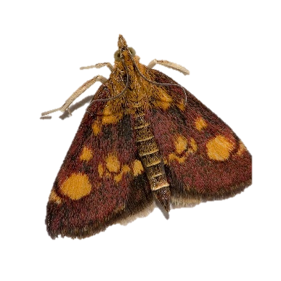
Teach
Teach a new letter.
Teach blending & segmenting.
What do you notice about where this sound comes in the word?
Revisit and review
Practise previously learned letters.
Practise oral blending and segmentation.
Let’s practise reading these words together.
bath thick
thin moth

Slide 8
Teach
Teach a new letter.
Teach blending & segmenting.
What do you notice about where this sound comes in the word?
Revisit and review
Practise previously learned letters.
Practise oral blending and segmentation.
Let’s practise reading these words together.
with that
this them

Slide 9
Revision of sh, ch, th, th
Practise
Practise reading and/or spelling words with the new letter.
Quick read
chip
shock
them
thick

Slide 10

Revision of sh, ch, th, th
Practise
Practise reading and/or spelling words with the new letter.
Can you read the yes/no question sentence?
Are you in a rush?

Slide 11

Revision of sh, ch, th, th
Practise
Practise reading and/or spelling words with the new letter.
Can you read the yes/no question sentence?
Did you have a birthday bash?

Slide 12
Revision of sh, ch, th, th
Practise
Practise reading and/or spelling words with the new letter.
Act like a chicken.

Slide 13

Apply
Read or write application
Include CEW in sentences.
such
then
fish
path

