Slide 1

CEW Revisit/Teach
Revisit CEW incorrect/ tricky or commonly used.
Teach new CEW when necessary.
Phonics
Common Exception Words
Our common exception words this week are:
different
thought
eyes

Slide 2



Revisit and review
Practise previously learned letters.
Practise oral blending and segmentation.
Remember…
Notes:
https://www.phonicsplay.co.uk/resources/phase/5/flashcards-time-challenge

Slide 3

Revisit/Teach/Practise
Revisit CEW incorrect/ tricky or commonly used.
Teach new CEW when necessary.
Teach
Teach a new letter.
Teach blending & segmenting.
Today we are going to revise the graphemes:
ai ee igh oa

Slide 4
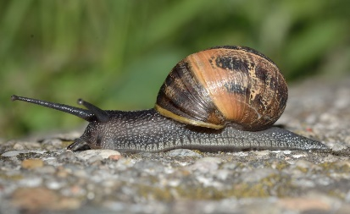

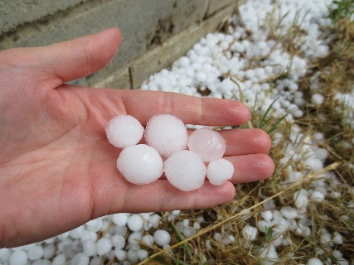
Teach
Teach a new letter.
Teach blending & segmenting.
What do you notice about where this sound comes in the word?
Revisit and review
Practise previously learned letters.
Practise oral blending and segmentation.
Let’s practise reading these ai words together.
waiting snail
raid hailing

Slide 5

Teach
Teach a new letter.
Teach blending & segmenting.
What do you notice about where this sound comes in the word?
Revisit and review
Practise previously learned letters.
Practise oral blending and segmentation.
Let’s practise reading these ee words together.
meet sheet
sheep fleet

Slide 6
Teach
Teach a new letter.
Teach blending & segmenting.
What do you notice about where this sound comes in the word?
Revisit and review
Practise previously learned letters.
Practise oral blending and segmentation.
Let’s practise reading these igh words together.
flight bright
sighting right

Slide 7
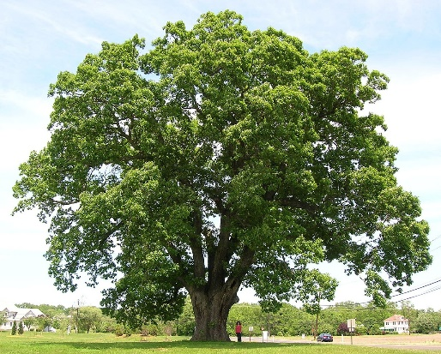
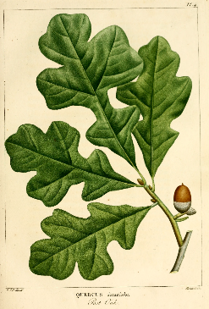
Teach
Teach a new letter.
Teach blending & segmenting.
What do you notice about where this sound comes in the word?
Revisit and review
Practise previously learned letters.
Practise oral blending and segmentation.
Let’s practise reading these oa words together.
soap oak
goat load

Slide 8
Practise
Practise reading and/or spelling words with the new letter.
Can we swap any of the words below so the sentence still makes sense?
Gail
fed the .
dog
moon
Mark
cat
hid

Slide 9
Practise
Practise reading and/or spelling words with the new letter.
Can we swap any of the words below so the sentence still makes sense?
The are in the .
sheep
shed
cars
farmyards
wait
bedroom

Slide 10

Apply
Read or write application
Include CEW in sentences.
The fisherman needs less bait when its raining.
His eyes were bright when he asked for a song.

