Slide 1

CEW Revisit/Teach
Revisit CEW incorrect/ tricky or commonly used.
Teach new CEW when necessary.
Phonics
Common Exception Words
Our common exception words this week are:
friends
once
water
where

Slide 2



Revisit and review
Practise previously learned letters.
Practise oral blending and segmentation.
Remember…
Notes:
https://www.phonicsplay.co.uk/resources/phase/5/flashcards-time-challenge

Slide 3

Teach
Teach a new letter.
Teach blending & segmenting.
Revisit and review
Practise previously learned letters.
Practise oral blending and segmentation.
Today we are going to revise the graphemes we have learnt already this year.

Slide 4
f
b
k
s
t
l
i

Slide 5

Teach
Teach a new letter.
Teach blending & segmenting.
What do you notice about where this sound comes in the word?
Revisit and review
Practise previously learned letters.
Practise oral blending and segmentation.
Let’s practise reading these words together.
now down
town bow

Slide 6
Teach
Teach a new letter.
Teach blending & segmenting.
What do you notice about where this sound comes in the word?
Revisit and review
Practise previously learned letters.
Practise oral blending and segmentation.
Let’s practise reading these words together.
brown towel
clown growl

Slide 7
Teach
Teach a new letter.
Teach blending & segmenting.
What do you notice about where this sound comes in the word?
Revisit and review
Practise previously learned letters.
Practise oral blending and segmentation.
Let’s practise reading these words together.
frown crown
fowl crowd

Slide 8
Revision of ow
Practise
Practise reading and/or spelling words with the new letter.
Quick read
brown
crowd
growl
frown

Slide 9
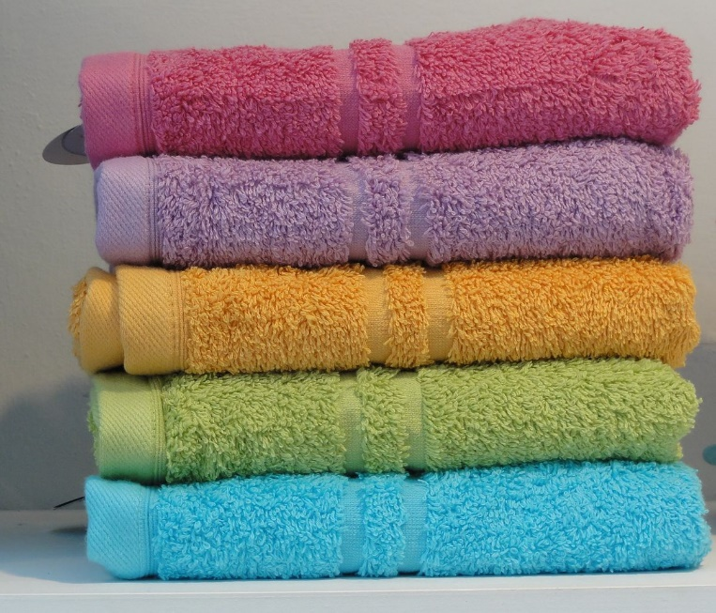
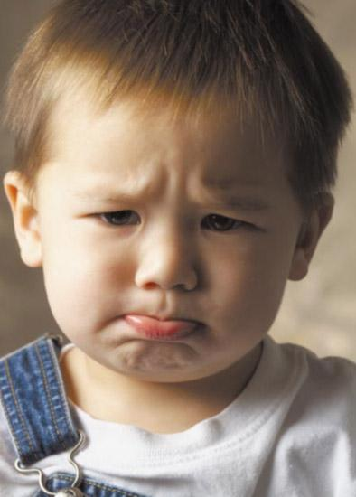
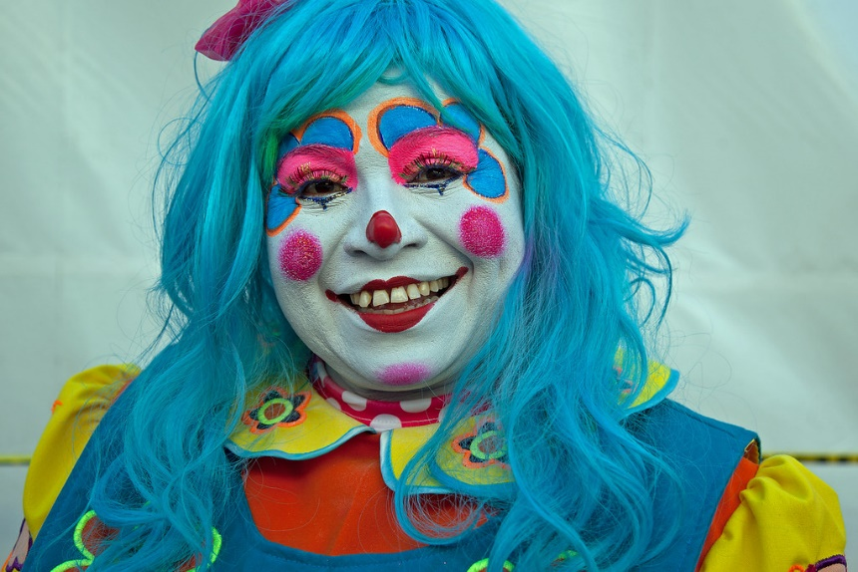
Revision of ow
Practise
Practise reading and/or spelling words with the new letter.
What are the pictures?

Slide 10
Revision of ow
Practise
Practise reading and/or spelling words with the new letter.
What are the pictures?
clown
towel
frown

Slide 11

Apply
Read or write application
Include CEW in sentences.
town
down
growl
brown

