Slide 1

CEW Revisit/Teach
Revisit CEW incorrect/ tricky or commonly used.
Teach new CEW when necessary.
Phonics
Common Exception Words
Our common exception words this week are:
friends
once
water
where

Slide 2



Revisit and review
Practise previously learned letters.
Practise oral blending and segmentation.
Remember…
Notes:
https://www.phonicsplay.co.uk/resources/phase/5/flashcards-time-challenge

Slide 3

Teach
Teach a new letter.
Teach blending & segmenting.
Revisit and review
Practise previously learned letters.
Practise oral blending and segmentation.
Today we are going to revise the graphemes we have learnt already this year.

Slide 4
p
h
c
ff
m
u

Slide 5

Teach
Teach a new letter.
Teach blending & segmenting.
What do you notice about where this sound comes in the word?
Revisit and review
Practise previously learned letters.
Practise oral blending and segmentation.
Let’s practise reading these words together.
ear dear
fear hear

Slide 6
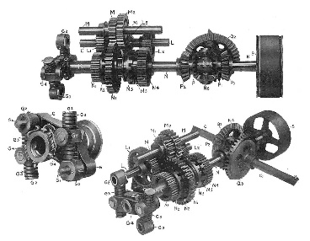
Teach
Teach a new letter.
Teach blending & segmenting.
What do you notice about where this sound comes in the word?
Revisit and review
Practise previously learned letters.
Practise oral blending and segmentation.
Let’s practise reading these words together.
gear near
spear year

Slide 7
Teach
Teach a new letter.
Teach blending & segmenting.
What do you notice about where this sound comes in the word?
Revisit and review
Practise previously learned letters.
Practise oral blending and segmentation.
Let’s practise reading these words together.
beard rear
smear appear

Slide 8
Revision of ear
Practise
Practise reading and/or spelling words with the new letter.
Quick read
beard
fearful
spear
clear

Slide 9
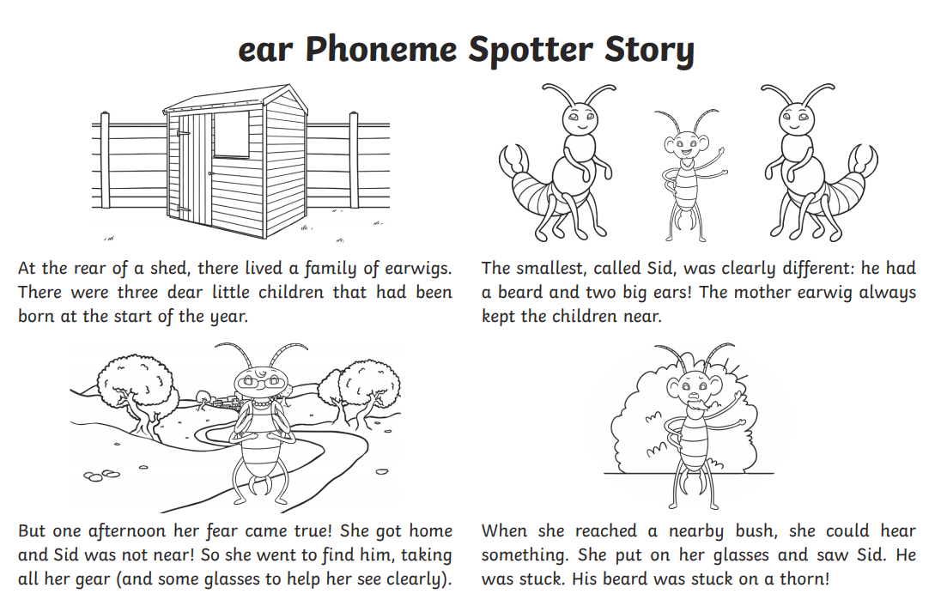
Revision of ear
Practise
Practise reading and/or spelling words with the new letter.
Can you find the ear sound?

Slide 10

Apply
Read or write application
Include CEW in sentences.
fear
beard
spear
tear

