Slide 1

CEW Revisit/Teach
Revisit CEW incorrect/ tricky or commonly used.
Teach new CEW when necessary.
Phonics
Common Exception Words
Our common exception words this week are:
friends
once
water
where

Slide 2



Revisit and review
Practise previously learned letters.
Practise oral blending and segmentation.
Remember…
Notes:
https://www.phonicsplay.co.uk/resources/phase/5/flashcards-time-challenge

Slide 3

Teach
Teach a new letter.
Teach blending & segmenting.
Revisit and review
Practise previously learned letters.
Practise oral blending and segmentation.
Today we are going to revise the graphemes we have learnt already this year.

Slide 4
d
k
d
r
i
b
l

Slide 5

Teach
Teach a new letter.
Teach blending & segmenting.
What do you notice about where this sound comes in the word?
Revisit and review
Practise previously learned letters.
Practise oral blending and segmentation.
Let’s practise reading these words together.
fur burn
surf hurt

Slide 6
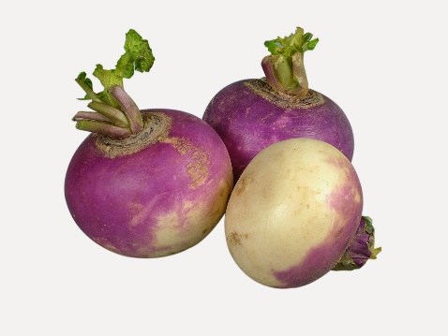
Teach
Teach a new letter.
Teach blending & segmenting.
What do you notice about where this sound comes in the word?
Revisit and review
Practise previously learned letters.
Practise oral blending and segmentation.
Let’s practise reading these words together.
burnt turnip
burger church

Slide 7
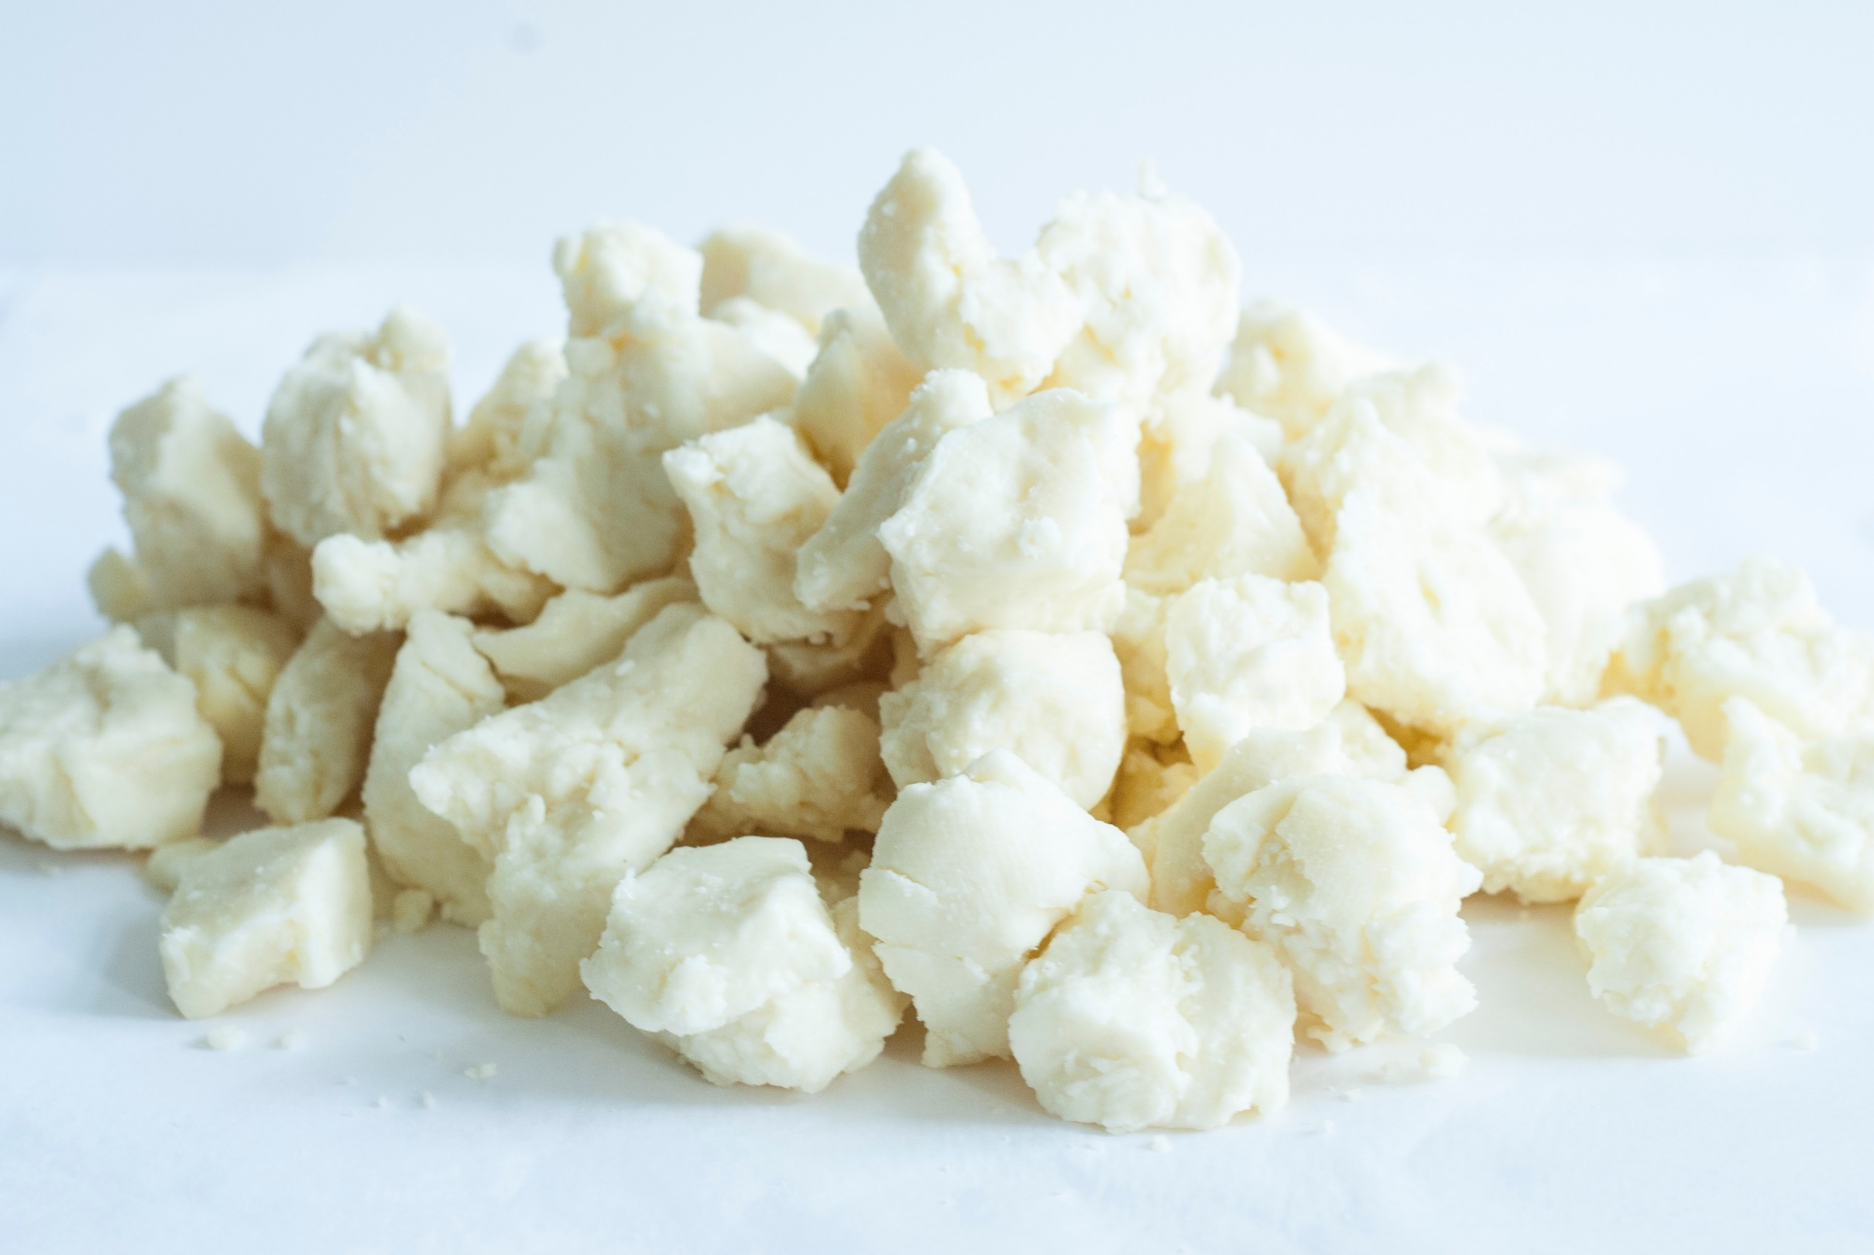
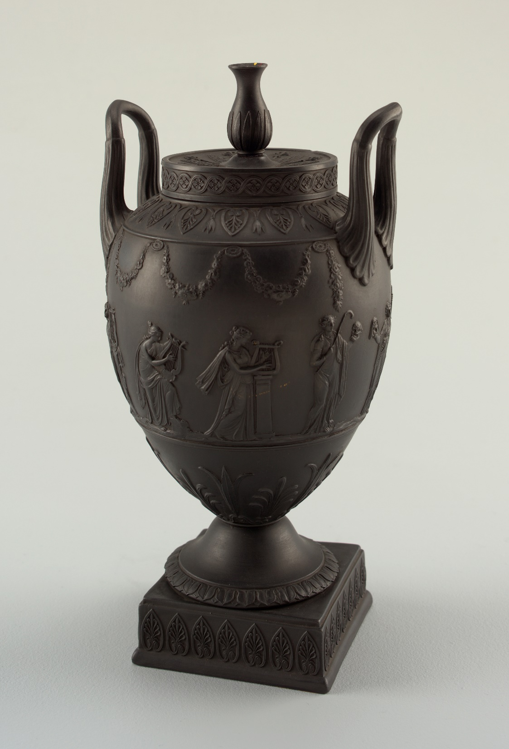
Teach
Teach a new letter.
Teach blending & segmenting.
What do you notice about where this sound comes in the word?
Revisit and review
Practise previously learned letters.
Practise oral blending and segmentation.
Let’s practise reading these words together.
curds lurk
hurl urn

Slide 8
Revision of ur
Practise
Practise reading and/or spelling words with the new letter.
Quick read
urn
burp
curl
surf

Slide 9
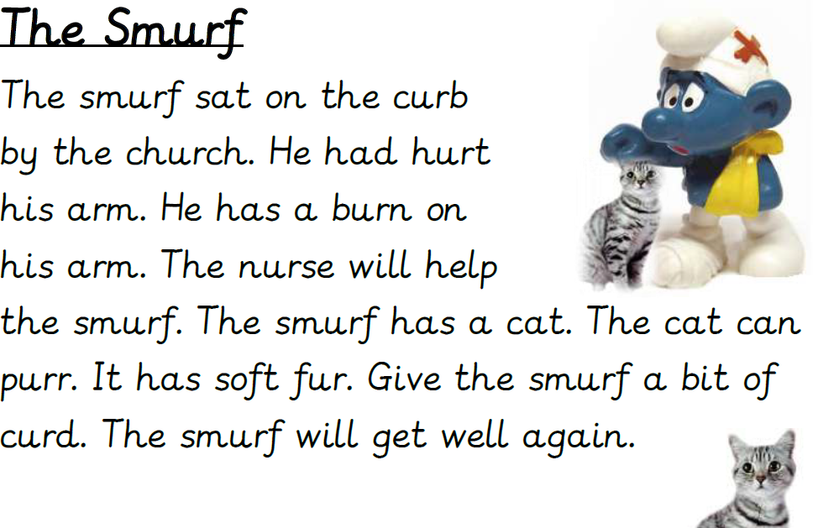
Revision of ur
Practise
Practise reading and/or spelling words with the new letter.
Read this passage:
Can you spot any of the digraphs we have looked at today? Which sounds do they make?

Slide 10

Apply
Read or write application
Include CEW in sentences.
burn
church
curds
hurting

