Slide 1

CEW Revisit/Teach
Revisit CEW incorrect/ tricky or commonly used.
Teach new CEW when necessary.
Phonics
Common Exception Words
Our common exception words this week are:
friends
once
water
where

Slide 2



Revisit and review
Practise previously learned letters.
Practise oral blending and segmentation.
Remember…
Notes:
https://www.phonicsplay.co.uk/resources/phase/5/flashcards-time-challenge

Slide 3

Teach
Teach a new letter.
Teach blending & segmenting.
Revisit and review
Practise previously learned letters.
Practise oral blending and segmentation.
Today we are going to revise the graphemes we have learnt already this year.

Slide 4
m
h
th
ss
k
i

Slide 5

Teach
Teach a new letter.
Teach blending & segmenting.
What do you notice about where this sound comes in the word?
Revisit and review
Practise previously learned letters.
Practise oral blending and segmentation.
Let’s practise reading these words together.
air pair
fair hair

Slide 6
Teach
Teach a new letter.
Teach blending & segmenting.
What do you notice about where this sound comes in the word?
Revisit and review
Practise previously learned letters.
Practise oral blending and segmentation.
Let’s practise reading these words together.
lair cairn
stair chair

Slide 7
Teach
Teach a new letter.
Teach blending & segmenting.
What do you notice about where this sound comes in the word?
Revisit and review
Practise previously learned letters.
Practise oral blending and segmentation.
Let’s practise reading these words together.
flair fairground
staircase unfair

Slide 8
Revision of ear
Practise
Practise reading and/or spelling words with the new letter.
Quick read
pair
funfair
chair
stairs

Slide 9
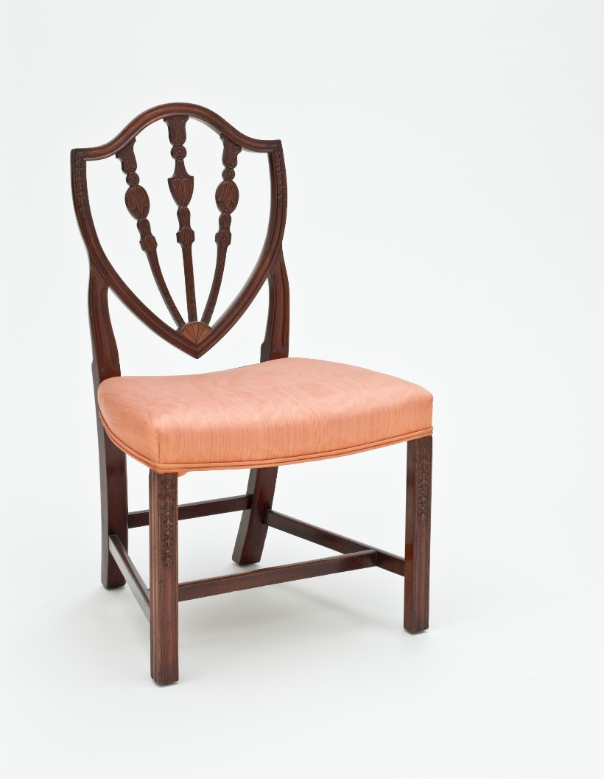


Revision of air
Practise
Practise reading and/or spelling words with the new letter.
What are the words?

Slide 10
Revision of air
Practise
Practise reading and/or spelling words with the new letter.
What are the words?
funfair
stairs
chair

Slide 11

Apply
Read or write application
Include CEW in sentences.
pair
chair
unfair
hair

