Slide 1

CEW Revisit/Teach
Revisit CEW incorrect/ tricky or commonly used.
Teach new CEW when necessary.
Phonics
Common Exception Words
Our common exception words this week are:
friends
once
water
where

Slide 2



Revisit and review
Practise previously learned letters.
Practise oral blending and segmentation.
Remember…
Notes:
https://www.phonicsplay.co.uk/resources/phase/5/flashcards-time-challenge

Slide 3

Revisit/Teach/Practise
Revisit CEW incorrect/ tricky or commonly used.
Teach new CEW when necessary.
Teach
Teach a new letter.
Teach blending & segmenting.
Today we are going to revise the graphemes:
ai ay a-e

Slide 4

Teach
Teach a new letter.
Teach blending & segmenting.
What do you notice about where this sound comes in the word?
Revisit and review
Practise previously learned letters.
Practise oral blending and segmentation.
Let’s practise reading these ai words together.
bait rain
tail main

Slide 5
Teach
Teach a new letter.
Teach blending & segmenting.
What do you notice about where this sound comes in the word?
Revisit and review
Practise previously learned letters.
Practise oral blending and segmentation.
Let’s practise reading these ay words together.
tray say
may play

Slide 6
Teach
Teach a new letter.
Teach blending & segmenting.
What do you notice about where this sound comes in the word?
Revisit and review
Practise previously learned letters.
Practise oral blending and segmentation.
Let’s practise reading these a-e words together.
late snake
lake bake

Slide 7
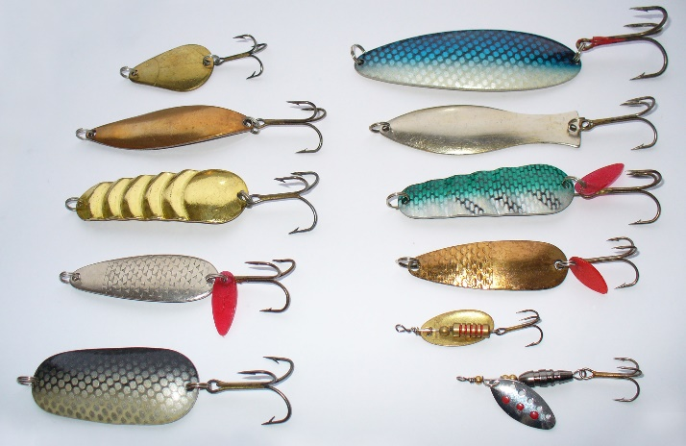
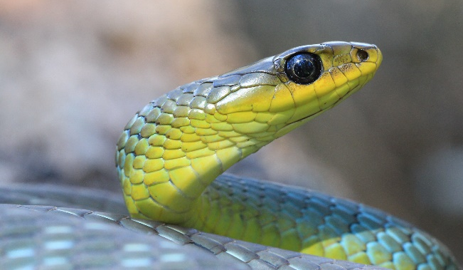

Practise
Practise reading and/or spelling words with the new letter.
Can you work out words from the pictures below and sort them into the table?
ai | ay | a-e
bait day snake

Slide 8

Apply
Read or write application
Include CEW in sentences.
It was the date of the big game.
I will not say no to a milk tray.

