Slide 1

CEW Revisit/Teach
Revisit CEW incorrect/ tricky or commonly used.
Teach new CEW when necessary.
Phonics
Common Exception Words
Our common exception words this week are:
friends
once
water
where

Slide 2



Revisit and review
Practise previously learned letters.
Practise oral blending and segmentation.
Remember…
Notes:
https://www.phonicsplay.co.uk/resources/phase/5/flashcards-time-challenge

Slide 3

Revisit/Teach/Practise
Revisit CEW incorrect/ tricky or commonly used.
Teach new CEW when necessary.
Teach
Teach a new letter.
Teach blending & segmenting.
Today we are going to revise the graphemes:
er ure air

Slide 4
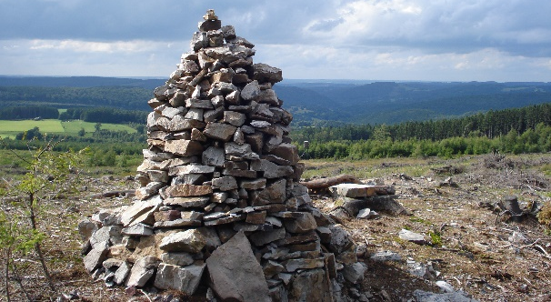

Teach
Teach a new letter.
Teach blending & segmenting.
What do you notice about where this sound comes in the word?
Revisit and review
Practise previously learned letters.
Practise oral blending and segmentation.
Let’s practise reading these air words together.
cairn pair
lair hair

Slide 5
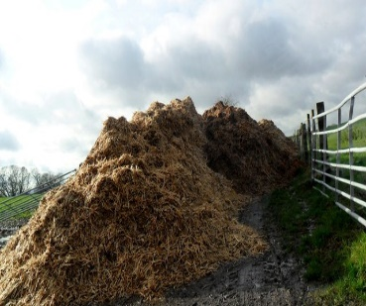

Teach
Teach a new letter.
Teach blending & segmenting.
What do you notice about where this sound comes in the word?
Revisit and review
Practise previously learned letters.
Practise oral blending and segmentation.
Let’s practise reading these ure words together.
mature cure
manure secure

Slide 6
Teach
Teach a new letter.
Teach blending & segmenting.
What do you notice about where this sound comes in the word?
Revisit and review
Practise previously learned letters.
Practise oral blending and segmentation.
Let’s practise reading these ure words together.
pure insure
assure lure

Slide 7
Teach
Teach a new letter.
Teach blending & segmenting.
What do you notice about where this sound comes in the word?
Revisit and review
Practise previously learned letters.
Practise oral blending and segmentation.
Let’s practise reading these er words together.
banner summer
better boxer

Slide 8



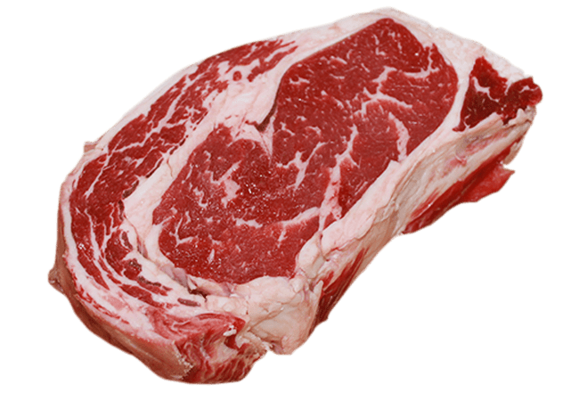
Practise
Practise reading and/or spelling words with the new letter.
Can you work out words from the pictures below and sort them into the table?
ea | ee
sea
meat
week
see

Slide 9

Apply
Read or write application
Include CEW in sentences.
Where are your friends?
Once upon a time there was a boxer.

