Slide 1

CEW Revisit/Teach
Revisit CEW incorrect/ tricky or commonly used.
Teach new CEW when necessary.
Phonics
Common Exception Words
Our common exception words this week are:
friends
once
water
where

Slide 2



Revisit and review
Practise previously learned letters.
Practise oral blending and segmentation.
Remember…
Notes:
https://www.phonicsplay.co.uk/resources/phase/5/flashcards-time-challenge

Slide 3

Revisit/Teach/Practise
Revisit CEW incorrect/ tricky or commonly used.
Teach new CEW when necessary.
Teach
Teach a new letter.
Teach blending & segmenting.
Today we are going to revise the graphemes:
ur ow oi ear

Slide 4
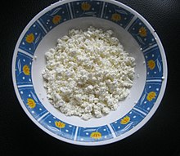

Teach
Teach a new letter.
Teach blending & segmenting.
What do you notice about where this sound comes in the word?
Revisit and review
Practise previously learned letters.
Practise oral blending and segmentation.
Let’s practise reading these ur words together.
curds turnips
turf surfing

Slide 5
Teach
Teach a new letter.
Teach blending & segmenting.
What do you notice about where this sound comes in the word?
Revisit and review
Practise previously learned letters.
Practise oral blending and segmentation.
Let’s practise reading these ow words together.
towel town
row pow!

Slide 6
Teach
Teach a new letter.
Teach blending & segmenting.
What do you notice about where this sound comes in the word?
Revisit and review
Practise previously learned letters.
Practise oral blending and segmentation.
Let’s practise reading these ear words together.
dear ear
fear hear

Slide 7
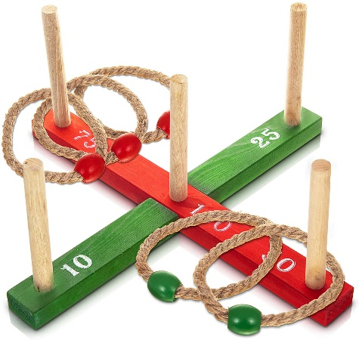
What do you notice about where this sound comes in the word?
Teach
Teach a new letter.
Teach blending & segmenting.
Revisit and review
Practise previously learned letters.
Practise oral blending and segmentation.
Let’s practise reading these oi words together.
tinfoil poison
quoit toil

Slide 8
Practise
Practise reading and/or spelling words with the new letter.
Can we swap any of the words below so the sentence still makes sense?
Join me in the pool.
them
park
Keep
coach

Slide 9
Practise
Practise reading and/or spelling words with the new letter.
Can we swap any of the words below so the sentence still makes sense?
This is a good shop for chips.
coats
year
coffee
bad

Slide 10

Apply
Read or write application
Include CEW in sentences.
Wipe the tear from your dear face.
Her joints did not feel good after the jumping.

