Slide 1

CEW Revisit/Teach
Revisit CEW incorrect/ tricky or commonly used.
Teach new CEW when necessary.
Phonics
Common Exception Words
Our common exception words this week are:
please
through
again

Slide 2



Revisit and review
Practise previously learned letters.
Practise oral blending and segmentation.
Remember…
Notes:
https://www.phonicsplay.co.uk/resources/phase/5/flashcards-time-challenge

Slide 3

Revisit/Teach/Practise
Revisit CEW incorrect/ tricky or commonly used.
Teach new CEW when necessary.
Teach
Teach a new letter.
Teach blending & segmenting.
Today we are going to revise the graphemes:
oe

Slide 4

Teach
Teach a new letter.
Teach blending & segmenting.
What do you notice about where this sound comes in the word?
Revisit and review
Practise previously learned letters.
Practise oral blending and segmentation.
Let’s practise reading these oe words together.
toe hoe
doe foe

Slide 5
Teach
Teach a new letter.
Teach blending & segmenting.
What do you notice about where this sound comes in the word?
Revisit and review
Practise previously learned letters.
Practise oral blending and segmentation.
Let’s practise reading these oe words together.
woe Joe
goes tomatoes

Slide 6
Teach
Teach a new letter.
Teach blending & segmenting.
What do you notice about where this sound comes in the word?
Revisit and review
Practise previously learned letters.
Practise oral blending and segmentation.
Let’s practise reading these oe words together.
potatoes heroes

Slide 7
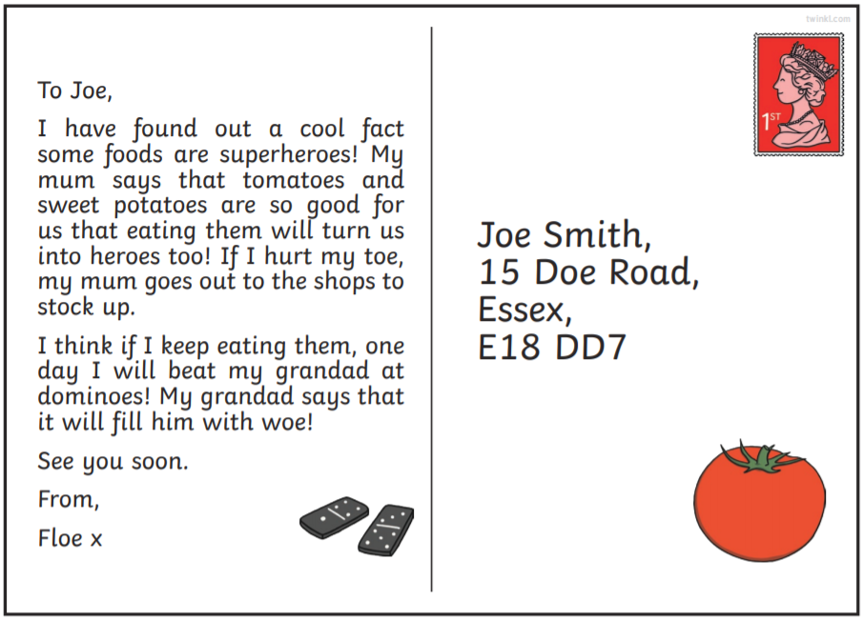
Practise
Practise reading and/or spelling words with the new letter.
Can you spot the words with the grapheme ‘oe’.

Slide 8

Apply
Read or write application
Include CEW in sentences.
He was full of woe when he lost his hoe.
Joe knew his heroes could fight his foes.

