Slide 1

CEW Revisit/Teach
Revisit CEW incorrect/ tricky or commonly used.
Teach new CEW when necessary.
Phonics
Common Exception Words
Our common exception words this week are:
please
through
again

Slide 2



Revisit and review
Practise previously learned letters.
Practise oral blending and segmentation.
Remember…
Notes:
https://www.phonicsplay.co.uk/resources/phase/5/flashcards-time-challenge

Slide 3

Revisit/Teach/Practise
Revisit CEW incorrect/ tricky or commonly used.
Teach new CEW when necessary.
Teach
Teach a new letter.
Teach blending & segmenting.
Today we are going to revise the graphemes:
i-e

Slide 4

Teach
Teach a new letter.
Teach blending & segmenting.
What do you notice about where this sound comes in the word?
Revisit and review
Practise previously learned letters.
Practise oral blending and segmentation.
Let’s practise reading these i-e words together.
time pine
shine lime

Slide 5
Teach
Teach a new letter.
Teach blending & segmenting.
What do you notice about where this sound comes in the word?
Revisit and review
Practise previously learned letters.
Practise oral blending and segmentation.
Let’s practise reading these i-e words together.
fine dine
slime dime

Slide 6
Teach
Teach a new letter.
Teach blending & segmenting.
What do you notice about where this sound comes in the word?
Revisit and review
Practise previously learned letters.
Practise oral blending and segmentation.
Let’s practise reading these i-e words together.
ripe invite
inside like

Slide 7
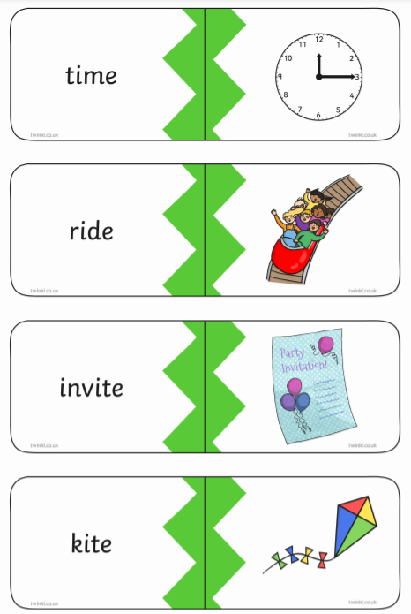
Practise
Practise reading and/or spelling words with the new letter.
Can you match the pictures to the words?

Slide 8
Practise
Practise reading and/or spelling words with the new letter.
Can you match the pictures to the words?

Slide 9

Apply
Read or write application
Include CEW in sentences.
Please stay inside the fine room.
We will dine again on ripe tomatoes.

