Slide 1

CEW Revisit/Teach
Revisit CEW incorrect/ tricky or commonly used.
Teach new CEW when necessary.
Phonics
Common Exception Words
Our common exception words this week are:
please
through
again
any
many

Slide 2



Revisit and review
Practise previously learned letters.
Practise oral blending and segmentation.
Remember…
Notes:
https://www.phonicsplay.co.uk/resources/phase/5/flashcards-time-challenge

Slide 3

Revisit/Teach/Practise
Revisit CEW incorrect/ tricky or commonly used.
Teach new CEW when necessary.
Teach
Teach a new letter.
Teach blending & segmenting.
Today we are going to revise the graphemes:
ie

Slide 4

Teach
Teach a new letter.
Teach blending & segmenting.
What do you notice about where this sound comes in the word?
Revisit and review
Practise previously learned letters.
Practise oral blending and segmentation.
Let’s practise reading these ie words together.
fried tie
lie cried

Slide 5
Teach
Teach a new letter.
Teach blending & segmenting.
What do you notice about where this sound comes in the word?
Revisit and review
Practise previously learned letters.
Practise oral blending and segmentation.
Let’s practise reading these ie words together.
spied die
pie tried

Slide 6
Teach
Teach a new letter.
Teach blending & segmenting.
What do you notice about where this sound comes in the word?
Revisit and review
Practise previously learned letters.
Practise oral blending and segmentation.
Let’s practise reading these ie words together.
replied denied

Slide 7
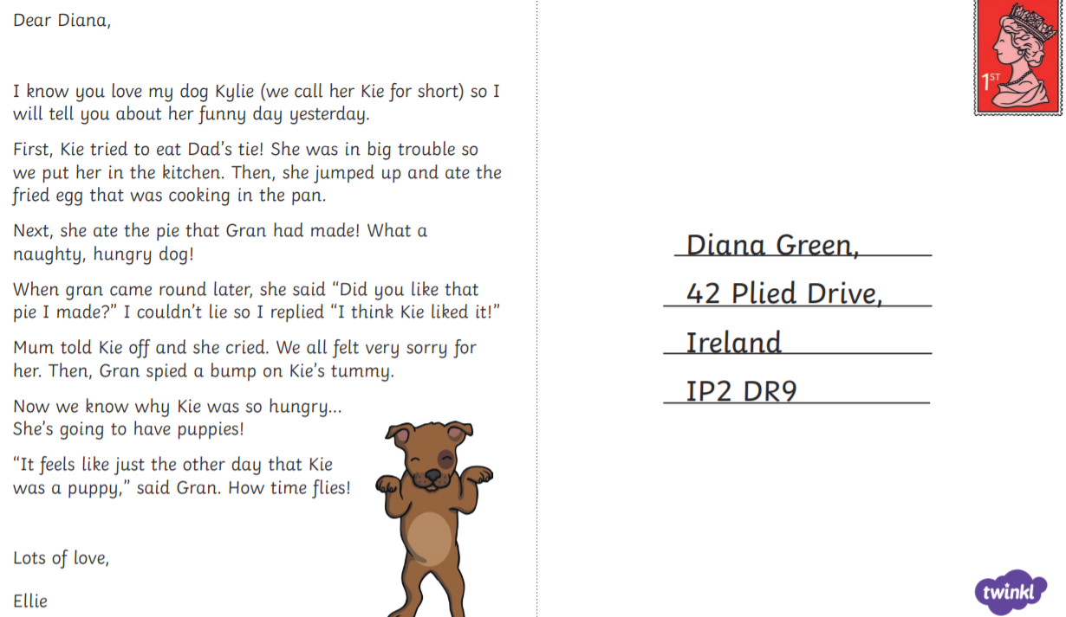
Practise
Practise reading and/or spelling words with the new letter.
Can you spot the ‘ie’ graphemes?

Slide 8

Apply
Read or write application
Include CEW in sentences.
The girl cried again because she lied.
She spied the red tie around the tree.

